Slide 1
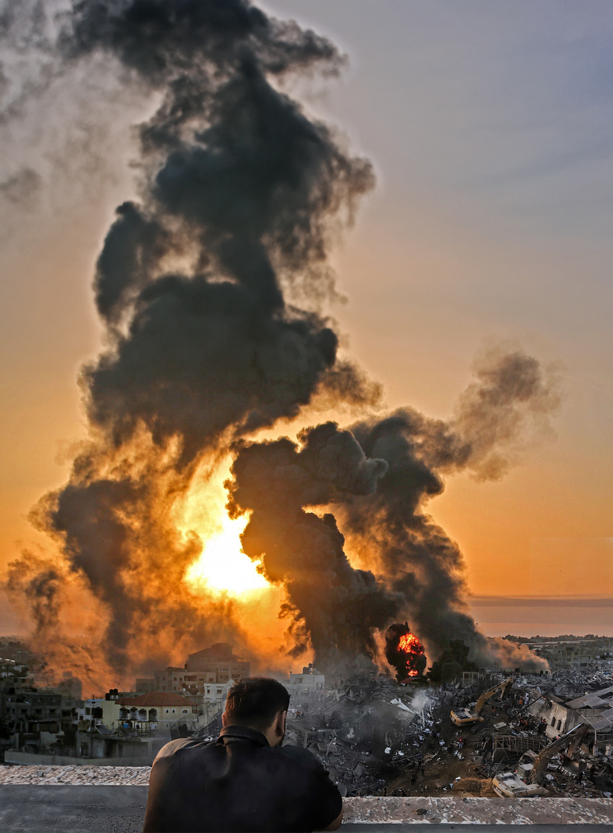

犹太民族&
以巴冲突
基督徒应该如何看待？
巴勒斯坦属于犹太人吗？
神赞同以军在加沙的所作所为吗？
神为何选择犹太人？他们还是选民吗？
神今天怎么使用犹太人？
Notes:
The Jewish 民族 and the Israel-Palestine conflict: As Xians, how should we view it?

Slide 2

基督徒应该如何看待以巴冲突？
整个巴勒斯坦地区是否都属于犹太人？
神是否同意以色列军队在加沙所做的一切？
基督徒是否应该为现代政治国家以色列祈福和祈祷？
引言
Notes:
How should Christians view the Israeli-Palestinian conflict?
Does all of Palestine belong to the Jews?
Does God approve of everything the Israeli army is doing in Gaza?
Should Christians bless and pray for the modern political state of Israel?

Slide 3

一些基督徒说：
我们应该支持以色列，包括为他们的胜利祈祷。
一些基督徒的
诗篇122：6你们要为耶路撒冷求平安，耶路撒冷啊，爱你的人必然兴旺。
观点
创世记12：3为你祝福的，我必赐福与他；那咒诅你的，我必咒诅他……
Notes:
Some Christians say: We should support Israel, including praying for their victory
Psalm 122:6 Pray for the peace of Jerusalem: "May they prosper who love you.
Genesis 12:3 …And I will bless those who bless you, And the one who curses you I will curse.

Slide 4
另一些基督徒说：
这是一个政治问题，我们作为基督徒不应该参与其中，也不应该有偏见。
一些基督徒的
现代以色列国并非所做的一切都是正确的。
观点
在这场战争中，加沙有几万平民丧生，其中包括许多妇女和儿童。
Notes:
Other Christians say: This is a political issue; we as Christians should not be involved nor have a bias.
Not everything the modern state of Israel does is right.
Tens of thousand of civilians have died in Gaza during this war, including many women and children.

Slide 5
还有一些基督徒提醒：
基督徒似乎总是支持现代以色列国，即使他们在做坏事。
一些基督徒的
这让人们很难接受福音，尤其是穆斯林穆。
观点
尤其是穆斯林背景的基督徒，对这个问题有疑问。
Notes:
Some Christians even warn:
It seems Christians always support the modern state of Israel, even when they’re doing bad things.
This makes it hard for ppl to accept the gospel--especially people who are Muslims
MBB’s especially have questions about this issue

Slide 6
神为什么拣选犹太人？祂的目标是什么？
神向犹太人应许了什么？
犹太人还是神的选民吗？
对犹太人的应许适用于现代以色列国吗？
以色列在加沙战争中的行为是对是错？
巴勒斯坦问题的背景是什么？
巴勒斯坦问题的解决方法是什么？这一切的难题最终将如何解决？
神通过这一切在做什么？祂的目的是什么？
八个
要解答的问题
Notes:
8 Q’s to Ans.:
Why did God choose the Jews? The purpose of the existence of the Jews.
What did God promise to the Jews?
Are the Jews still God’s chosen people?
Do the promises to the Jews apply to the modern state of Israel?
Is Israel’s conduct of the Gaza war right or wrong?
What is the background to the Palestinian problem?
What is the solution to the Palestinian problem? How will it all finally be resolved?
What God is doing through all of this? What is His purpose?

Slide 7
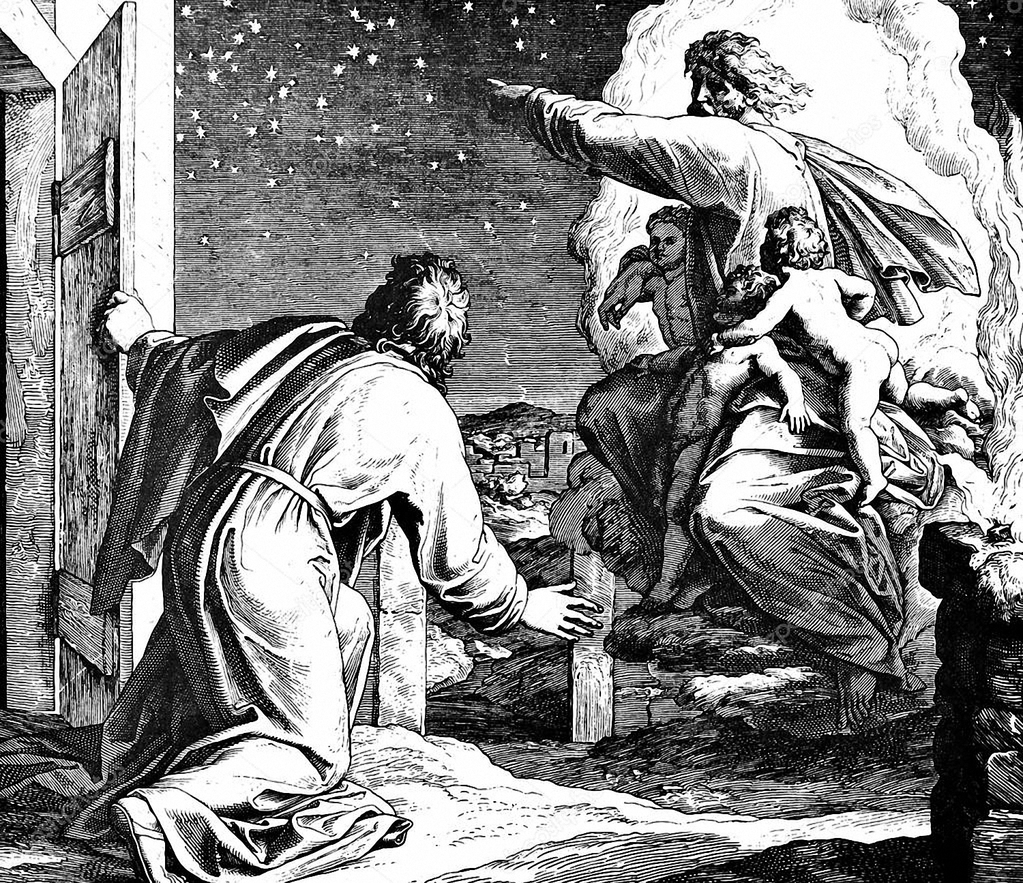
一. 神为什么拣选犹太人？祂的目标是什么？
1. 神选择犹太人来祝福世界。
创世记12：1耶和华对亚伯兰说：“……3……地上的万族都要因你得福。”
创世记22：15耶和华的使者第二次从天上呼叫亚伯拉罕，说：“……18……并且地上万国都必因你的后裔得福。”
Notes:
1. God choose the Jews: To bless the world.
Genesis 12:1 Now the LORD said to Abram… 3 … And in you all the families of the earth shall be blessed. "
Genesis 22:15 Then the angel of the LORD called to Abraham a second time from heaven, … 18 "And in your seed all the nations of the earth shall be blessed…

Slide 8
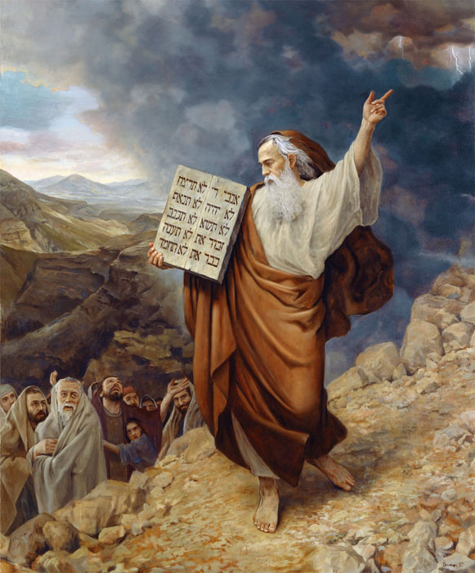
一. 神为什么拣选犹太人？祂的目标是什么？
2. 神选择了犹太人，通过他们颁布了摩西律法和整部旧约《圣经》。
尼希米书9：13你也降临在西乃山，从天上与他们说话，赐给他们正直的典章、真实的律法、美好的条例与诫命；14又使他们知道你的安息圣日，并藉你仆人摩西传给他们诫命、条例、律法。
Notes:
2. God choose the Jews: To give the Law of Moses and the entire OT Bible through them
Nehemiah 9:13 "Then Thou didst come down on Mount Sinai, And didst speak with them from heaven; Thou didst give to them just ordinances and true laws, Good statutes and commandments. 14 "So Thou didst make known to them Thy holy sabbath, And didst lay down for them commandments, statutes, and law, Through Thy servant Moses.

Slide 9
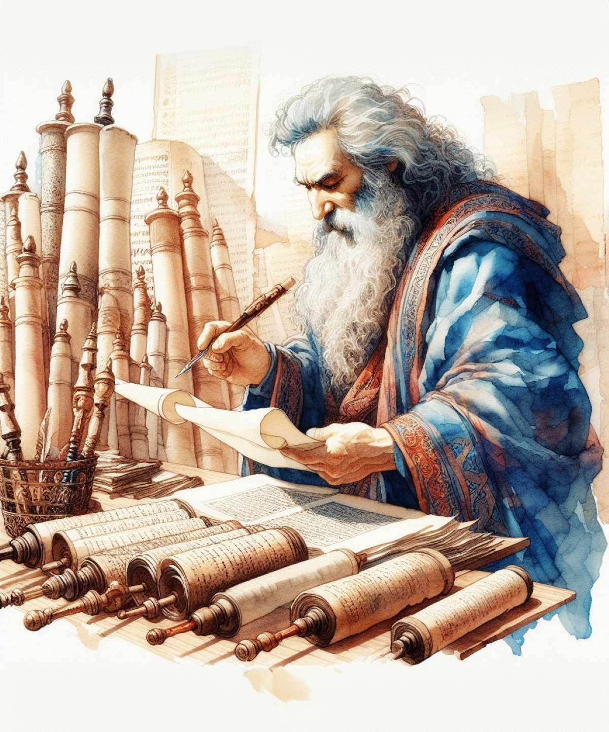
一. 神为什么拣选犹太人？祂的目标是什么？
2. 神选择了犹太人，通过他们颁布了摩西律法和整部旧约《圣经》。
罗马书3：1这样说来，犹太人有什么长处？割礼有什么益处呢？2凡事大有好处，第一，是神的圣言交托他们。
约翰福音1：17律法本是藉著摩西传的，恩典和真理都是由耶稣基督来的；
Notes:
优势 you1shi4 advantage 2. God choose the Jews: To give the Law of Moses and the entire OT Bible through them
Romans 3:1 Then what advantage has the Jew? Or what is the benefit of circumcision? 2 Great in every respect. First of all, that they were entrusted with the oracles of God.
John 1:17 For the Law was given through Moses; grace and truth were realized through Jesus Christ.

Slide 10
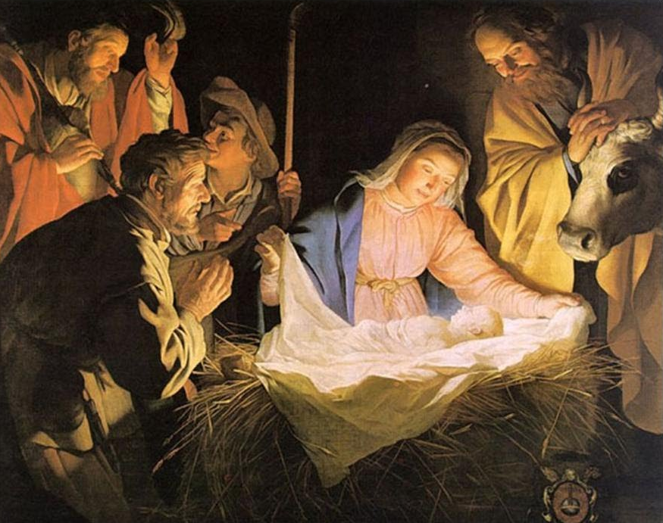
一. 神为什么拣选犹太人？祂的目标是什么？
3. 神选择了犹太人，基督是通过他们来到世界。
罗马书9：4他们是以色列人，那儿子的名分、荣耀、诸约、律法、礼仪、应许，都是他们的。5列祖就是他们的祖宗，按肉体说，基督也是从他们出来的……
约翰福音4：22……因为救恩是从犹太人出来的。
Notes:
3. God choose the Jews: So the Christ would come through them.
Romans 9:4 who are Israelites, to whom belongs the adoption as sons and the glory and the covenants and the giving of the Law and the temple service and the promises, 5 whose are the fathers, and from whom is the Christ according to the flesh…
John 4:22 …for salvation is from the Jews.

Slide 11
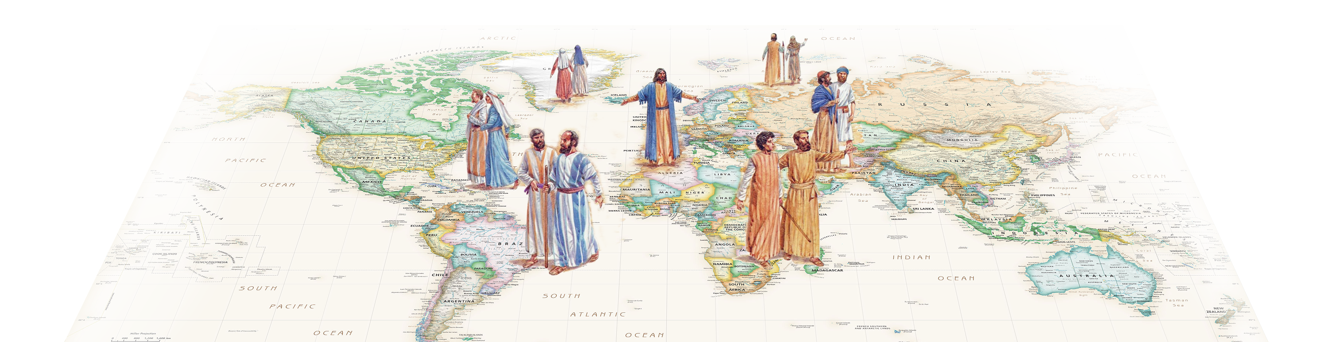
一. 神为什么拣选犹太人？祂的目标是什么？
4. 神选择犹太人为祂向全世界作见证。
神通过耶稣基督赐给人类的救恩，犹太人本应为此做见证，但他们大多数人并没有做。
反而，通过他们的兴衰史，见证了《圣经》真理和启示性——无论他们愿意与否！
Notes:
4. God choose the Jews: To be a testimony to the entire world
READ SLIDE They were to witness to God’s grace and salvation through Jesus the Messiah, but most of them aren’t.
But thru their history, they testify to the Bible’s truth & inspiration—whether they want to be or not!
I knew a grad student from S. Amer…

Slide 12
一. 神为什么拣选犹太人？祂的目标是什么？
神选择犹太人来祝福世界。
神选择了犹太人，通过他们颁布了摩西律法和整部旧约《圣经》。
神选择了犹太人，基督是通过他们来到世界。
神选择犹太人为祂向全世界作见证。
小结
Notes:
Summary: Why did God choose the Jews?
1)Bless world. 2)Give OT & Law 3)Christ thru them. 4)Be witness to world.

Slide 13
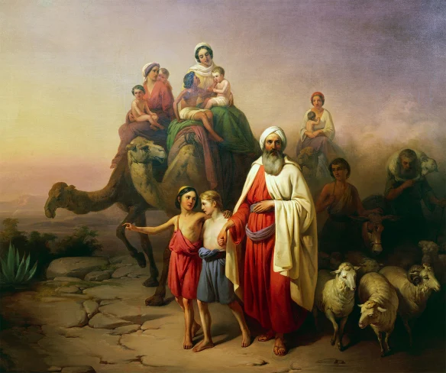
二. 神向犹太人应许了什么？
1. 迦南地
创世记12：4 亚伯兰【亚伯拉罕】就照着耶和华吩咐他的去了……
5……到迦南地去。7 耶和华向亚伯兰显现，说:“我要把这地赐给你的后裔。”…… 17：8“我要将你现在寄居的地，就是迦南全地，赐给你和你的后裔永远为业……”
Notes:
2. What did God promise to the Jews? 1. The Land of Canaan
Genesis 12:4 So Abram went forth as the LORD had spoken to him… 5 …thus they came to the land of Canaan. … 7 And the LORD appeared to Abram and said, “To your descendants I will give this land.” … 17:8 “And I will give to you and to your descendants after you, the land of your sojournings, all the land of Canaan, for an everlasting possession…"

Slide 14
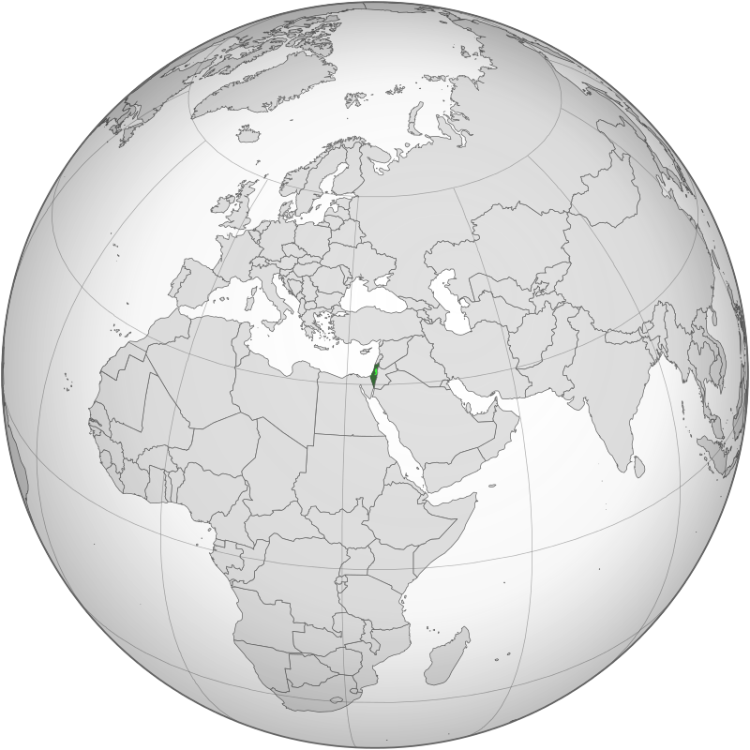
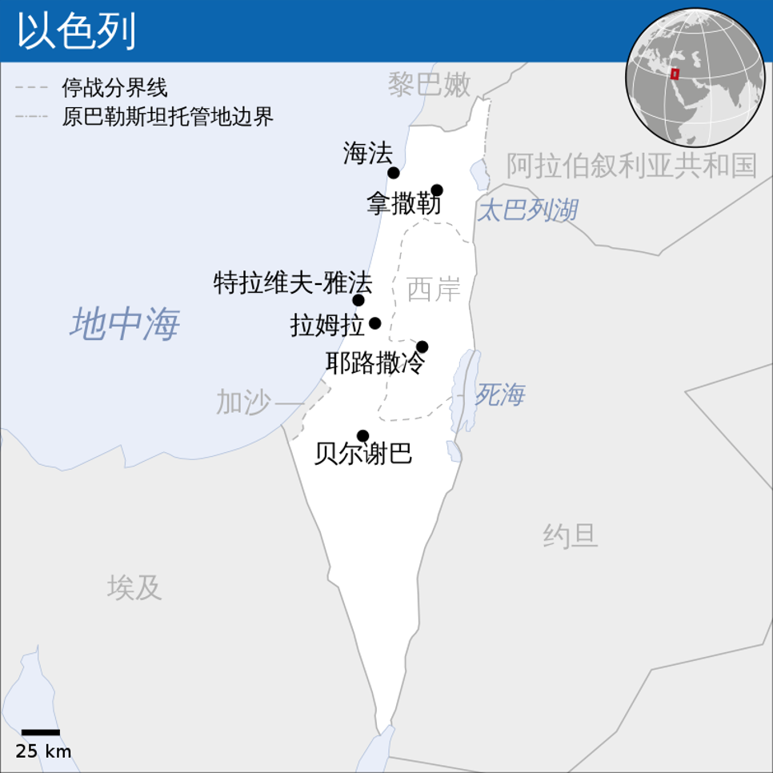
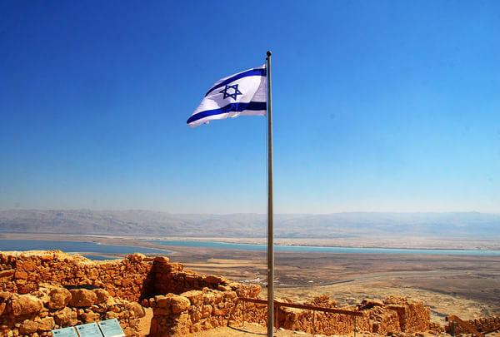
二. 神向犹太人应许了什么？
“迦南地”大约等同于现在的以色列国
Notes:
Roughly today’s Isl, incl. 约旦河的西岸。
今天，这个应许已经应验了，犹太人生活在巴勒斯坦的以色列，在那里有自己的国家。但以色列在1948年复国之前的1800多年，犹太人被分散在世界各地。下面，我们先来看圣经如何预言了犹太人会分散全球。

Slide 15
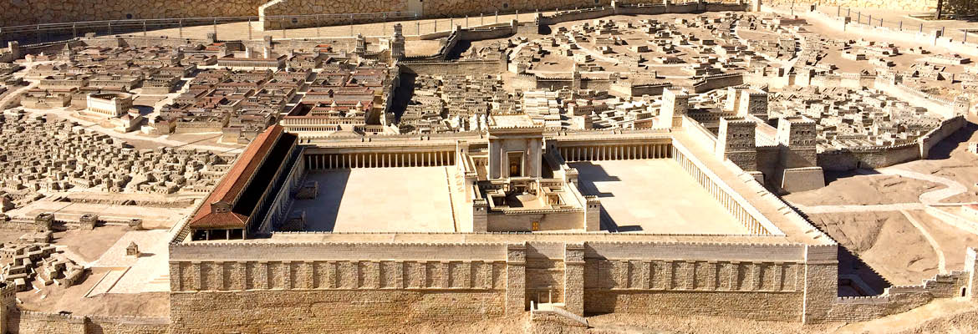
二. 神向犹太人应许了什么？
2. 耶路撒冷
列王纪下21：7……我在以色列众支派中所选择的耶路撒冷和这殿，必立我的名，直到永远。
Notes:
2. Jerusalem
2Kings 21:7…the LORD said to David and to his son Solomon, "In this house and in Jerusalem, which I have chosen from all the tribes of Israel, I will put My name forever.

Slide 16
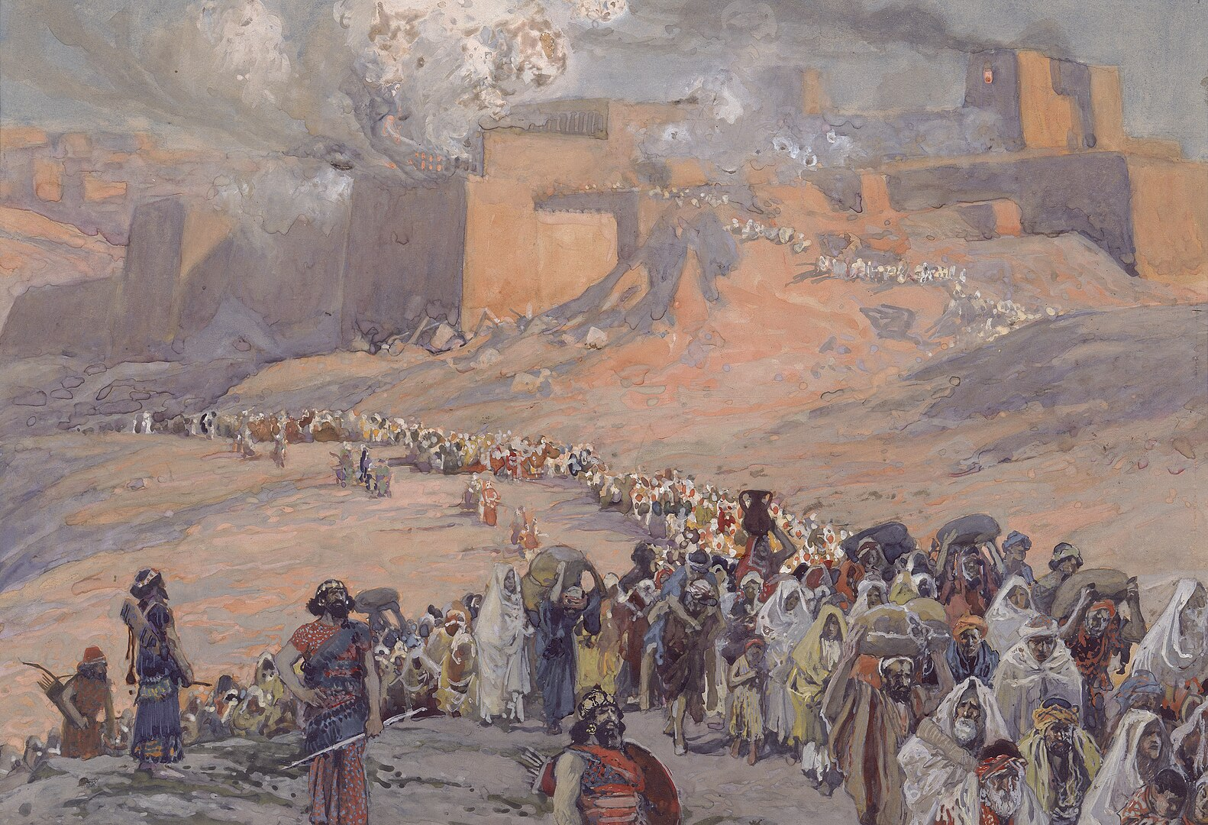
二. 神向犹太人应许了什么？
3. 分散全球、受逼迫
申命记28：1你若留意听从耶和华你神的话，谨守遵行他的一切诫命，就是我今日所吩咐你的，他必使你超乎天下万民之上。……58-59……你若不谨守遵行，耶和华就必将奇灾……加在你和你后裔的身上；63……你们从所要进去得的地上，必被拔除。64耶和华必使你们分散在万民中，从地这边到地那边……65在那些国中，你必不得安逸，也不得落脚之地……
以色列人被巴比伦掳掠
Notes:
俘虏 Fu2Lu3 3. Scattering, Persecution
Deuteronomy 28:1 “Now it shall be, if you will diligently obey the LORD your God, being careful to do all His commandments which I command you today, the LORD your God will set you high above all the nations of the earth. … 58 ”If you are not careful to observe all the words…59…will bring extraordinary plagues on you and your descendants… 63 …and you shall be torn from the land where you are entering to possess it. 64 "Moreover, the LORD will scatter you among all peoples, from one end of the earth to the other end of the earth; … 65 "And among those nations you shall find no rest, and there shall be no resting place for the sole of your foot; but there the LORD will give you a trembling heart, failing of eyes, and despair of soul.

Slide 17
二. 神向犹太人应许了什么？
3. 分散全球、受逼迫
路加福音21：24他们要倒在刀下，又被掳到各国去。耶路撒冷要被外邦人践踏，直到外邦人的日期满了。
以色列人被罗马人掳掠
Notes:
俘虏 Fu2Lu3 3. Scattering, Persecution
Luke 21:24 and they will fall by the edge of the sword, and will be led captive into all the nations; and Jerusalem will be trampled under foot by the Gentiles until the times of the Gentiles be fulfilled.

Slide 18
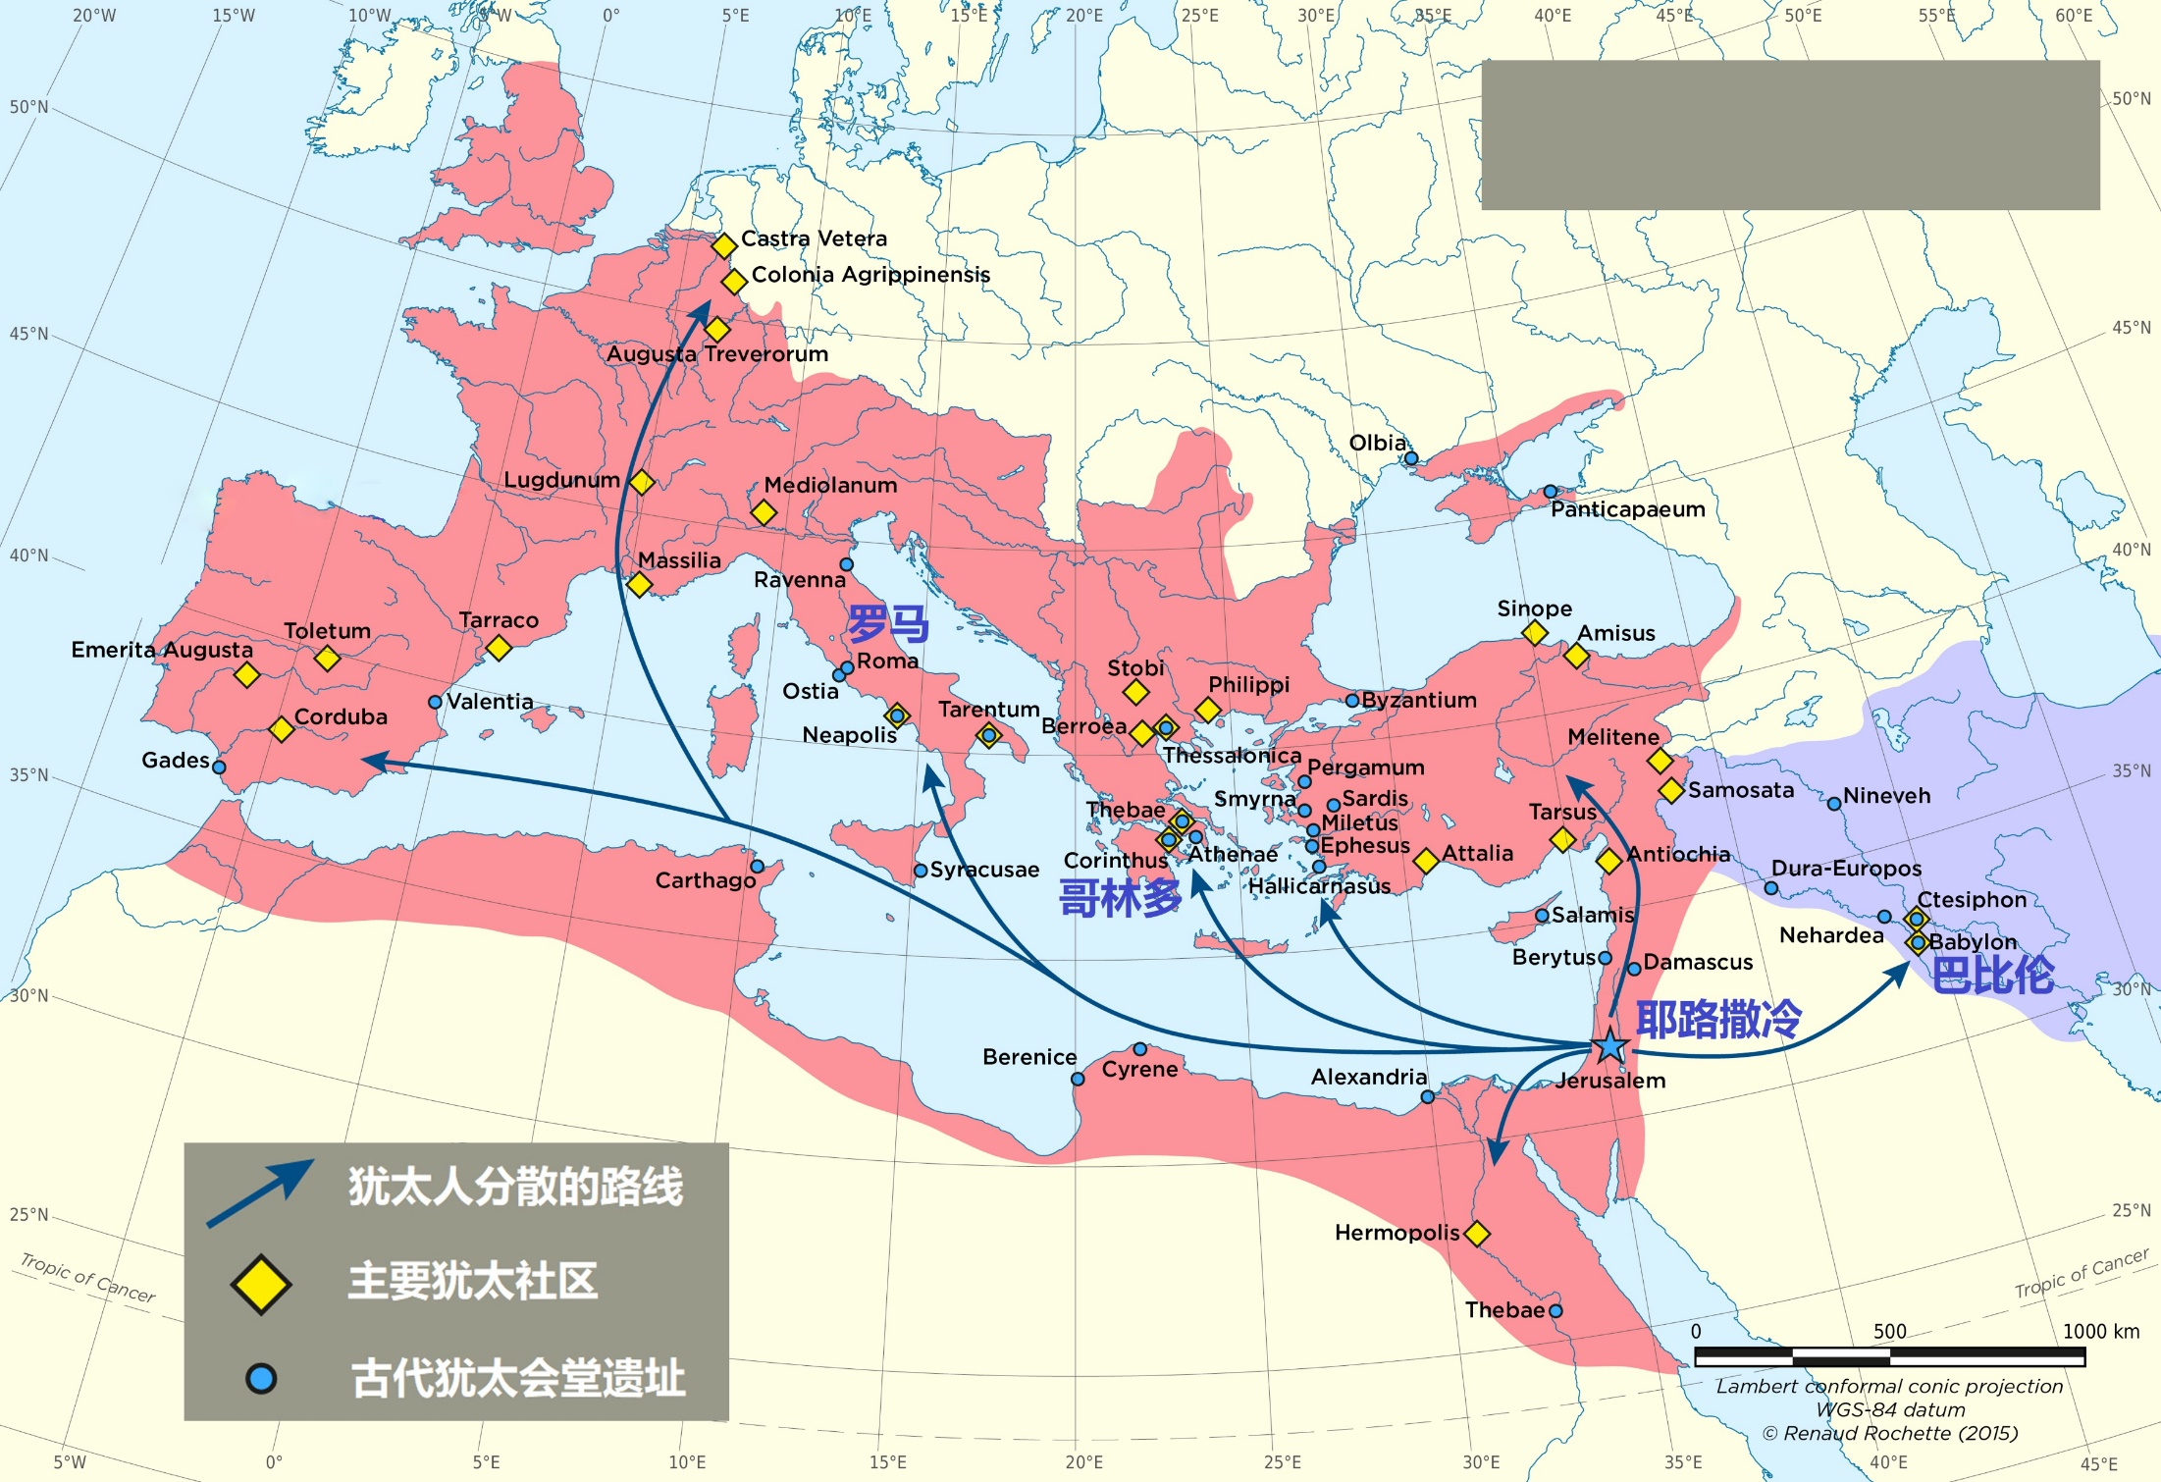
公元135年
犹太人被罗马驱逐
公元135年后的几百年中没有犹太人居住巴勒斯坦。到了1500年，有大约5000犹太人居住。
Notes:
驱逐 Qu1Zhu2 Expulsion
No Jews lived in Palestine for hundreds of years after 135AD. By 1500, there were about 5,000 Jews living there.
几十年之后，犹太人再度反抗，到了135年，几乎所有的犹太人都被赶出巴勒斯坦地区，流放各地，在后来的几个世纪中，罗马皇帝禁止犹太人住在巴勒斯坦地区，直到1850年，巴勒斯坦的犹太人也不到两万。摩西和耶稣关于犹太人会被分散到“各国”的预言就这样应验了。

Slide 19
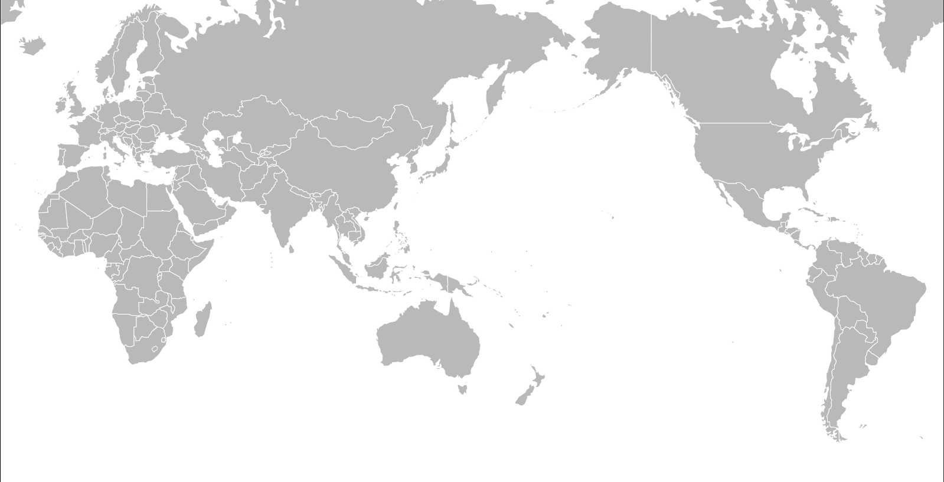
在1938年，大约 40 万犹太人居住巴勒斯坦地，比欧洲、北美少得多。
犹太人口1万以下
犹太人口1万-10万
犹太人口10万以上
1938年
Notes:
The Jews were scattered around the world for more than 1,800 years. Jews can be found in every country in Europe, everywhere in North Africa, throughout the Middle East and in India.
In 1938 there were only about 400,000 in Palestine, much less than Europe or N. Amer.
犹太人散居在世界各地，四处搬迁，长达1800多年。欧洲的每个国家、北非各处、整个中东和印度都能看到犹太人的身影。

Slide 20
二. 神向犹太人应许了什么？
4. 回归
以西结书37：21“……主耶和华如此说：‘我要将以色列人从他们所到的各国收取；又从四围聚集他们，引导他们归回本地。’”
以赛亚书11：11当那日，主必二次伸手救回自己百姓中所余剩的，就是在亚述、埃及、巴忒罗、古实、以拦、示拿、哈马，并众海岛所剩下的。12……招回以色列被赶散的人，又从地的四方聚集分散的犹大人。
Notes:
4. Regathering We’ll talk about this in a moment. 我们稍后再讨论这点。
Ezekiel 37:21 “…‘Thus says the Lord GOD,” Behold, I will take the sons of Israel from among the nations where they have gone, and I will gather them from every side and bring them into their own land; （为了确认是指末世，请参考以西结书37:24、38:8）
Isaiah 11:11 Then it will happen on that day that the Lord Will again recover the second time with His hand The remnant of His people, who will remain, From Assyria, Egypt, Pathros, Cush, Elam, Shinar, Hamath, And from the islands of the sea. 12 …And will gather the dispersed of Judah From the four corners of the earth.

Slide 21
二. 神向犹太人应许了什么？
迦南地。
耶路撒冷。
分散全球、受逼迫。
回归。
小结
Notes:
Summary: Why did God promise the Jews?
1)Canaan. 2)Jerusalem. 3)Scattering, persecution. 4)Return.

Slide 22
三. 犹太人还是神的选民吗？
肉身上，是的，所以物质上的应许在他们身上仍然适用——包括关于惩罚的警告！
属灵上，只有真正信基督的人才是神的选民。
罗马书9：6……因为从以色列生的，不都是以色列人。
Notes:
3. Are the Jews still God’s chosen people?
Physically, yes—so physical promises still apply. Including the ones about punishment!
Spiritually, only true believers in Jesus are God’s chosen.
Romans 9:6 …they are not all Israel who are descended from Israel;

Slide 23
三. 犹太人还是神的选民吗？
基督徒会提到某些 “很虔诚的 ”犹太人，并且有些犹太人非常有宗教生活和道德。
但如果一个人拒绝耶稣，他就是拒绝亚伯拉罕的神耶和华：
约翰一书2：22谁是说谎话的呢？不是那不认耶稣为基督的吗？不认父与子的，这就是敌基督的。23凡不认子的，就没有父；认子的，连父也有了。
尽管如此，由于犹太人在肉身上仍是神的选民，神已经开始履行将他们重新聚集到以色列应许之地的承诺。
Notes:
履行 Lv3Xing2 Fulfill, perform.
Christians often speak of “pious” Jews; some are very religious and moral
But if you reject Jesus, you reject Yaweh, the God of Abraham:
1 John 2:22 Who is the liar but the one who denies that Jesus is the Christ? This is the antichrist, the one who denies the Father and the Son. 23 Whoever denies the Son does not have the Father; the one who confesses the Son has the Father also.
Nonetheless, because the Jews are still the physical chosen, God has begun to fulfill the promise of regathering them to the promised land in Israel.

Slide 24
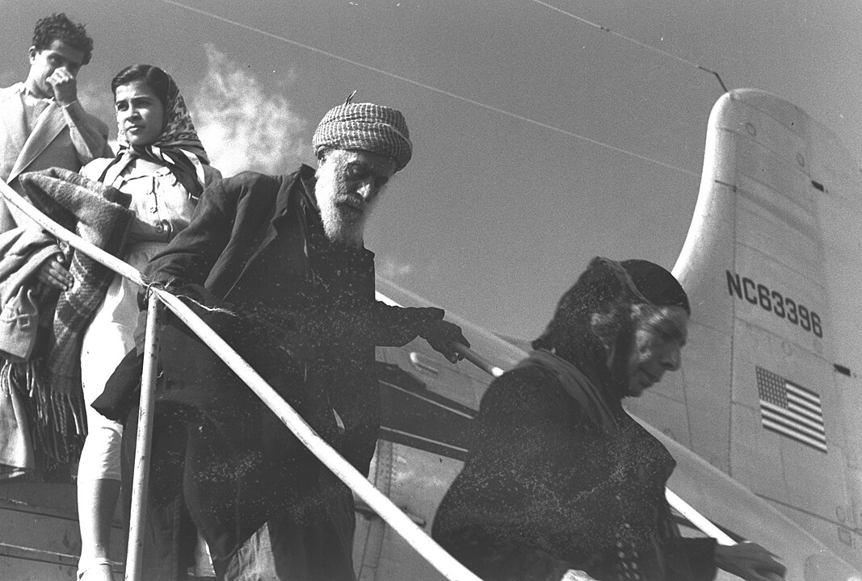
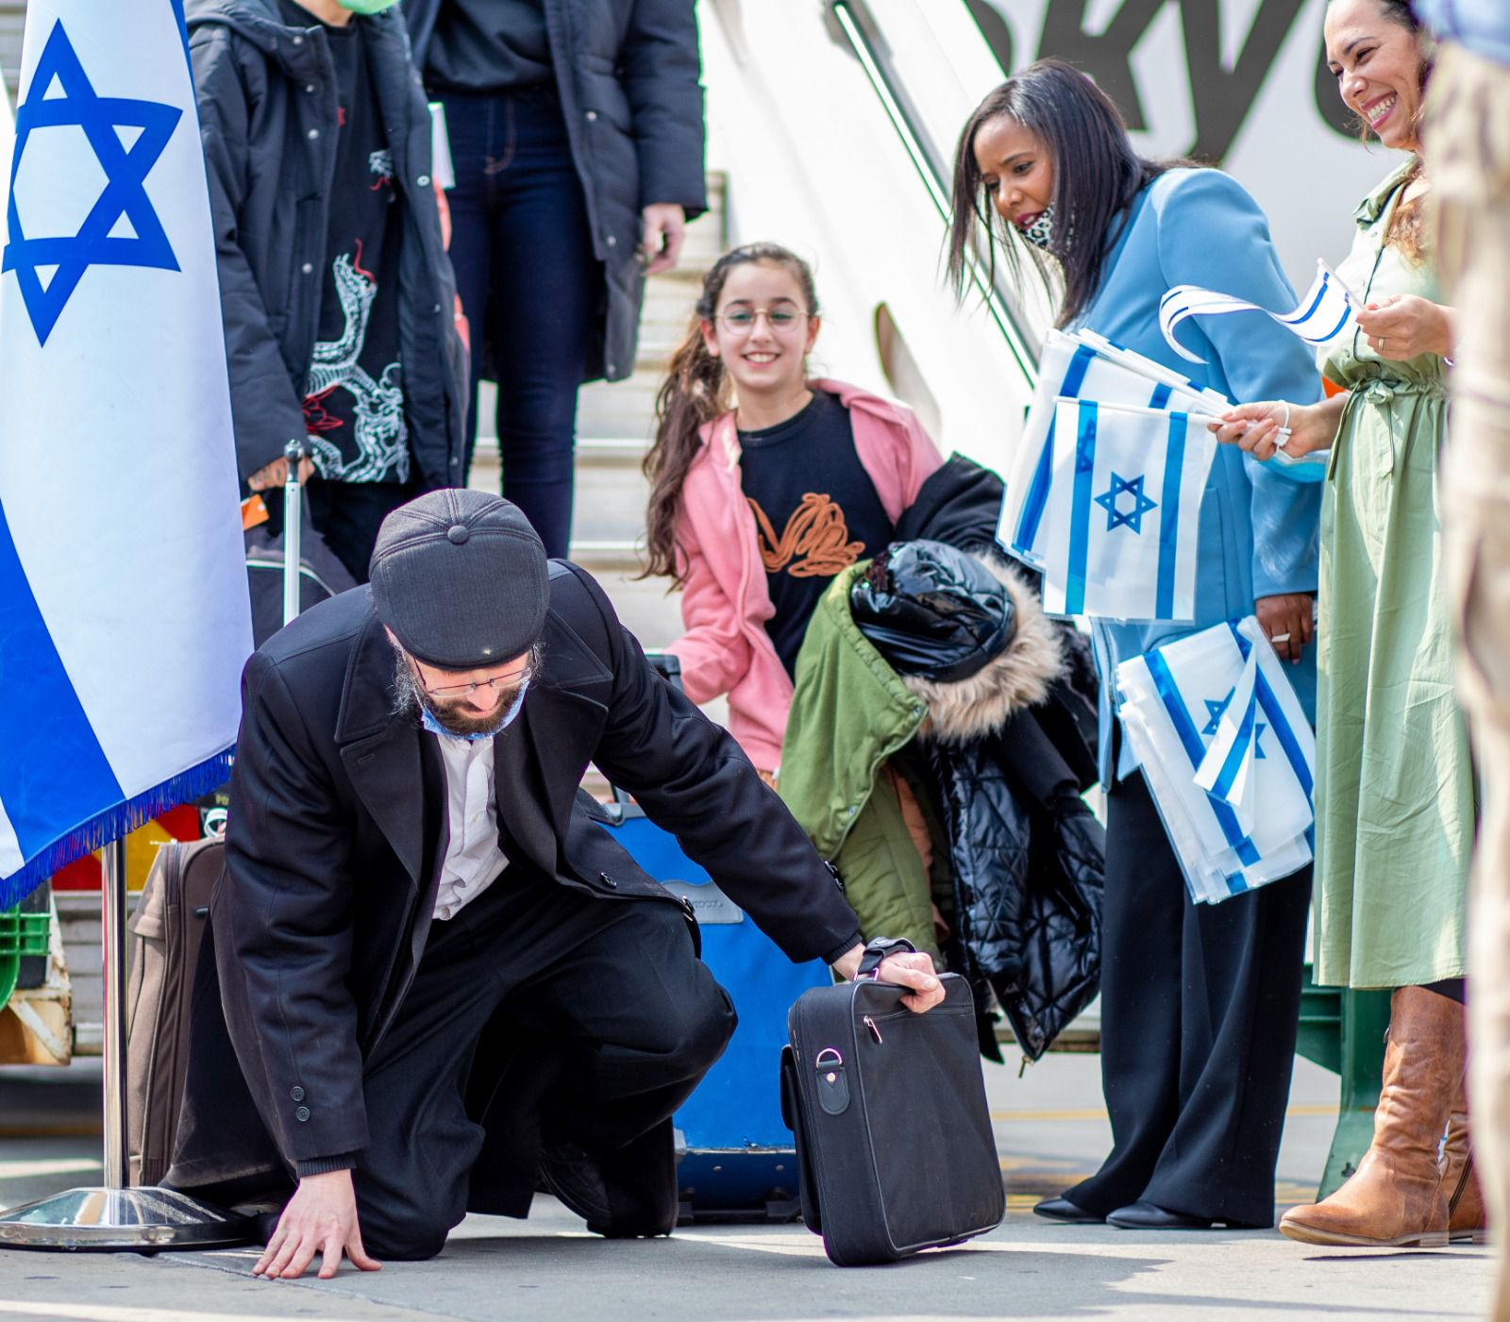
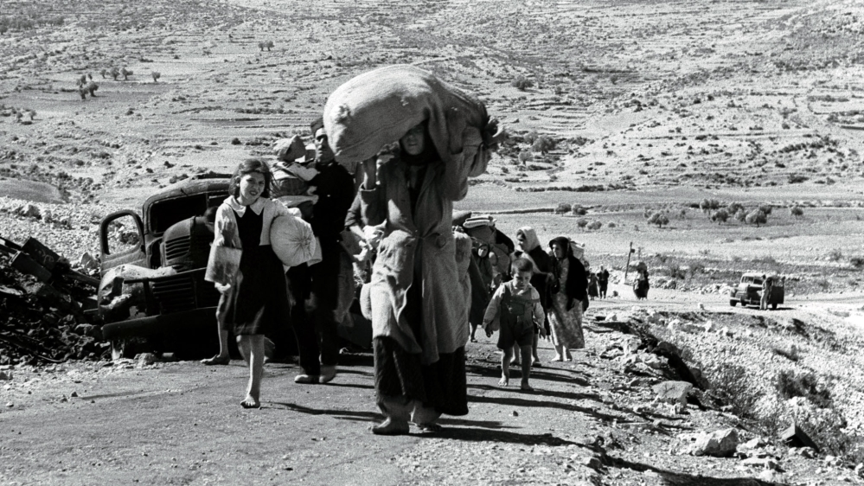
三. 犹太人还是神的选民吗？
回归
以西结书37：21“……主耶和华如此说：‘我要将以色列人从他们所到的各国收取；又从四围聚集他们，引导他们归回本地。’”
Notes:
Regathering
Ezekiel 37:21 “…‘Thus says the Lord GOD,” Behold, I will take the sons of Israel from among the nations where they have gone, and I will gather them from every side and bring them into their own land; （为了确认是指末世，请参考以西结书37:24、38:8）
That’s the promise; but when?

Slide 25
三. 犹太人还是神的选民吗？
何时回归?
以赛亚书11：6……少壮狮子与牛犊并肥畜同群；小孩子要牵引它们。7牛必与熊同食；牛犊必与小熊同卧；狮子必吃草，与牛一样。…… 11当那日，主必二次伸手救回自己百姓中所余剩的，就是在亚述、埃及、巴忒罗、古实、以拦、示拿、哈马，并众海岛所剩下的。12……招回以色列被赶散的人，又从地的四方聚集分散的犹大人。
以赛亚书第11章中预言的犹太人的完全归回要等到千禧年才能完成，那时 “狮子必吃草，与牛一样”。
但预言在我们这个时代已经得到了部分应验，而且还在实现。
Notes:
When’ll they be regathered?
Isaiah 11:6 …And the calf and the young lion and the fatling together; And a little boy will lead them. 7 Also the cow and the bear will graze; Their young will lie down together; And the lion will eat straw like the ox. … 11 Then it will happen on that day that the Lord Will again recover the second time with His hand The remnant of His people, who will remain, From Assyria, Egypt, Pathros, Cush, Elam, Shinar, Hamath, And from the islands of the sea. 12 …And will gather the dispersed of Judah From the four corners of the earth.
The complete regathering of the Jews predicted in Isaiah 11 will not be completed until the Millennium, when “the lion eat[s] straw like the ox.”
But the partial fulfillment has happened and is happening in our times.

Slide 26
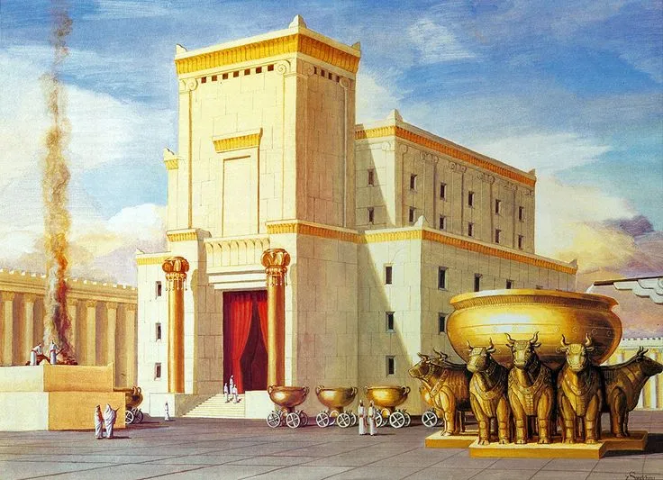
三. 犹太人还是神的选民吗？
犹太人部分归回必须发生在基督再来到世界和千禧年开始之前，因为《圣经》说，在耶稣回到地球上之前，也就是在千禧年开始之前：
在耶路撒冷会有犹太教的圣殿；
统治全球的“兽”会带领军队在哈米吉多顿战场攻击在以色列国的犹太人，意味着以色列国已存在。
Notes:
This partial regathering had to happen before the Christ’s Second Coming and the Millennium because the Bible says before Jesus returns to this earth, i.e. before the Millennium starts:
There’ll be a Jewish temple in Jerusalem
The army of the world ruler, the “Beast,” will attack the Jews in the nation of Isl.—so Isl. will exist then.
Let’s discuss these two in detail.

Slide 27
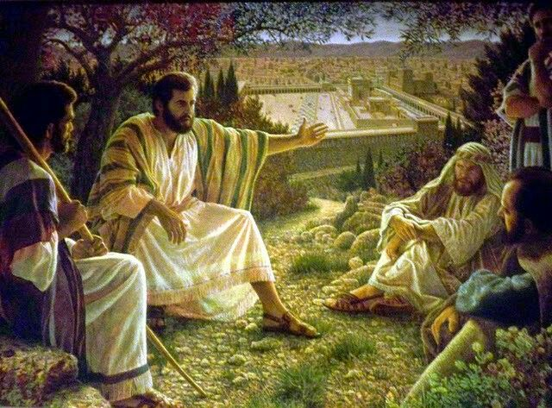
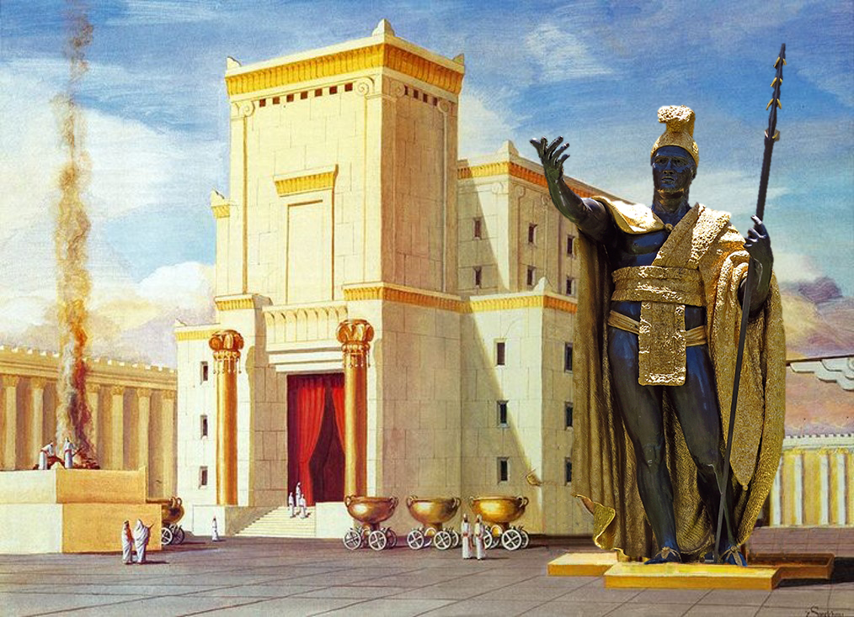
三. 犹太人还是神的选民吗？
在耶稣回到地球上之前，也就是在千禧年开始之前，在耶路撒冷必须有犹太教的圣殿。耶稣发预言：
马太福音24：14……然后末期才来到。15你们看见先知但以理所说的“那行毁坏可憎的”站在圣地【圣殿】……
Notes:
Before Jesus returns to this earth, i.e. before the Millennium starts, there will be a Jewish temple in Jerusalem.
Matthew 24:14 “…and then the end shall come. 15 "Therefore when you see the ABOMINATION OF DESOLATION which was spoken of through Daniel the prophet, standing in the holy place…

Slide 28
三. 犹太人还是神的选民吗？
在耶稣回到地球上之前，也就是在千禧年开始之前，统治全球的“兽”会带领军队在哈米吉多顿战场攻击在以色列国的犹太人，意味着以色列国已存在。
撒迦利亚书12:2“我必使耶路撒冷被围困的时候，向四围列国的民成为令人昏醉的杯；这默示也论到犹大。3那日，我必使耶路撒冷向聚集攻击她的万民当作一块重石头。凡举起的必受重伤；地上的万国都聚集攻击它。”《和合本》与《和合本修订版》合并使用
启示录16:14……出去到普天下众王那里，叫他们在神全能者的大日，聚集争战。……16……叫众王聚集在一处，希伯来话叫作哈米吉多顿。
Notes:
Before Jesus returns to this earth, i.e. before the Millennium starts, The army of the world ruler, the “Beast,” will attack the Jews in the nation of Isl.—so Isl. will exist then. [Megiddo: ~45km SW of Sea of Galilee 米吉多位于加利利海西南约 45 公里处]
Zechariah 12:2 "Behold, I am going to make Jerusalem a cup that causes reeling to all the peoples around; and when the siege is against Jerusalem, it will also be against Judah. 3 "And it will come about in that day that I will make Jerusalem a heavy stone for all the peoples; all who lift it will be severely injured. And all the nations of the earth will be gathered against it.
Revelation 16:14 …which go out to the kings of the whole world, to gather them together for the war of the great day of God, the Almighty. … 16 And they gathered them together to the place which in Hebrew is called Har-Magedon.

Slide 29
三. 犹太人还是神的选民吗？
物质上的应许在犹太民族身上仍然有效；
属灵上，只有真正信基督的人才是神的选民；
圣经预言，末世前必有犹太人开始归回并复国。
小结
Notes:
1)The material promises are still valid for the Jewish people; 2)Spiritually, only true believers in Christ are God's chosen people; 3)The Bible prophesies that the Jews will begin to return and will reestablish a nation before the Endtimes.

Slide 30
四. 对犹太人的应许适用于现代以色列国吗？
区分： 犹太民族与现代以色列国：
应许是给一个民族群体（雅各的后裔）的，而且应许是部分带条件的——要求真正地相信并顺服才能得到；
应许不是给一个现代实体的国家（以色列国）。
现代以色列国并没完全实现预言；它的复国与现状只是部分预备预言的完全应验。
Notes:
4. Do the promises to the Jews apply to the modern state of Israel?
Distinguish: Jewish people group versus the modern state of Israel
the promises were given to a people group, the descendants of Jacob, and are partly conditional on obedience
the promises were not given to a modern national entity
The modern state of Israel is not the complete fulfillment of the prophecies; it is only a partial preparation

Slide 31
四. 对犹太人的应许适用于现代以色列国吗？
是的，神允许犹太人回归并重建以色列国，这是预言的部分应验，也是为最终的千禧年国度做准备。
但是，为实现预言而发生的事情并不意味着神认可这种行为或做出这种行为的人。
    例如：偶像崇拜者尼布甲尼撒和巴比伦人入侵以色列，犹太人被俘虏到巴比伦去
    例如：祭司们、罗马人把耶稣钉在十字架上
即使犹太民族和以色列国大部分的人没有得救，而且他们所做的某些事情是错误的，神仍可能使用他们的选择来实现预言。
Notes:
入侵 ru4qin1 俘虏 fu2lu3 Yes, God allowed the Jews to return and re-establish the state of Israel as a partial fulfillment of prophecy and as a preparation for the eventual Millennial Kingdom
• But just because something happens in fulfillment of prophecy doesn’t mean God approves of the action or the ppl who do it.
E.g. Idol worshippers Nebuchadnezzar and the Babylonians invading Israel and the Babylonian captivity
E.g. priests and Romans crucifying Jesus
• God might still use the choices of the Jews and the nation of Israel to fulfill prophecy even if they are not saved, and even if some of the things they are doing are wrong.

Slide 32
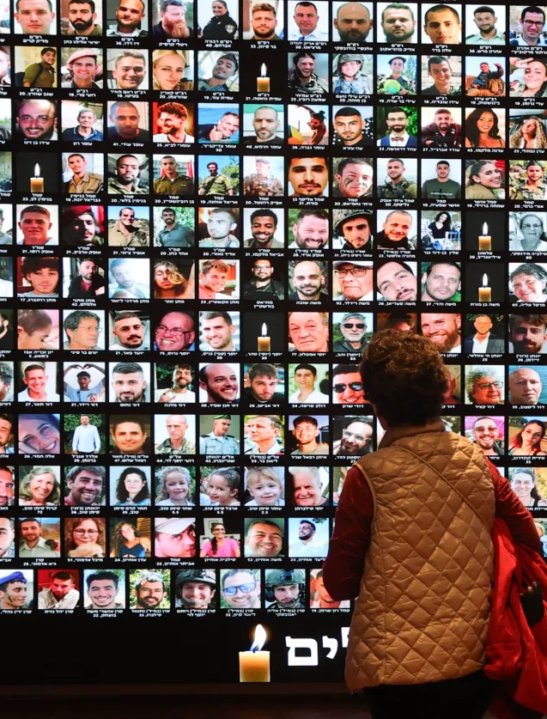
五. 以色列在加沙战争中的行为是对是错？
要评判这场战争，要看人的行动，而不是他们的身份。
能打正义战争的依据在创世记第 9 章：
  创世记9：6凡流人血的，他的血也必被人所流，因为神造人，是照自己的形象造的。
哈马斯发动袭击，杀害1195平民，并绑架251人（其中约73人已被杀害）；
以色列有理由做出强烈反应，包括找办法确保哈马斯无法再次发动类似袭击；
一名妇人在观看被绑架者名单
Notes:
袭击 Xi2Ji1 raid 愤懑 Fen4Men4 加沙地带 Jia1Sha1 Di4Dai4 Gaza Strip
5. Is Israel’s conduct of the Gaza war right or wrong?
To judge the war, look at their actions, not their 身份.
Just war is based on Genesis 9
Genesis 9:6 "Whoever sheds man's blood, By man his blood shall be shed, For in the image of God He made man.
Hamas attacked, killed 1,195 people, kidnapped 251 (of whom about 73 have been killed)
A strong response was justified, including trying to make sure Hamas is not able to do it again.

Slide 33
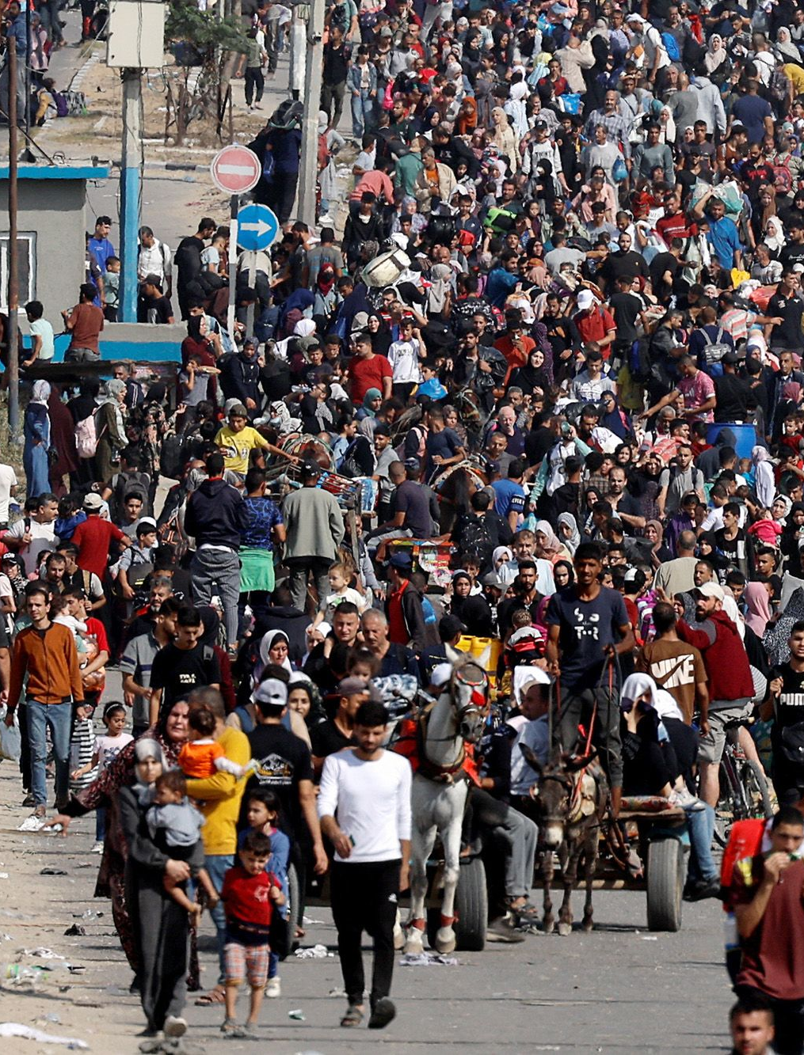
五. 以色列在加沙战争中的行为是对是错？
以色列极力避免杀害平民。他们在攻击居民楼前发出警告。他们好像已经在尽力避免平民死亡；
哈马斯故意地将战斗人员安置在医院、学校和居民公寓楼内（以及这些建筑正下方的地道中）；
哈马斯心怀愤懑，认为只有牺牲平民才能实现自己的目标；
同时，许多人说，以色列不允许足够的人道主义援助进入加沙，因为以色列担心哈马斯会得到武器或经济支持。
加沙居民在撤离
Notes:
袭击 Xi2Ji1 raid 愤懑 Fen4Men4 援助 Yuan2Zhu4
Israel has tried very hard to avoid killing civilians. They give warnings before attacks on buildings. They are probably doing the best they can to avoid civilian deaths.
• Hamas has knowingly housed fighters inside hospitals, schools, and residential apartment buildings (and in tunnels right underneath them).
• They are embittered, and believe there is no way to achieve their goals except by sacrificing civilians.
• At the same time, any say Israel is not allowing enough humanitarian aid into Gaza for fear of weapons or economic aid to Hamas.

Slide 34
五. 以色列在加沙战争中的行为是对是错？
作为基督徒，我们的主要目标必须与神永恒不变的目标一致：
                罪人得救
                信徒成圣
加沙战争的真实情况是：两批走向地狱的罪人互相憎恨、互相争斗。
我们应祷告神软化交战双方的心，让他们接受福音。
我们应该为加沙和以色列军队中极少数真正的基督徒祷告，让他们能够分享福音，并让一些人得救。
Notes:
Our main goal as Christians must be the same as God’s goal, which never changes: Salvation of the lost, sanctification of the saved.
The real situation in Gaza war: two groups of sinners headed for hell hating each other and fighting each other.
We should pray God will soften hearts of people on both sides of the fight to receive the gospel
We should pray for the tiny number of real Xians in Gaza and in the Israeli army, for them to be able to share the gospel and for some to be saved
think how hard it is for those few Christians in Gaza… in the IDF…想想加沙或以色列军队中的少数基督徒是多么艰难......

Slide 35
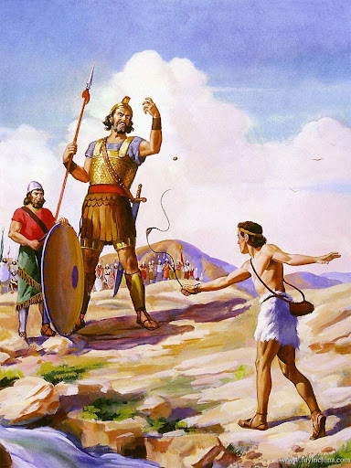
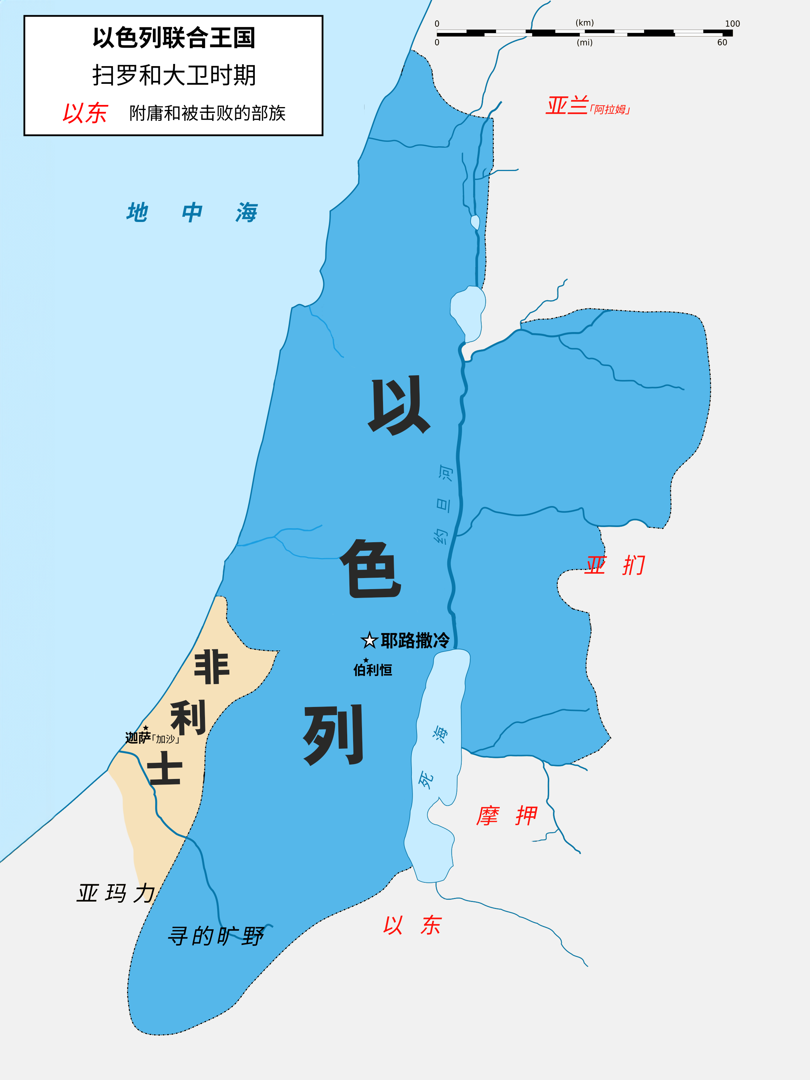
六. 巴勒斯坦问题的背景是什么？
巴勒斯坦人是谁？他们来自哪里？
“巴勒斯坦”一词源于“非利士人”（对比英文：Palestine, Philistine）。
非利士人早已不复存在，但古希腊人和罗马人曾用他们的名字代表以色列全境和一些邻近地区。
Notes:
歌利亚 Goliath Ba1Le4Si1Tan3 Palestine 加沙地带 Jia1Sha1 Di4Dai4 Gaza Strip
6. What is the solution to the Palestinian problem?
Who are the Palestinians? Where did they come from?
The word “Palestine” comes from the word “Philistine.” The Philistine ethnicity is long gone, but their name was used by Greeks and Romans to refer to all of Israel and some adjacent areas.

Slide 36
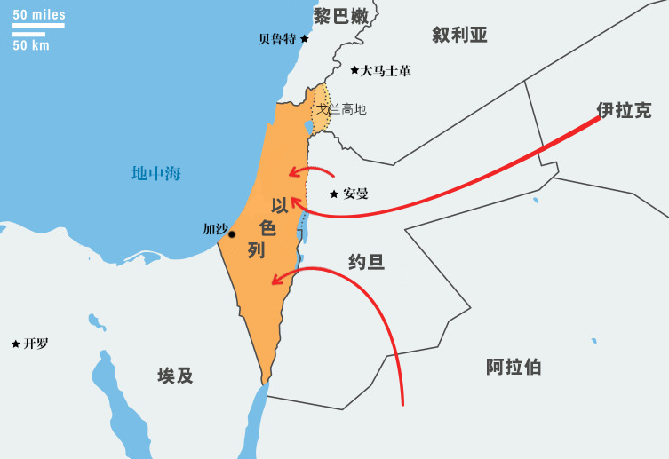
六. 巴勒斯坦问题的背景是什么？
巴勒斯坦人是谁？他们来自哪里？
公元70年和135年犹太人反叛后，罗马人不允许任何犹太人在巴勒斯坦居住。
此后，大量阿拉伯人迁入巴勒斯坦地区，与当地的其他非犹太人通婚。最终，阿拉伯民族和文化在该地区占据了主导地位。
公元135年
犹太人被罗马驱逐
犹太人被驱逐后，周边的阿拉伯人逐步聚集于以色列。
Notes:
Ba1Le4Si1Tan3 Palestine 加沙地带 Jia1Sha1 Di4Dai4 Gaza Strip
Who are the Palestinians? Where did they come from?
After the Jewish revolts in 70AD and 135AD, the Romans did not allow any Jews to live in Palestine.
After that, significant numbers of Arabs moved into Palestine, intermarrying with the other non-Jewish people there. Eventually Arab ethnicity and culture came to dominate the area.
The people who today are called “Palestinians” are mostly ethnic Arabs. They never had an independent nation; first the Romans, then Byzantines, Arab empires, and the Turkish Ottoman empire controlled the region. They never claimed to be a separate ethnicity until the early 20th century.

Slide 37
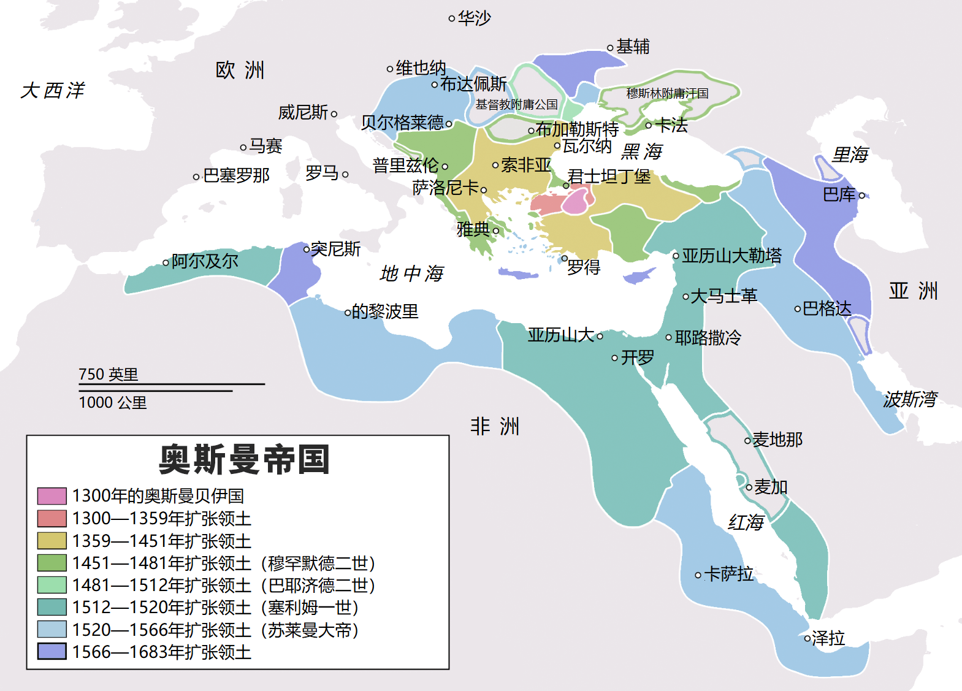
六. 巴勒斯坦问题的背景是什么？
巴勒斯坦人是谁？他们来自哪里？
今天被称为 “巴勒斯坦人 ”的祖先大部分来自阿拉伯民族。他们从未有过独立的国家；先是罗马人，然后是拜占庭人、阿拉伯帝国和土耳其奥斯曼帝国控制了该地区。直到 20 世纪初，他们才宣称自己是一个独立的民族。
Notes:
Who are the Palestinians? Where did they come from?
The people who today are called “Palestinians” are mostly ethnic Arabs. They never had an independent nation; first the Romans, then Byzantines, Arab empires, and the Turkish Ottoman empire controlled the region. They never claimed to be a separate ethnicity until the early 20th century.

Slide 38
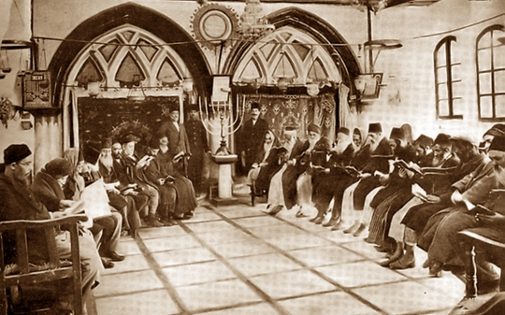
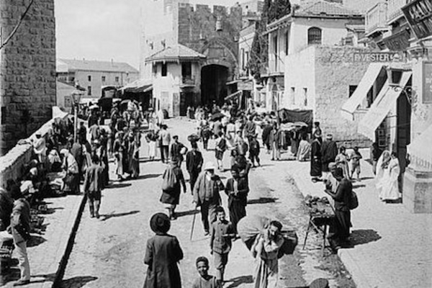
六. 巴勒斯坦问题的背景是什么？
1850 年，巴勒斯坦只有约 13000 名犹太人，约 350000 名阿拉伯人和其他人。
19世纪，会堂里的犹太人
19世纪，集市上的阿拉伯人
Notes:
In 1850, there were only about 13,000 Jews in Palestine, and about 350,000 Arabs and others.

Slide 39
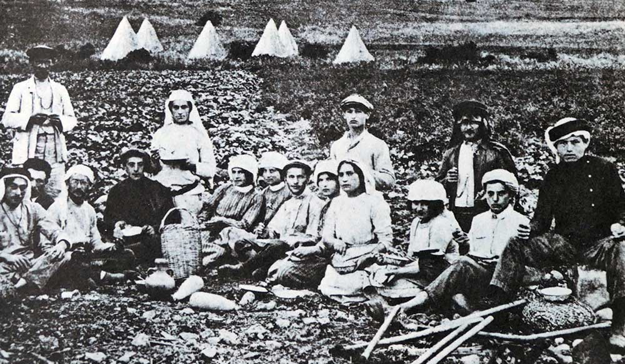
六. 巴勒斯坦问题的背景是什么？
19 世纪末，少数犹太人在巴勒斯坦购买了土地，并逐步迁入。
Notes:
In the late 1800s, a small number of Jews purchased land in Palestine and moved in gradually.
Later, around 1936-1947 (during and after Hitler’s Holocaust), many Jews came suddenly, desperately seeking a safe place. There was conflict with the Palestinians.
The Jews declared an independent state of Israel in 1948 and were attacked by the surrounding nations. The territory of Palestine was effectively divided.
Since 1948 there has been almost constant conflict between the Jews and the Palestinians.

Slide 40
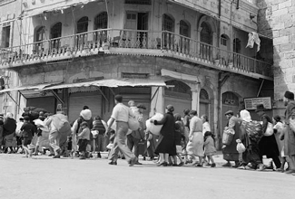
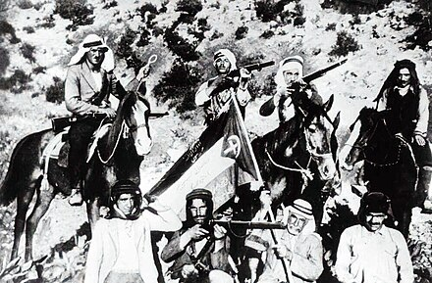
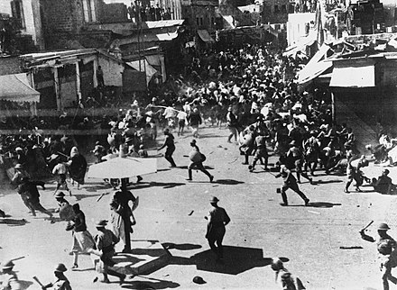
六. 巴勒斯坦问题的背景是什么？
后来，大约在 1936-1947 年（希特勒的大屠杀期间和之后），许多犹太人突然来到巴勒斯坦，急切地寻找一个安全的地方。他们与巴勒斯坦人发生了冲突。
Notes:
Later, around 1936-1947 (during and after Hitler’s Holocaust), many Jews came suddenly, desperately seeking a safe place. There was conflict with the Palestinians.
The Jews declared an independent state of Israel in 1948 and were attacked by the surrounding nations. The territory of Palestine was effectively divided.
Since 1948 there has been almost constant conflict between the Jews and the Palestinians.

Slide 41
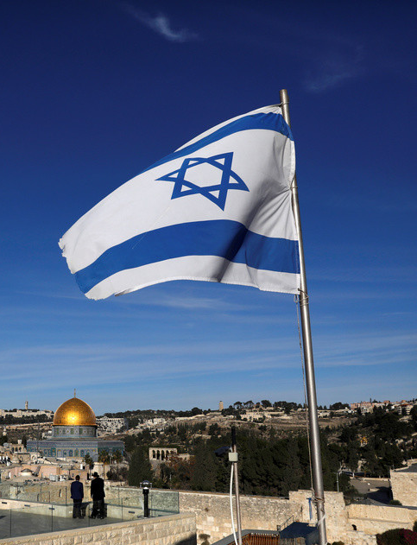
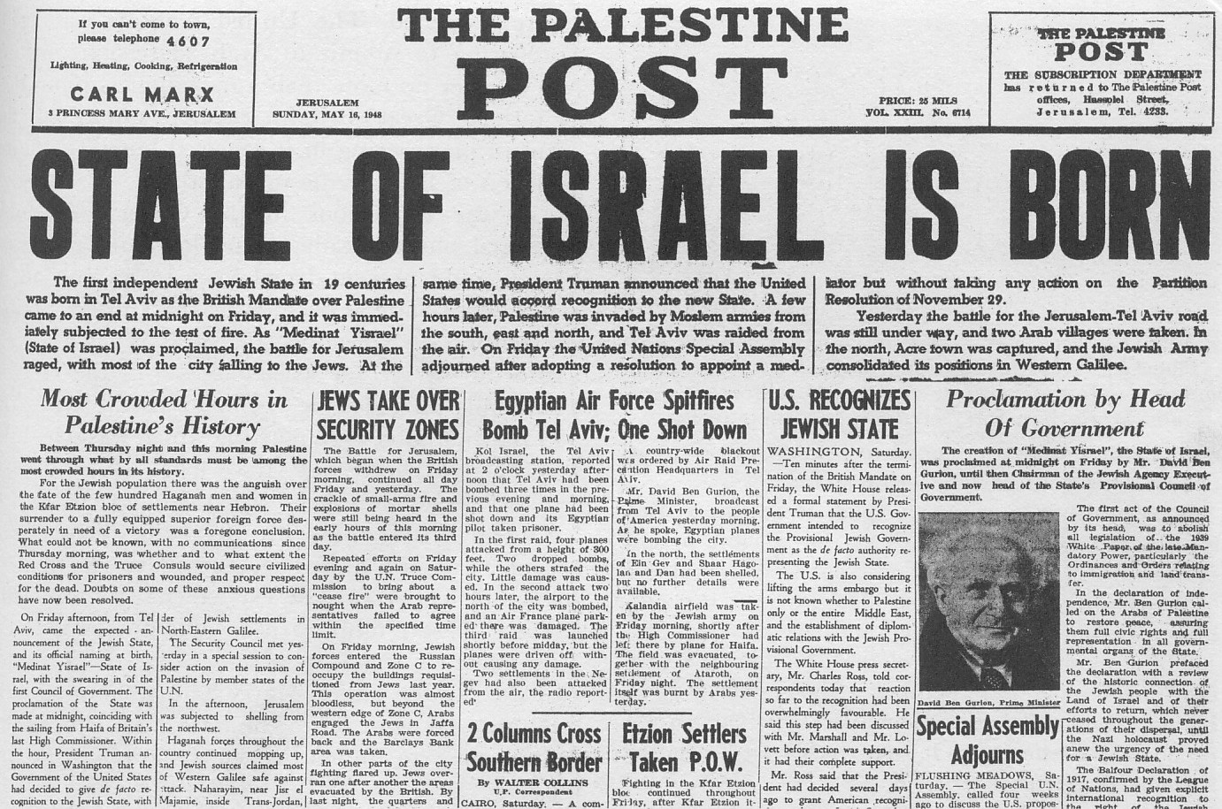
六. 巴勒斯坦问题的背景是什么？
1948年，犹太人宣布以色列独立复国，并遭到周边国家的攻击。巴勒斯坦地区被实际分割。
Notes:
The Jews declared an independent state of Israel in 1948 and were attacked by the surrounding nations. The territory of Palestine was effectively divided.
Since 1948 there has been almost constant conflict between the Jews and the Palestinians.

Slide 42
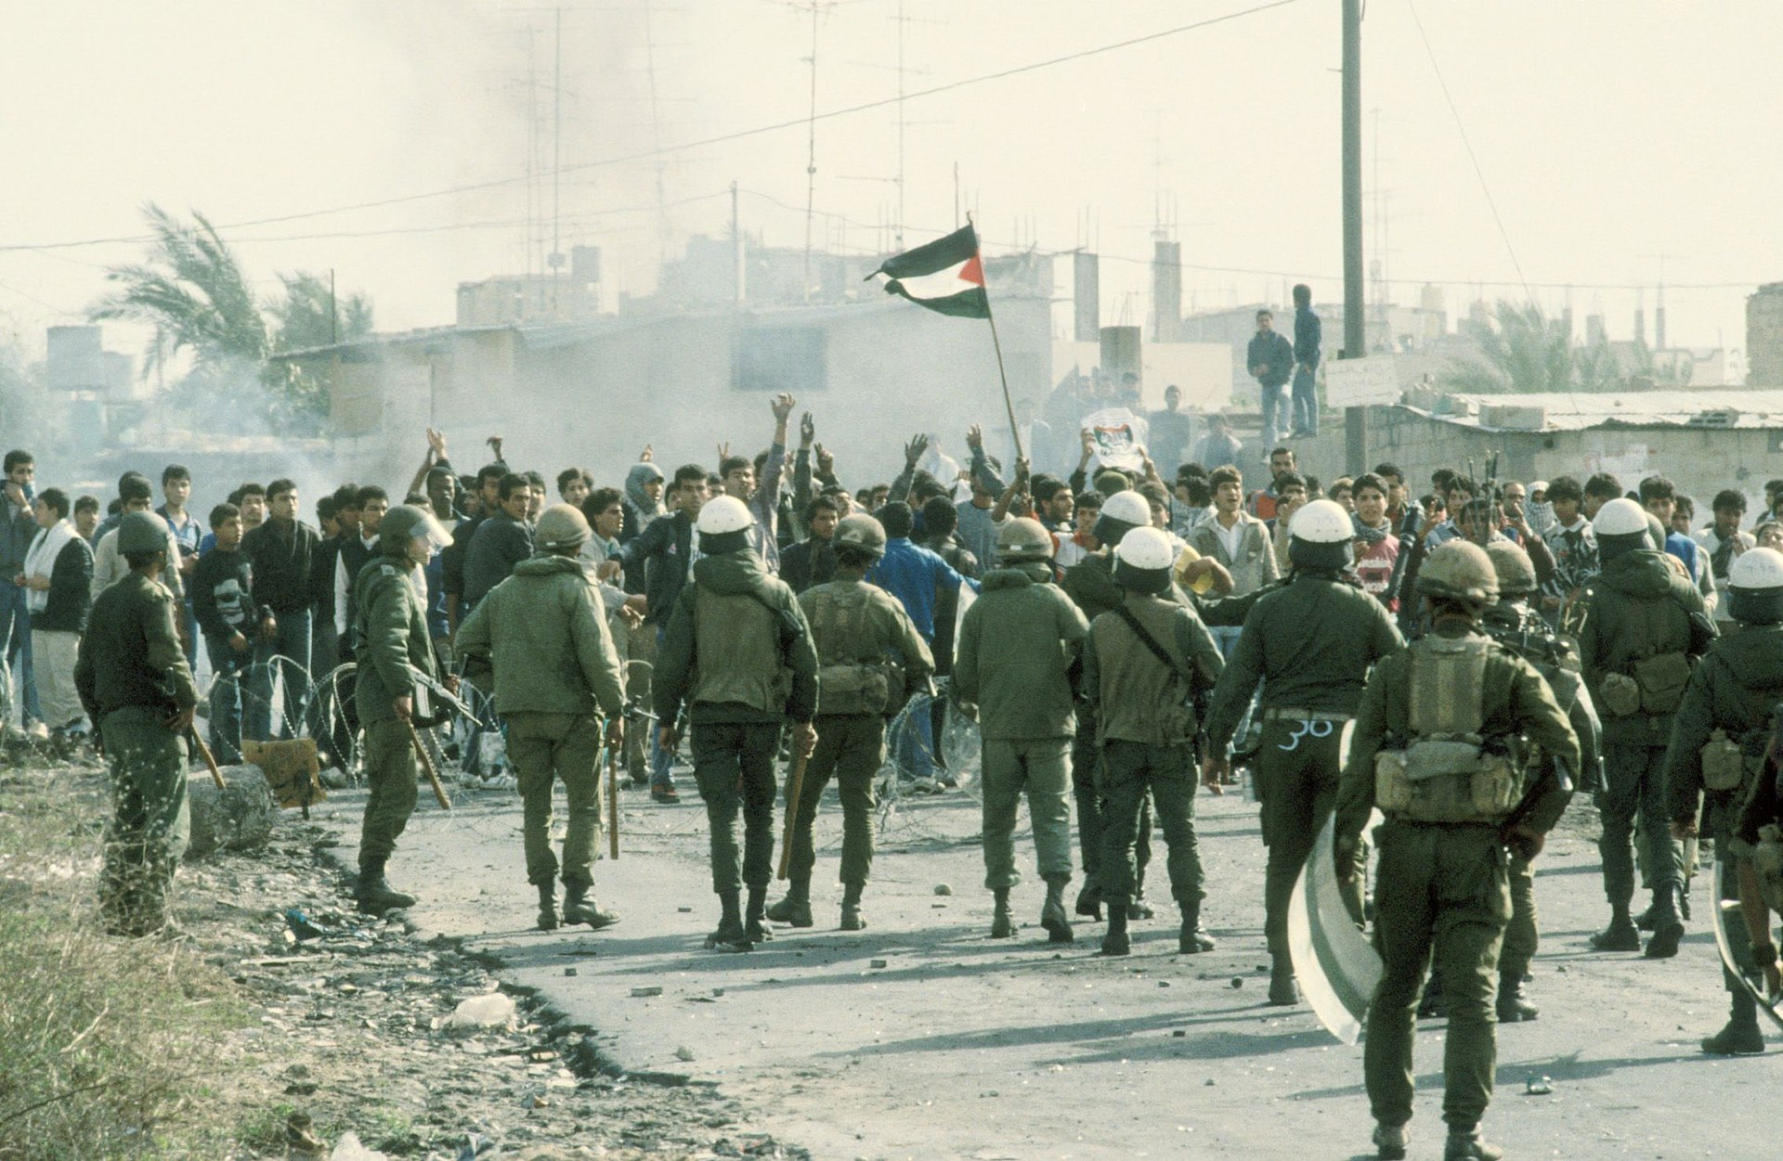
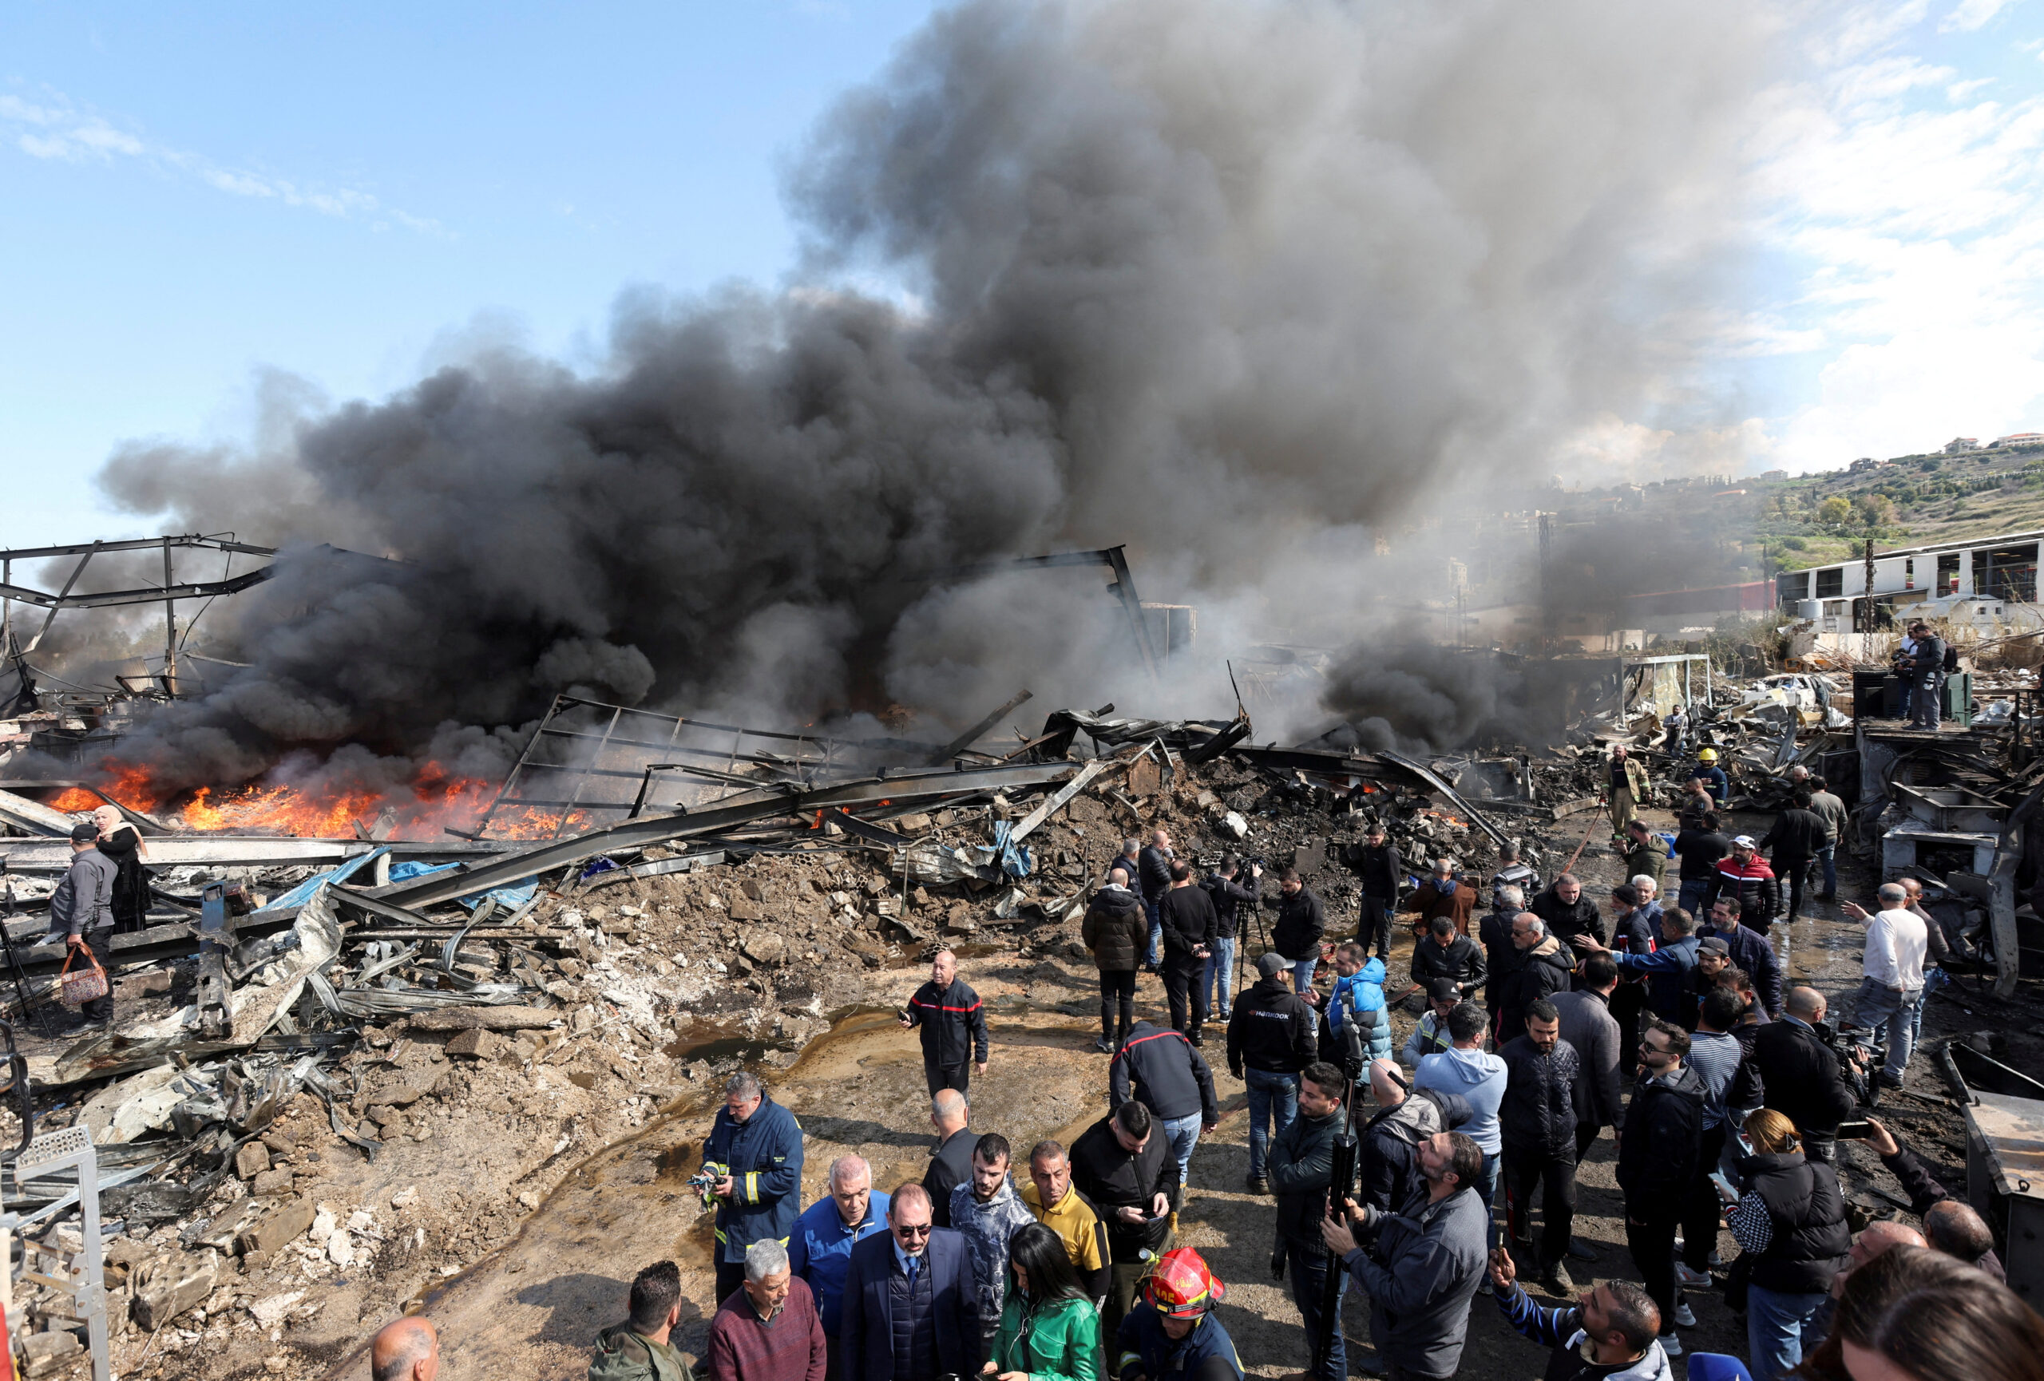
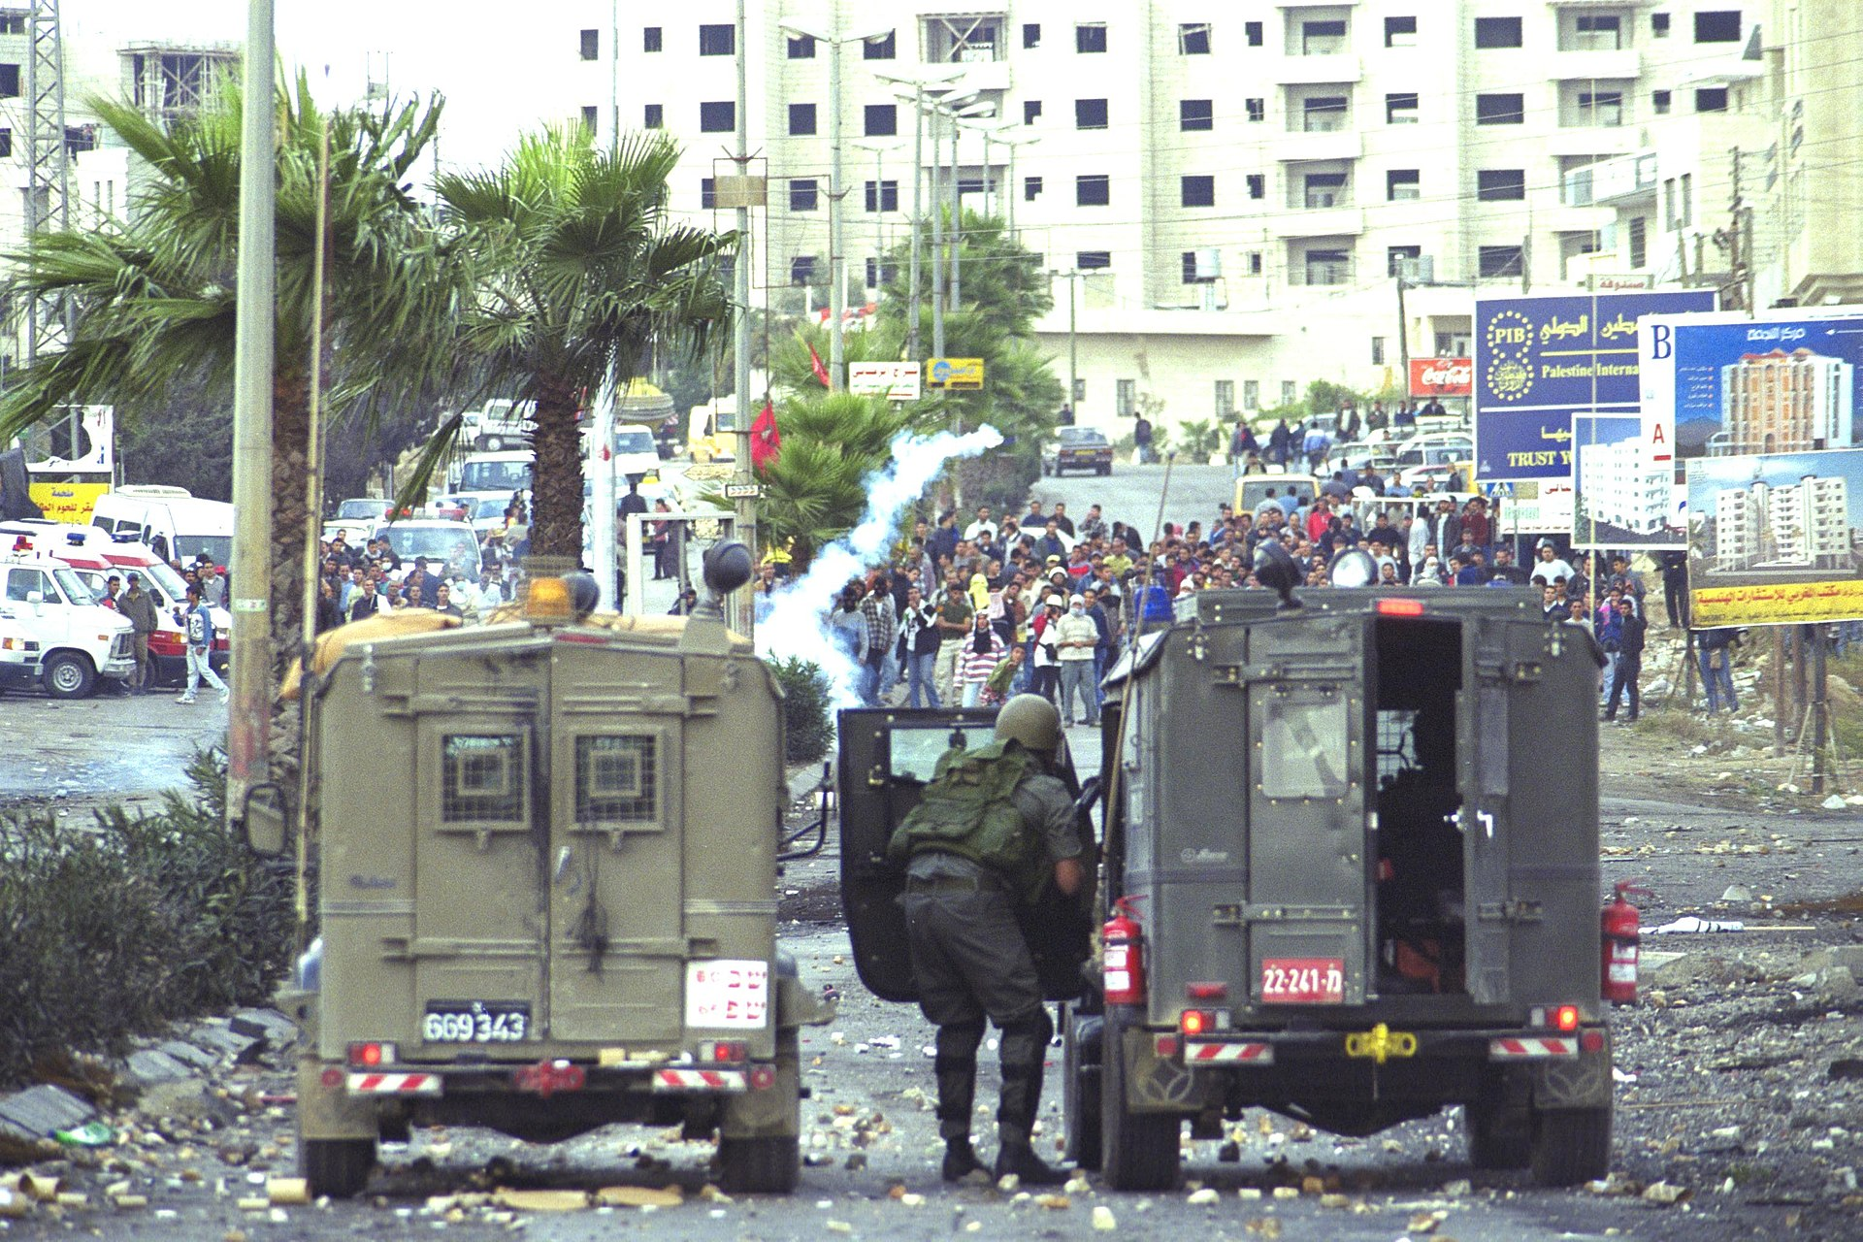
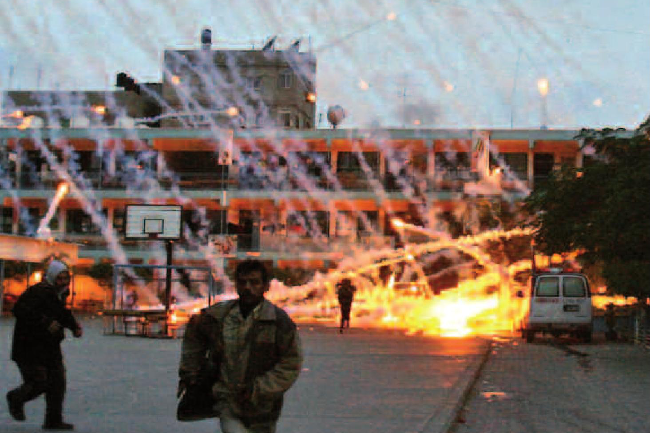
六. 巴勒斯坦问题的背景是什么？
自 1948 年以来，犹太人和巴勒斯坦人之间的冲突几乎从未中断过。
1987-1993
2023至今
2000-2005
2008-2009、2014
Notes:
Since 1948 there has been almost constant conflict between the Jews and the Palestinians.

Slide 43
六. 巴勒斯坦问题的背景是什么？
神希望犹太人如何对待巴勒斯坦人？
旧约中，神重复命令犹太人要平等公正地对待生活在他们领土上的非犹太人，甚至要特别善待有需要的外来人：
利未记33：33若有外人在你们国中和你同居，就不可欺负他。34和你们同居的外人，你们要看他如本地人一样，并要爱他如己，因为你们在埃及地也作过寄居的……
申命记24：17你不可向寄居的和孤儿屈枉正直……
申命记10：17因为耶和华你们的神……不以貌取人，也不受贿赂。18他为孤儿寡妇伸冤，又怜爱寄居的，赐给他衣食，19所以你们要怜爱寄居的……
Notes:
Ba1Le4Si1Tan3 Palestine
How does God want the Jews to treat the Palestinians?
In the Old Testament, God repeatedly commands the Jews to treat non-Jews living in their territory with equal justice and even special kindness toward the needy:
Leviticus 19:33 'When a stranger resides with you in your land, you shall not do him wrong. 34 'The stranger who resides with you shall be to you as the native among you, and you shall love him as yourself; for you were aliens in the land of Egypt: I am the LORD your God.
Deuteronomy 24:17 "You shall not pervert the justice due an alien or an orphan…
Deuteronomy 10:17 "For the LORD your God…does not show partiality, nor take a bribe. 18 "He executes justice for the orphan and the widow, and shows His love for the alien by giving him food and clothing. 19 "So show your love for the alien, for you were aliens in the land of Egypt.

Slide 44

六. 巴勒斯坦问题的背景是什么？
以色列约有 250 万非犹太民族的以色列公民（大致位于地图上的蓝色区域），占比超过 26%。其中包括约 200 万阿拉伯人。
以色列通常给予他们与犹太公民相同的权利，包括投票权。在以色列议会（Knesset）的 120 名议员中，近年来有 10-17 名是非犹太人。
Notes:
Ba1Le4Si1Tan3 Palestine
There are about 2.5 million non-Jewish Israeli citizens in Israel (in roughly the blue area on the map), which is more than 26%. This includes about 2 million Arabs.
Israel generally treats them with the same justice as the Jewish citizens, including the right to vote. Of the 120 members of Israel’s parliament (the Knesset), in recent years 10-17 have been non-Jews.

Slide 45
六. 巴勒斯坦问题的背景是什么？
然而，加沙（约 200 万）、西岸（约 300 万）和东耶路撒冷（约 35 万）的大多数巴勒斯坦阿拉伯人（大致位于地图上的红色区域）不被视为以色列公民。
他们被视为永久居民，不得投票，并面临许多其他限制。
Notes:
Ba1Le4Si1Tan3 Palestine
However, most of Palestinian Arabs in Gaza (about 2 million), the West Bank (about 3 million), and East Jerusalem (about 350000) are not considered Israeli citizens (roughly the red areas on the map).
They are regarded as permanent residents and are not allowed to vote and face many other restrictions.

Slide 46
六. 巴勒斯坦问题的背景是什么？
“巴勒斯坦”一词源于古代“非利士人”；
“巴勒斯坦”原来是地名，不是民族；
现在的巴勒斯坦人源于阿拉伯人；
巴勒斯坦地区从来没有以一个国家独立过；
多数犹太人归回时，冲突开始。
小结

Slide 47
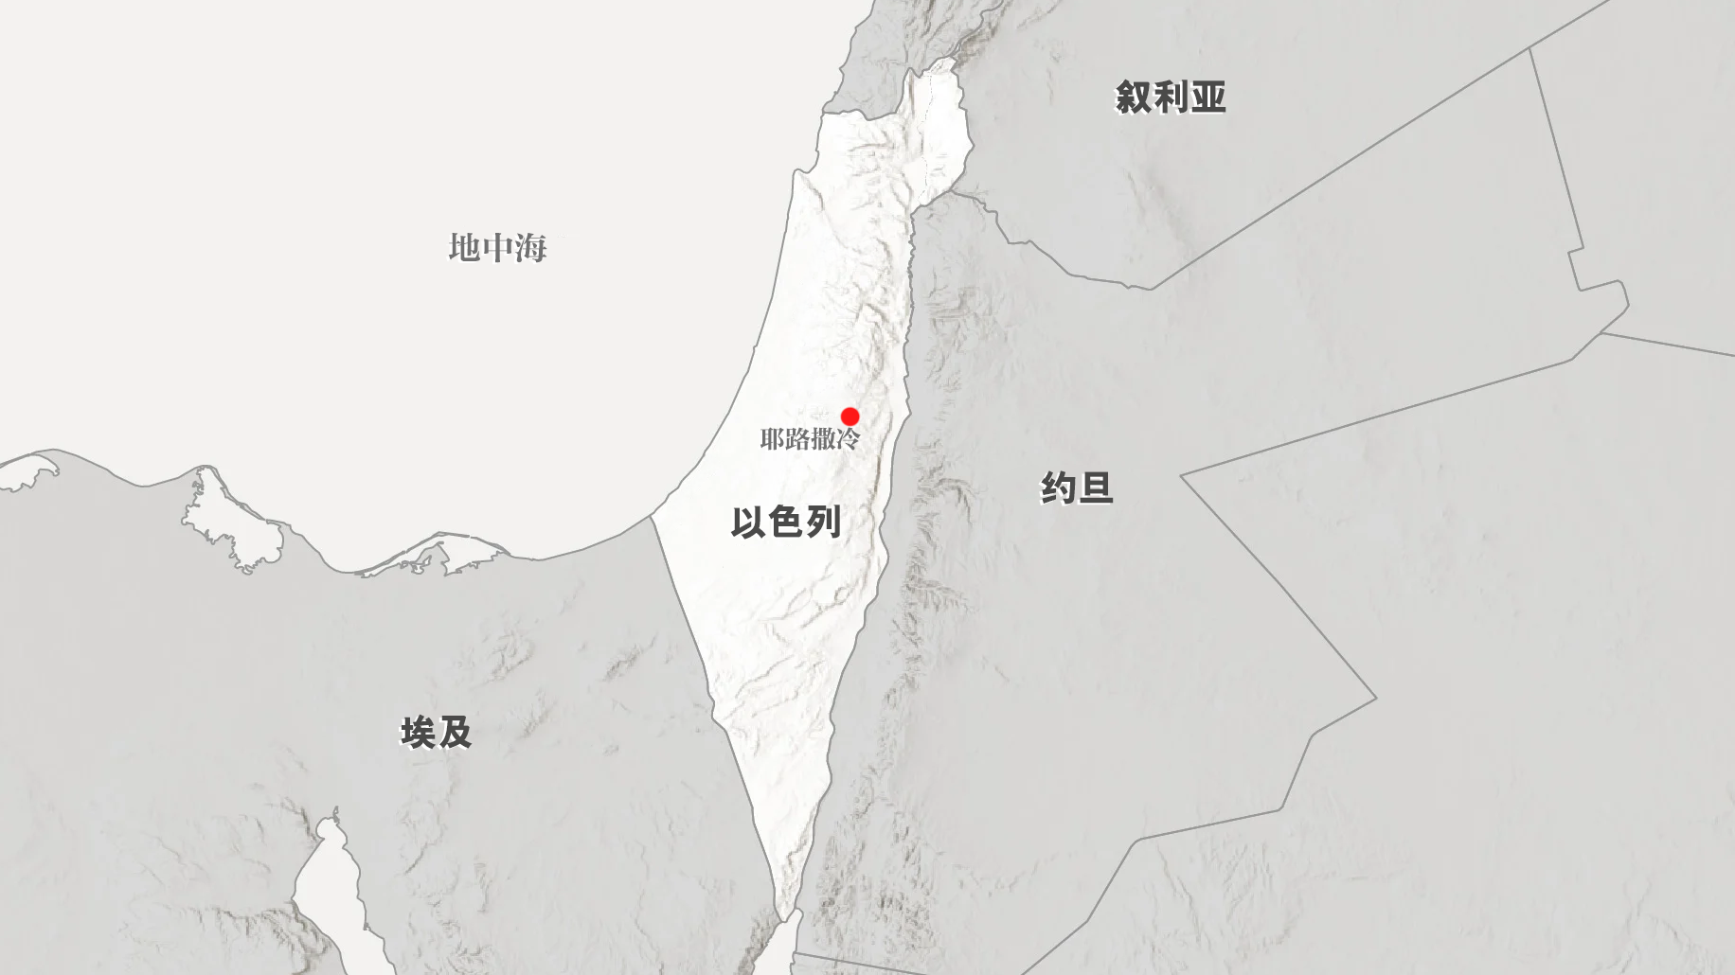
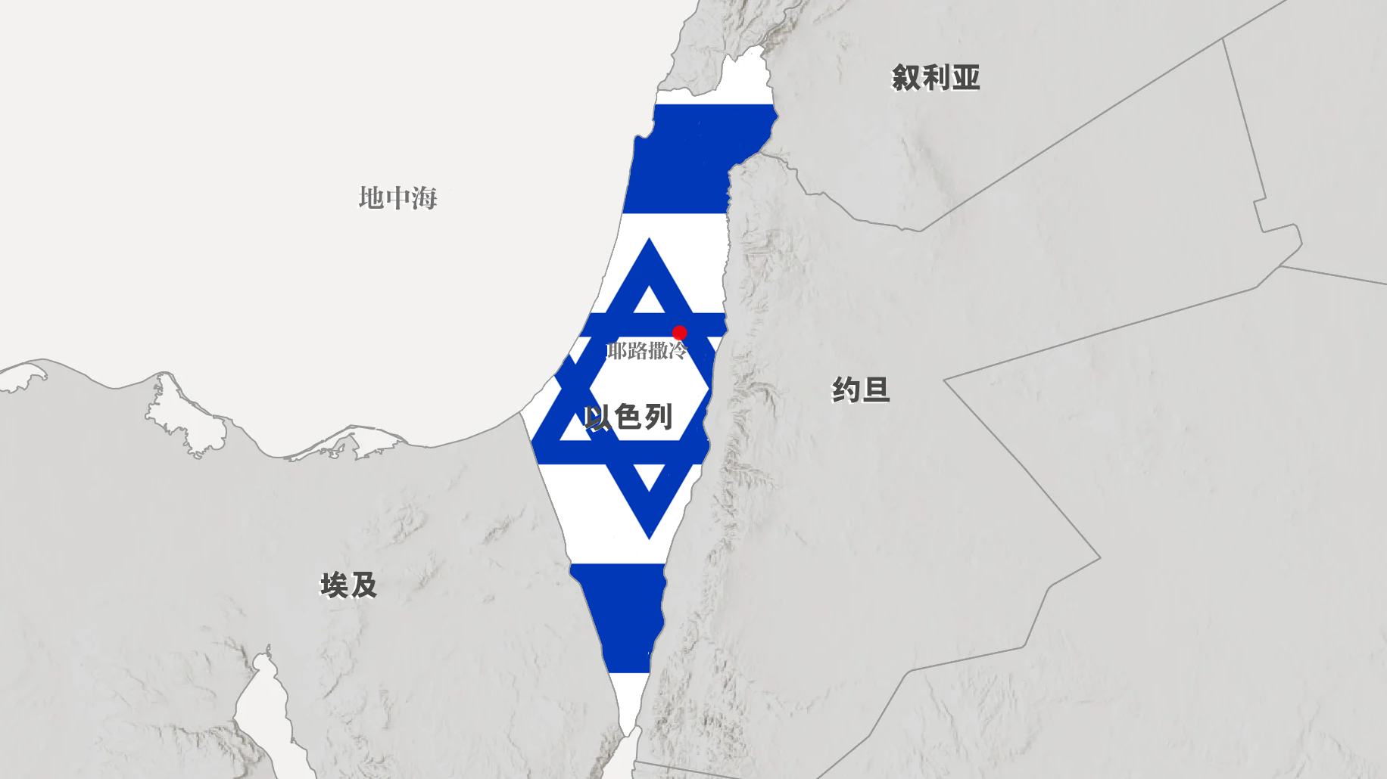
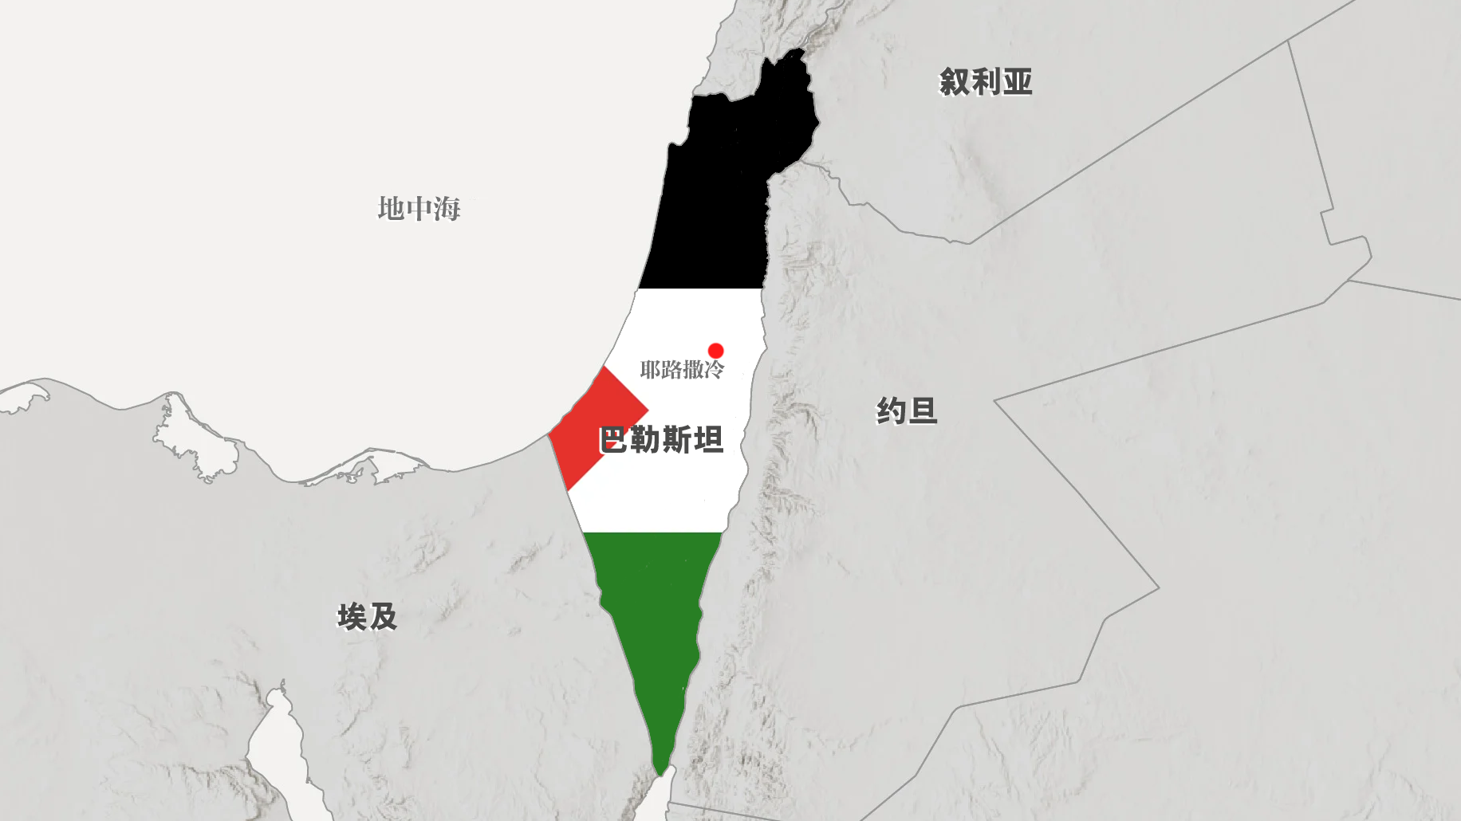
七. 巴勒斯坦问题的解决办法是什么？这一切最终将如何解决？
巴勒斯坦人希望建立自己的独立国家，包括有耶路撒冷为首都。许多巴勒斯坦人甚至坚持要彻底赶走犹太人，拥有整个巴勒斯坦地区。
似乎没有解决的办法！
犹太人坚持认为耶路撒冷是他们的首都，他们不会承认一个否认以色列国主权领土的巴勒斯坦国。一些犹太人甚至想完全接管西岸区，甚至加沙。
Notes:
Ba1Le4Si1Tan3 Palestine
7. What is the solution to the Palestinian problem? How will it all finally be resolved?
The Palestinians want their own independent state, including Jerusalem as their capital. Many of the Palestinians even insist on removing the Jews completely and having all of Palestine.
The Jews insist that Jerusalem is their capital and will not recognize a Palestinian state which does not recognize their own sovereign territory of Israel. Some of the Jews even want to take over the West Bank, and even Gaza, completely.
There does not seem to be a solution!

Slide 48
七. 巴勒斯坦问题的解决办法是什么？这一切最终将如何解决？
可悲的是，圣经清楚地表明，在耶稣再来之前，以色列、巴勒斯坦地区不会有持久的和平。
但以理书9：27一七之内，他必与许多人坚定盟约；一七之半，他必使祭祀与供献止息。那行毁坏可憎的如飞而来，并且有愤怒倾在那行毁坏的身上直到所定的结局。”
以西结书38：8过了多日，你必被差派。到末后之年，你必来到脱离刀剑从列国收回之地，到以色列常久荒凉的山上；但那从列国中招聚出来的必在其上安然居住。9你和你的军队，并同著你许多国的民，必如暴风上来，如密云遮盖地面。’”
Notes:
Sadly, Bible is clear there will be no lasting peace in Israel / Palestine there until Jesus returns.
Daniel 9:27 "And he will make a firm covenant with the many for one week, but in the middle of the week he will put a stop to sacrifice and grain offering; and on the wing of abominations will come one who makes desolate, even until a complete destruction, one that is decreed, is poured out on the one who makes desolate."
Ezekiel 38:8 "After many days you will be summoned; in the latter years you will come into the land that is restored from the sword, whose inhabitants have been gathered from many nations to the mountains of Israel which had been a continual waste; but its people were brought out from the nations, and they are living securely, all of them. 9 "And you will go up, you will come like a storm; you will be like a cloud covering the land, you and all your troops, and many peoples with you."

Slide 49
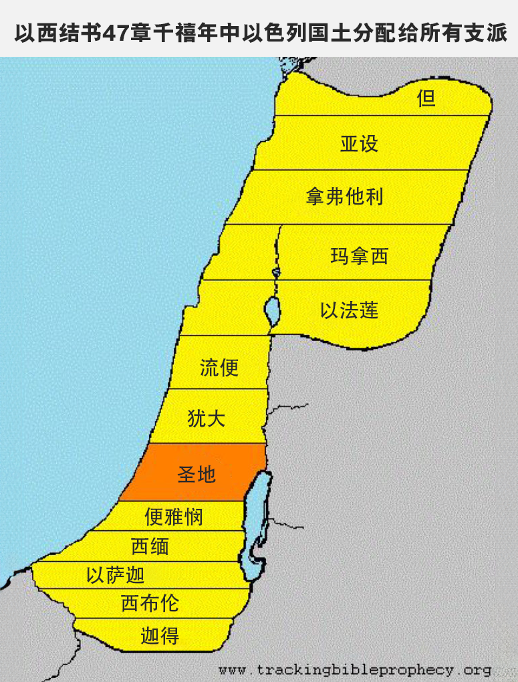
七. 巴勒斯坦问题的解决办法是什么？这一切最终将如何解决？
但在千禧年之初，问题就会得到解决：
以西结书47：21你们要按着以色列的支派彼此分这地。22要拈阄分这地为业，归与自己和你们中间寄居的外人，就是在你们中间生养儿女的外人。你们要看他们如同以色列人中所生的一样；他们在以色列支派中要与你们同得地业。23外人寄居在哪支派中，你们就在那里分给他地业。这是主耶和华说的。”
有耶稣作王，犹太人和非犹太人和睦同居巴勒斯坦地区中，彼此相爱，平等的分享土地和资源，顺服神的儿子，神的弥赛亚，主耶稣基督！
Notes:
But at the very beginning of the Millennium the Palestinian problem will be solved:
Ezekiel 47:21 "So you shall divide this land among yourselves according to the tribes of Israel. 22 "And it will come about that you shall divide it by lot for an inheritance among yourselves and among the aliens who stay in your midst, who bring forth sons in your midst. And they shall be to you as the native-born among the sons of Israel; they shall be allotted an inheritance with you among the tribes of Israel. 23 "And it will come about that in the tribe with which the alien stays, there you shall give him his inheritance," declares the Lord GOD.
With Jesus as King, Jews and non-Jews live together in harmony in the Palestinian areas, loving one another, sharing equally in the land and resources, and submitting to the Son of God, the Messiah of God, the Lord Jesus Christ!

Slide 50
八. 神通过这一切在做什么？祂的目的是什么？
神的长期目标
有一天，犹太人作为一个群体将承认耶稣为基督（弥赛亚），他们中的所有人或大多数人都将得救：
罗马书11：25弟兄们，我不愿意你们不知道这奥秘就是以色列人有几分是硬心的，等到外邦人的数目添满了，26於是以色列全家都要得救。如经上所记：“必有一位救主，从锡安出来，要消除雅各家的一切罪恶；”
Notes:
8. What God is doing through all of this? What is His purpose?
God’s long-term goal:
One day the Jews, as a group, will acknowledge Jesus as the Messiah and all or most of them will be saved:
Romans 11:25 For I do not want you, brethren, to be uninformed of this mystery, lest you be wise in your own estimation, that a partial hardening has happened to Israel until the fulness of the Gentiles has come in; 26 and thus all Israel will be saved; just as it is written, "THE DELIVERER WILL COME FROM ZION, HE WILL REMOVE UNGODLINESS FROM JACOB."

Slide 51
八. 神通过这一切在做什么？祂的目的是什么？
神的长期目标
但这要等到教会被提之后才会发生：
撒迦利亚书12：9那日，我必定意灭绝来攻击耶路撒冷各国的民。10我必将那施恩叫人恳求的灵，浇灌大卫家和耶路撒冷的居民。他们必仰望我，就是他们所扎的；必为我悲哀，如丧独生子，又为我愁苦，如丧长子。……12境内一家一家地都必悲哀。……13：1那日，必给大卫家和耶路撒冷的居民开一个泉源，洗除罪恶与污秽。”
Notes:
But that won’t happen until after the Rapture:
Zechariah 12: 9 "And it will come about in that day that I will set about to destroy all the nations that come against Jerusalem.10 "And I will pour out on the house of David and on the inhabitants of Jerusalem, the Spirit of grace and of supplication, so that they will look on Me whom they have pierced; and they will mourn for Him, as one mourns for an only son, and they will weep bitterly over Him, like the bitter weeping over a first-born. … 12 "And the land will mourn, every family by itself… 13:1 In that day a fountain will be opened for the house of David and for the inhabitants of Jerusalem, for sin and for impurity.

Slide 52
八. 神通过这一切在做什么？祂的目的是什么？
神的长期目标
那时候，犹太人将再次成为神在人间的属灵代表，为世界祝福：
撒迦利亚书8：22必有列邦的人和强国的民来到耶路撒冷，寻求万军之耶和华，恳求耶和华的恩。”23万军之耶和华如此说：“在那些日子，必有十个人从列国诸族中出来，拉住一个犹大人的衣襟，说：‘我们要与你们同去，因为我们听见神与你们同在了。’”
Notes:
Then the Jews will once again be God’s spiritual representatives on earth and bless the world:
Zechariah 8:22 'So many peoples and mighty nations will come to seek the LORD of hosts in Jerusalem and to entreat the favor of the LORD.' 23 "Thus says the LORD of hosts, 'In those days ten men from all the nations will grasp the garment of a Jew saying, "Let us go with you, for we have heard that God is with you. "'"

Slide 53
八. 神通过这一切在做什么？祂的目的是什么？
神的短期目标
短期目标 1：神正在向世人表明，他的《圣经》是真实的，圣经中所预言的一切都将成真：犹太人的分散、迫害、保存、重新聚集复国、以色列在千禧年之前不会有和平。
  通过被应验的预言，犹太人为神的真实做见证人，即使他们不相信或不顺服！
  三步论证……
Notes:
God’s short-term goals:
Short-term Goal #1: God is showing the world that His Bible is true and everything it predicts will come true: Scattering, persecution, preservation, regathering, no peace in Israel until the Millennium.
Through fulfilled prophecy, the Jews are a witness to God’s truth, even when they do not believe or obey!
Three Step Proof…

Slide 54

八. 神通过这一切在做什么？祂的目的是什么？
证实圣经是真理的三个步骤
1
第一：自然界证实了存在一位超自然的、非物质的、全能的创造者
Notes:
首先，我们复习一下，怎么知道创造者存在？（P击）对，大自然证实了存在一位创造者。
（P击）假设你跟朋友传福音，首先要说服他神存在。你可以跟他分享上学期学过的，氨基酸、蛋白质、鞭毛、不可简化的复杂性等，用具体的例证告诉他，大自然的诸多证据说明宇宙万物一定是由一位智慧超凡的创造者设计的。
证明了创造者的存在之后。第二步呢？你的朋友可能会问，这位创造者为什么就一定是圣经中的神呢？
54

Slide 55
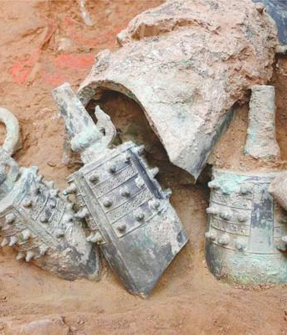
八. 神通过这一切在做什么？祂的目的是什么？
证实圣经是真理的三个步骤
1
2
第一：自然界证实了存在一位超自然的、非物质的、全能的创造者
第二：历史学与考古学证明圣经的记载是准确的
Notes:
我们就要看看圣经记载的历史是否是真实的。考古发现一再支持圣经的记载，说明圣经历史是准确的。
55

Slide 56
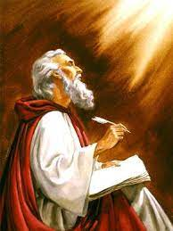
八. 神通过这一切在做什么？祂的目的是什么？
证实圣经是真理的三个步骤
1
2
3
第一：自然界证实了存在一位超自然的、非物质的、全能的创造者
第二：历史学与考古学证明圣经的记载是准确的
第三：圣经中记载的很多预言在过了很久以后都应验了这证明圣经是神的启示
Notes:
接下来的第三个步骤是什么？对，就是要考察预言：圣经中记载的很多预言在过了很久以后都应验了。这证明圣经是神的启示。
（P击）圣经中的预言有没有都按照先知所说的那样在历史中应验，能很好地验证圣经是不是神的启示，因为人不能准确预测未来。而圣经的许多预言都是写在应验前的几百甚至几千年，后来预言都一一应验了。这说明圣经的确是造物主的启示，圣经中的神就是那位掌管历史和未来的独一真神。这一课我们要学习的内容会着重于亚伯拉罕的历史和预言。
56

Slide 57


读物推荐
《求真求证》
本书分为36小章，每一章探讨一个问题或证据。
生物是进化还是被创造
地球到底有多古老
如何确定圣经中的神是真神
圣经中的预言
扫码获取
免费电子版
Notes:
这几天的讲座里面，有部分内容在这本书里面有较为详细的解说，大家可以扫码下载电子版阅读，还可以在微店上购买。而由于时间关系，圣经中的很多预言的应验，这次的讲座里面没有这个主题安排，但在这本书里面有很多很详尽的总结和解释，真的非常值得阅读。

Slide 58
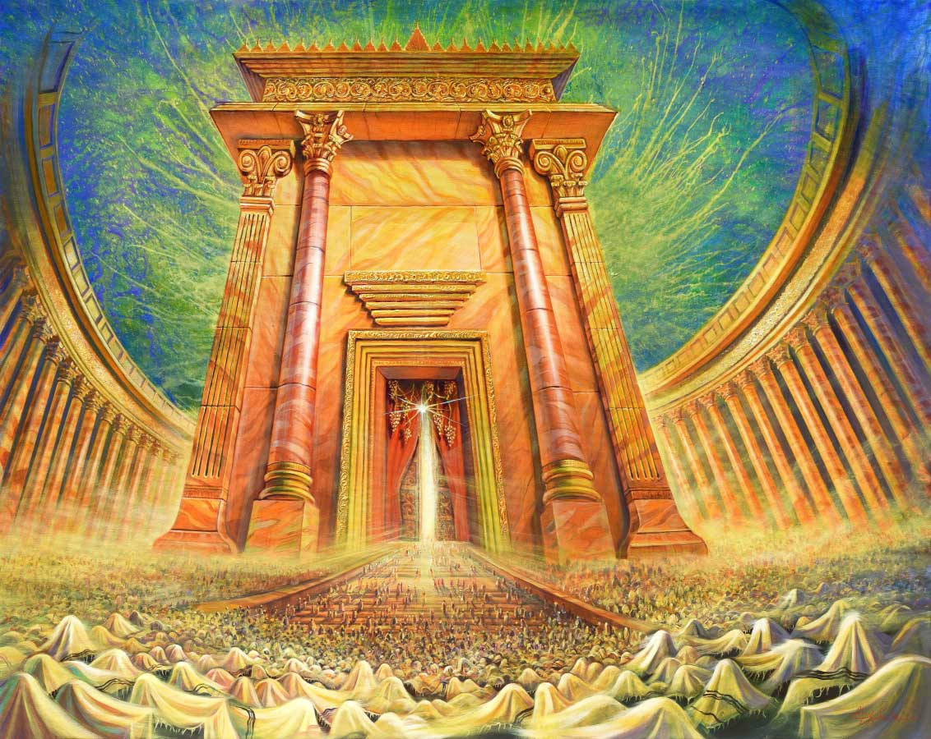
八. 神通过这一切在做什么？祂的目的是什么？
神的短期目标
短期目标 2：神正在为巴勒斯坦的末世情况做进一步的准备：
耶稣再来到世上时，耶路撒冷将有一座犹太圣殿；在目前的情况下，这是不可能实现的......
Notes:
Short-term Goal #2: God is further preparing the Endtimes situation in Palestine:
There will be a Jewish Temple in Jerusalem when Jesus returns to the earth; this could not possibly happen under the present situation…

Slide 59
八. 神通过这一切在做什么？祂的目的是什么？
神的短期目标
短期目标 3：最重要的是，神正在预备一些犹太人和巴勒斯坦人的心，让他们相信耶稣并得救。
让我们为加沙人中极少数的信徒（大约 1000 人至少有名义上的基督教背景，大多是东正教或天主教徒）祷告……也为那里的非信徒祷告。
让我们为以色列军队中极少数的信徒（几百人至少有名义上的基督教背景）祈祷......也为那里的非信徒祈祷。
Notes:
Short-term Goal #3: Most importantly of all, God is preparing some Jewish and Palestinian hearts to believe in Jesus and get saved
Let us be praying for the very few believers among Gazans (about 1,000 with at least nominal Christian background mostly Orthodox or Catholic) …and for unbelievers there. [add’l 50k in West Bank & Jer.]
Let us be praying for the very few believers (a few hundred with at least nominal Christian background) among IDF…and for unbelievers there. [Israel: c.2% profess Christianity, ¾ are Arabs; 7k-20k Jewish].

Slide 60
谢谢大家！
THANK YOU

