Slide 1
创造科学讲座系列
科学家为何相信
进化论和年老地球？
Notes:
大家好，欢迎来到今晚的在线课程。
今晚的内容是宇宙大爆炸与精细微调。

Slide 2
圣经说：创造是很明显
诗篇19:1诸天述说神的荣耀；穹苍传扬他的手段。
罗马书 1:20自从造天地以来，神的永能和神性是明明可知的，虽是眼不能见，但藉著所造之物，就可以晓得，叫人无可推诿。
Notes:
Qiong2 Cang1
The Bible says Creation is an obvious fact

Slide 3
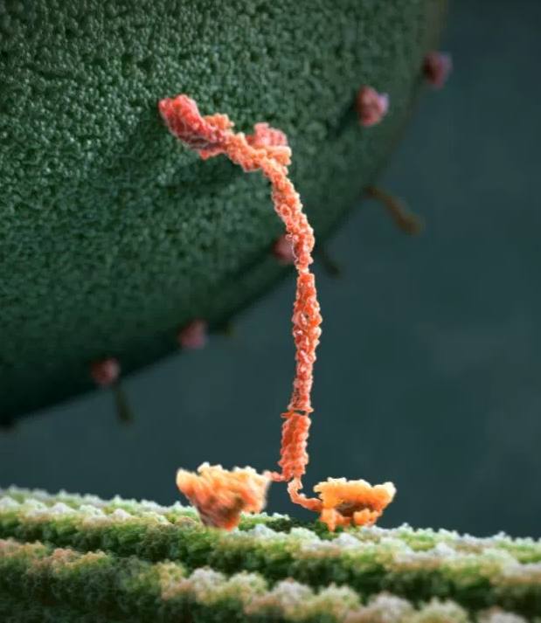
创造的证据：生命的起源
Protein 1: pics, summary
驱动蛋白
由氨基酸合成的链条
特定顺序排列
具有功能的微型机器
核糖核酸酶
Notes:
dan4bai2zhi4
chain: 链条 lian4 tiao2 （peptide chain: 肽链 tai4 lian4）
chemical bond: 化学键 jian4
Kinesin: 驱动蛋白 Qu1dong4 Dan4bai2
Ribonuclease: 核糖核酸酶 He2tang2 He2suan1 Mei2
Prokaryotes do not have kinesin, but they do have, e.g., dyneim

Slide 4
创造的证据：生命的起源
Protein 3: ribonuclease 2D ball diagram
核糖核酸酶(ribonuclease)
通过随机获得有具体功能、中等蛋白质分子的可能性有多大？
回答：少于10²⁰⁹ 分之一
Notes:
Ribonuclease: 核糖核酸酶 He2tang2 He2suan1 Mei2
dan4bai2zhi4
chain: 链条 lian4 tiao2 （peptide chain: 肽链 tai4 lian4）
chemical bond: 化学键 jian4

Slide 5
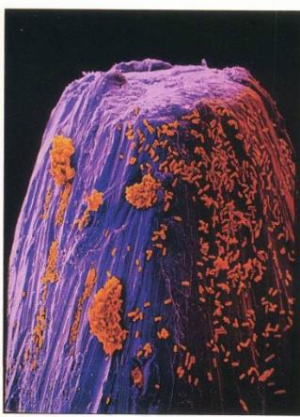
DNA不但含有物质，还含有信息
一个微小的大肠杆菌（E. coli）的DNA所包含的信息量相当于一本900页英文圣经的信息量。
Notes:
Needle Tip 针头 Zhen1Jian1
杆菌 Gan3Jun1
The DNA of a tiny E. coli bacterium contains about as much information as an entire 900 page English Bible.
Avg. # letters per English word: 4.5. Smallest bacterial genome Mycoplasma genitalium 582,790 base pairs (‘letters’) = 129,509 words (really probably 2/3 of that). E. Coli: 4.6M base pairs / letters = 1,022,222 words (really probably 2/3 of that). [TK calc: very roughly, three base pairs (64 possibilities) is two characters, including spaces & punctuation, but not including uppercase (which is redundant); for Heb. or Gr. w/o space or punctuation, closer to three characters, i.e. one character per base pair ]
NAS ~783,840 words. Gr. NT 138k + Heb OT 419k = 557k. 和合本 ~1M 字。Ordinary book 400 pages 12pt type is 100,000 words.
One volume of the Britannica is ~1,375,000 words on 1,000 [large!] pages.
5

Slide 6
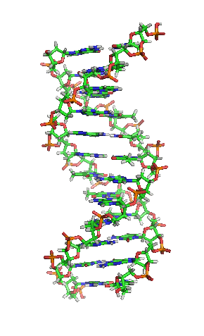
创造的证据：生命的起源
目前对最简单的生命体的最低估算：大概450个基因，有将近50 0000个基因字母（碱基对）
它们必须同时一步到位！
如果没有成型的DNA，就不会有生命、繁殖和自然选择
两位天文学家估算，无论在宇宙什么地方，生命偶然产生的概率是10⁴⁰⁰⁰⁰分之一 (Fred Hoyle and Chandra Wickramasinghe)
Notes:
Base Pair: 碱基对 Jian3 Ji1 Dui4 成型 Cheng2 Xing2 繁殖 Fan2 Zhi2
Present minimum estimate for simplest reproducing life form: about 450 genes, with 500,000 genetic ‘letters’ (base pairs).
These have to all be in place at the same time!
Without working DNA, there is no life, no reproduction, no natural selection
One scientist estimated the odds of life appearing by chance anywhere in the universe as 1 in 10⁴⁰⁰⁰⁰
Creation 39:4 (2017) p.8 Min. genome (synthetic bac.) 473 genes (531,560 ‘letters’); Mycoplasma genitalium 482 genes (582,790 ‘letters’) AND M. genitalium is parasitic. Former estimates for self-reproduction: [earlier]: 256 genes; 2006: 387 protein coding + 43 RNA coding = 430.
Note the human engineered minimal cell JCVI-syn3.0 has 438 proteins, not including some RNA molecules. C.A. Hutchison III et al., Design and synthesis of a minimal bacterial genome, Science 351:1414, March 25, 2016

Slide 7
5月14日 19:30 准时开讲
会议号:768-8131-2546
Notes:
再次预告本周六，就会讲《物种的起源》

Slide 8
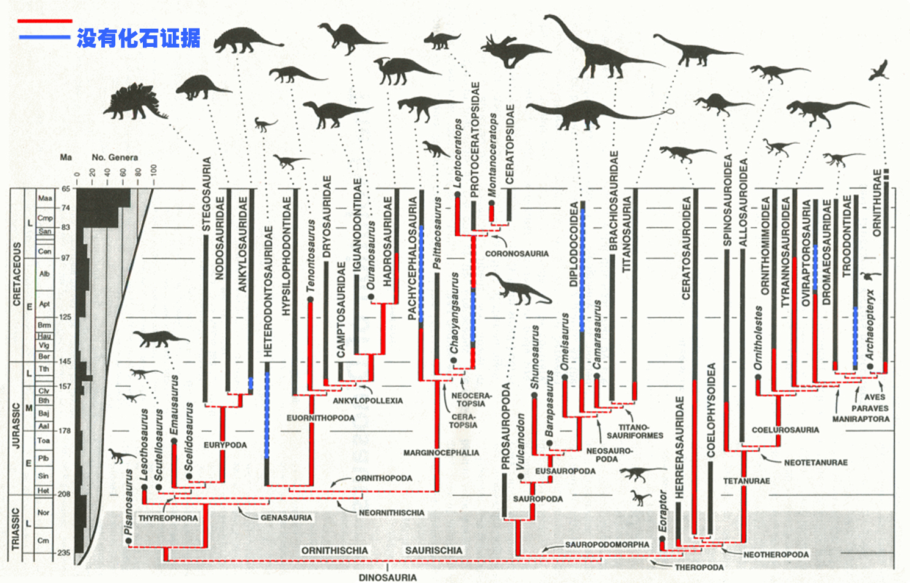
创造的证据：化石记录 『恐龙的进化』《科学》杂志1999年
Dino fossil record: Chart 2
Notes:
Jian4Long2 剑龙 Triceratops
Now let’s erase the imaginary part of the diagram (the red and blue).

Slide 9
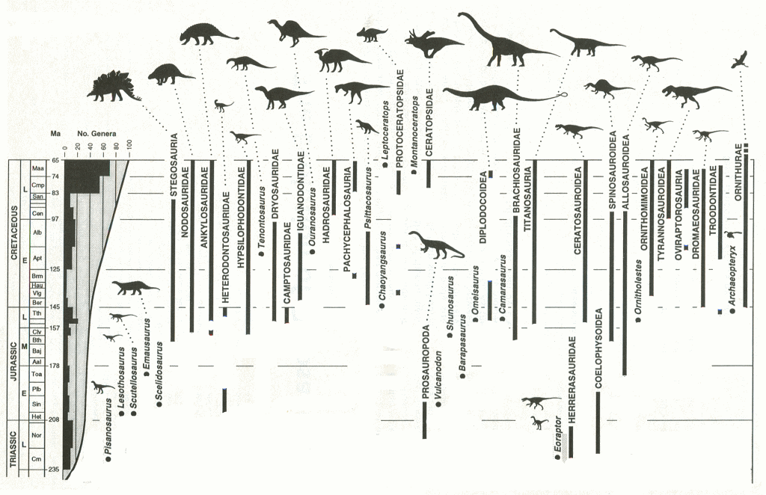
创造的证据：化石记录 『恐龙的进化』《科学》杂志1999年
Dino fossil record: Chart 3
Notes:
Jian4Long2 剑龙 Triceratops
We don’t have a dinosaur family tree any more. In other words, evolution is not based on fossil evidence but imagination. The evolutionists cannot claim that there are not enough fossils to show the family tree because there are thousands of fossils of the different types of dinosaurs. There should be many thousands that show the family tree (evolution). They are not there because evolution did not happen.

Slide 10
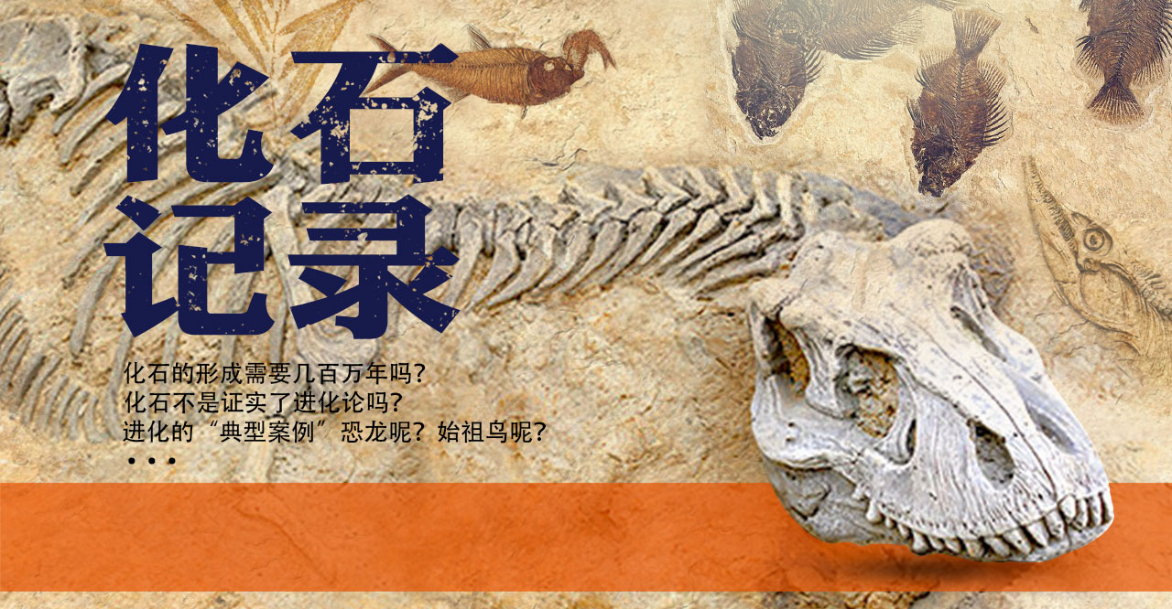
《化石记录》回播
5月2日 19:30 准时开讲
会议号：768-8131-2546 密码：7AiVf5

Slide 11
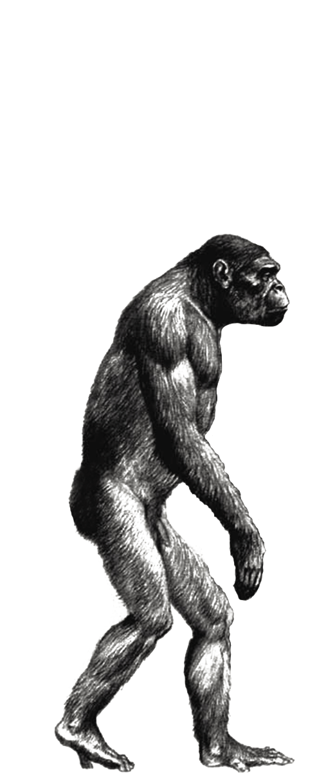
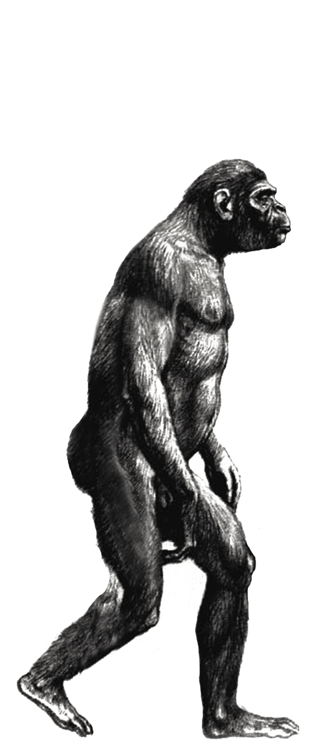
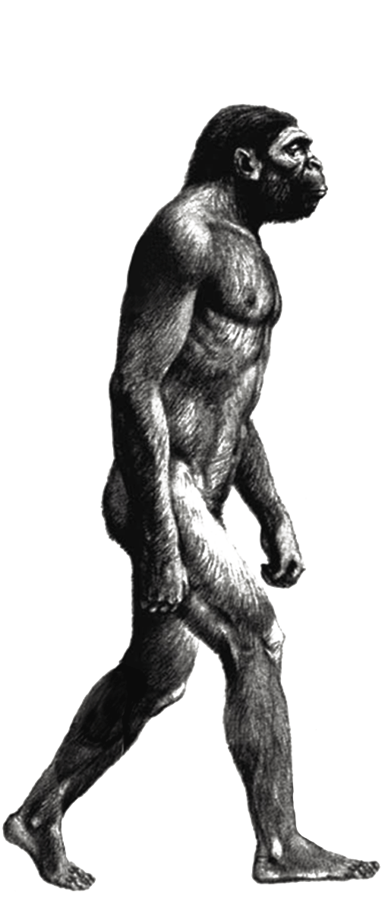
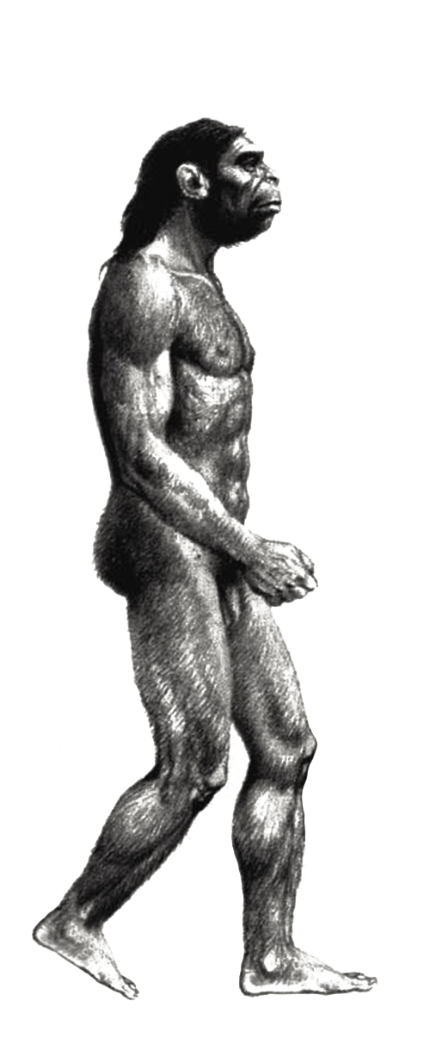
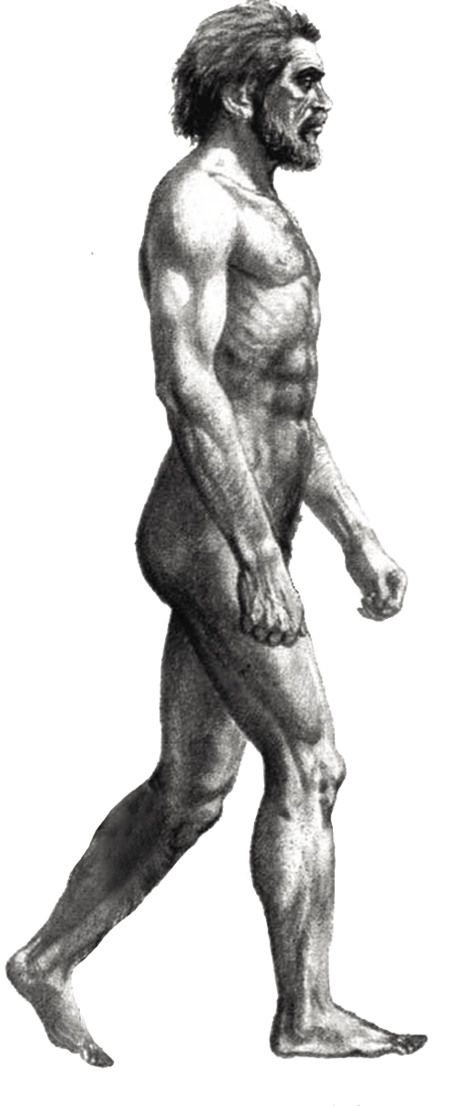
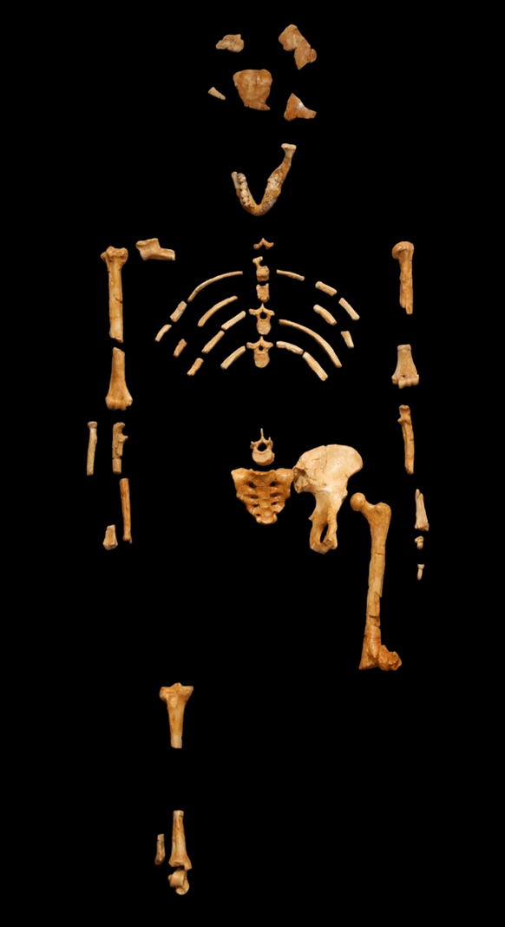
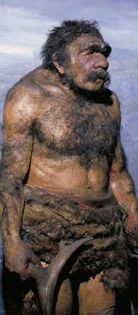
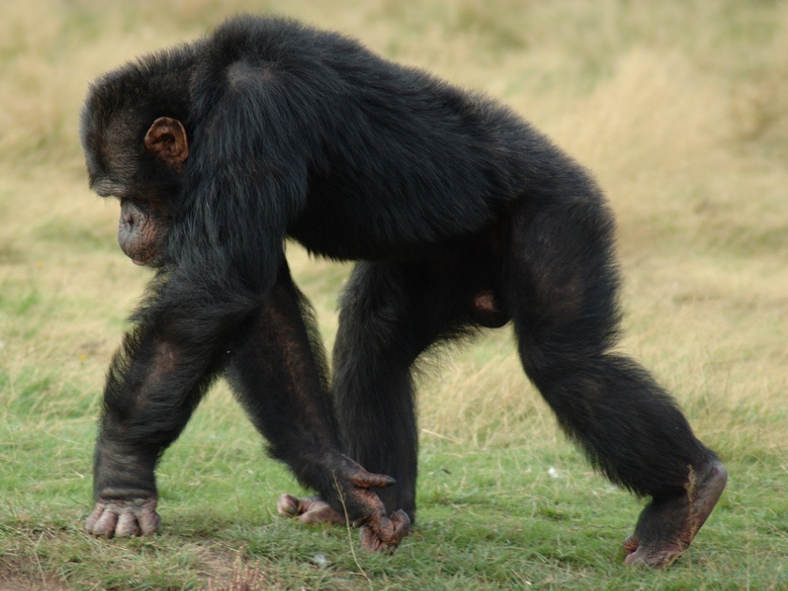
化石记录中的事实：有猿猴，有人，没有第三种
猿 猴
人 类
原上猿
腊玛古猿
南方古猿
直立猿人
尼安德特
现代人

Slide 12
人类 / 黑猩猩 基因相似度
Human vs. chimp DNA
1980: 98-99% based on several proteins
2002: 94-96% based on 0.03% of genome
2003: 87% based on 0.06% of genome
2005: <75% based on entire genome
Reality: probably 70% or less!
30% difference ≈ 八亿个基因“字母”（核苷酸）
二十万页英文文字有约八亿个字母和空格
实际情况：可能70%或更少！
30% 的区别 ≈ 八亿个基因“字母”(核苷酸)
二十万页英文文字有约八亿个字母和空格
八亿个区别！
Notes:
核苷酸 He2Gan1Suan1
1980: 98-99% based on several proteins
2002: 94-96% based on 0.03% of genome
2003: 87% based on 0.06% of genome
2005: <75% based on entire genome
Reality: probably 70% or less!
30% difference ≈ 八亿个基因“字母”（核苷酸）
二十万页英文文字有约八亿个字母和空格
Above does NOT include chimp excess over human, now estimated at 8% = ~250M more nucleotides. Britannica volume = c.1,000 very large pages, c. 1.375M words.
Best ref. for details: Jay L. Wile’s blogpost Chimp genome 99%_ 95%_ 87%_ 70%_ How Similar is the Human Genome to the Chimpanzee Genome_ _ Proslogion.html, on TK HD.
Also see: Acts&Facts 47(10) Oct 2018 p16 Jeffery Tomkins “New Chimp Genome…” Based on latest, more accurate 2018 evol’s sequencing (Science 360:6393), evol. Richard Buggs: “the percentage of nucleotides in the human genome that had one-to-one exact matches in the chimpanzee genome was 84.38%” AND “4.06% had no alignment to the chimp assembly” [this presumably IN ADDITION TO the 15.62% which did not have one-to-one matches; that’s how Tompkins interprets it.] Thus have evol admitting ~20% difference in 2018.

Slide 13
《猿人》回播
4月30日 19:30 准时开讲

Slide 14
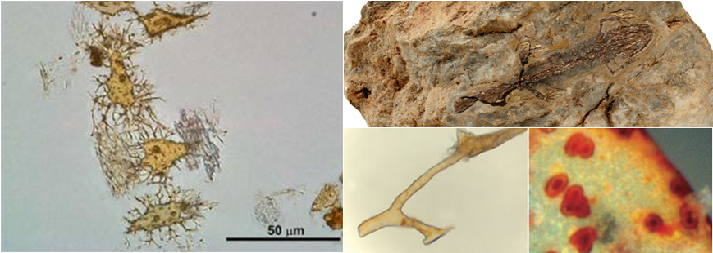
生物衰减计时器
柔软的血管、血红细胞、蛋白质、DNA……
这都说明不仅这些化石是年轻的
而且掩埋它们的岩层也是年轻的！
Notes:
掩埋 Yan3 Mai2
Rock Layer: 岩层、岩石层；Rock: 岩石. NOT 石岩

Slide 15
地表侵蚀：太快
目前，大陆平均高度是海拔623米
观测到的平均侵蚀率是6.1cm/1000年
根据现在侵蚀率，在不到一千五百万年的时间内，大陆将被侵蚀至海平面。
Notes:
侵蚀 Qin1Shi2
海拔 Hai3 Ba2

Slide 16
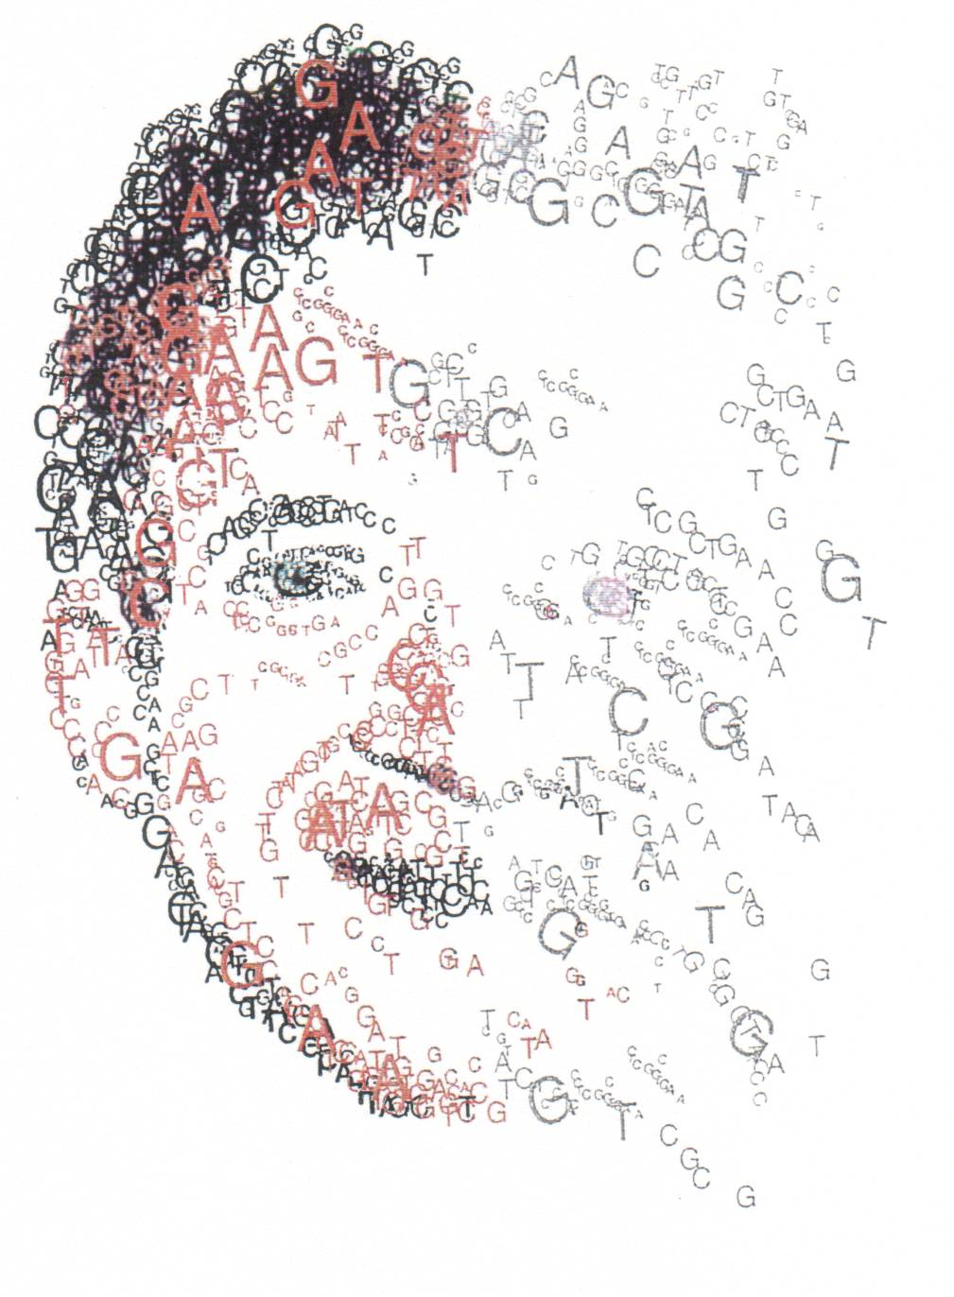
基因熵：破坏DNA，破坏结构的功能
每一个人每一代的新突变不少于100个！
每人有几万个有害突变
我们会给后代增加超过100个新的突变
5% 的新生儿携带基因疾病 (澳洲卫生部网站 2009.11)
Notes:
There are >100 new mutations per person per generation!
Each of us have tens of thousands of bad mutations.
5% of babies - born with a genetic disease. (Australian Department of Health website September 2009)
16

Slide 17
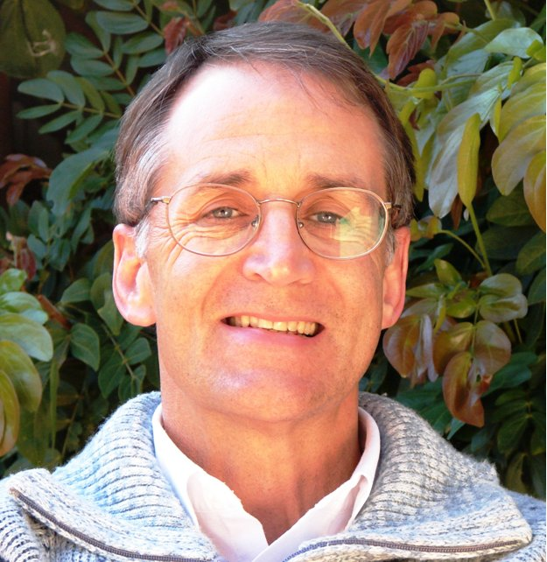
基因熵：不断积累的突变表示地球是年轻的
“即使有激烈选择压力，进化之路也是歧途——直奔灭绝！……总之达尔文理论全面失败……所有高级物种的基因组肯定明显在退化……[这]有力地证明生命和人类一定是年轻的。”
圣弗德2008年采访creation.com/sanford
积累的突变在不到一百万年中导致物种灭绝
结论：无论是人还是猿都不可能在地球上生活超过一百万年！
Notes:
歧途 qi2tu2 (wrong road)
采访 cai3fang3
Our declining genes “Even with intense selection, evolution is going the wrong way—toward extinction! … The bottom line is that Darwinian theory fails on every level … all higher genomes must clearly degenerate. … [This is] powerful evidence that life and mankind must be young.”
Accumulated mutations will cause extinction in less than a million years.
Conclusion: neither humans nor apes have been on earth for a million years!
17

Slide 18
5月16日:年轻地球的证据 & 5月19日:放射性测年代法与碳14
会议号:768-8131-2546
会议号:768-8131-2546
5月12日 19:30 准时开讲

Slide 19
但如果事实是 创造论 是 显然的，
而且，很 进化论 是错误的，
那么 ，为什么这么多 “科学家”相信进化论？

Slide 20
“科学家”是什么样的人？

Slide 21
我们脑海中对“科学家”的概念：
没有偏见
已经证实过的才相信
严谨地检验所有的假设
总会“实事求是”：
随时愿意跟着新的发现
改变他们的想法
Notes:
no biases; believe things based on evidence; rigorously test hypotheses; ready to change his opinions anytime based on new findings

Slide 22
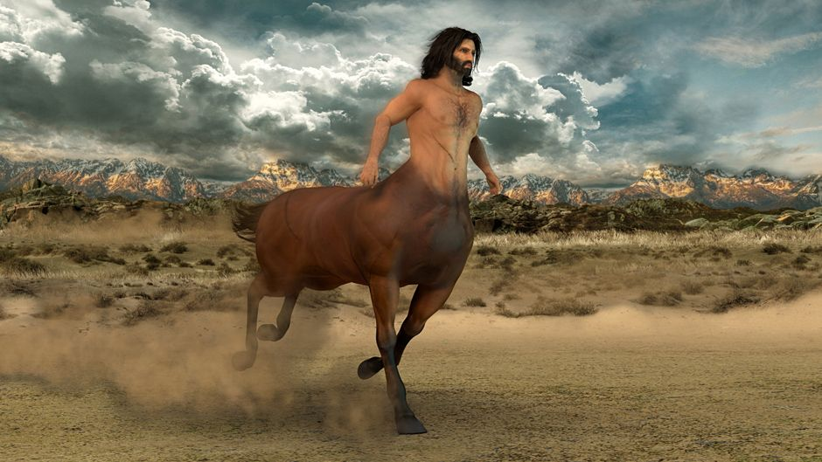
半人半马的神话
人首马身的怪物 ：只存在于想象中！

Slide 23
科学家的神话：半人半电脑
长着电脑的头，又有人的身体，这样的怪物只存在于想象中！
Notes:
长着 Zhang3zhe

Slide 24
科学家的真实面目
99.999%的他所知道或相信的是基于权威（课本、刊物等）
有一个解释框架（世界观、前设）
一般不会质疑他的解释框架，甚至不会意识到
按照此思想框架来解释证据
Notes:
99.999% of beliefs are based on authority (textbooks, journals, etc.); holds an interpretive framework (presuppositions, world view); usually does not question it—often is not even aware of it; interprets evidence in terms of the framework

Slide 25
为什么 如此多的“科学家” (和其他人)都相信进化论?
大部分科学家相信进化论是因为他们曾受过的教育使他们接受进化论、年老地球论的世界观。
进化论的发起者和积极推动者正在寻找一种没有神的解释生命和宇宙起源的方法。

Slide 26
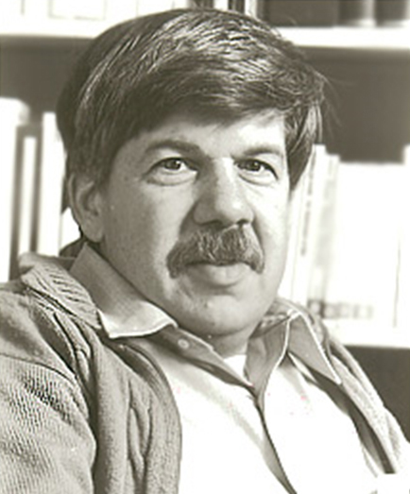
观察到的“事实”（证据）需要解释
事实并不会为自己说话；它们只会按照理论被解读。科学跟艺术领域一样，创新思维能促使观念发生改变。科学就是一种典型的人类活动，它并非是一种机械的、如同机器人般的客观信息积累，通过逻辑规律的引导得到必然的解释。
“The validation of continental drift” in Ever Since Darwin, Burnett Books, 1978 p.61–162.
哈佛大学古生物学家史蒂芬•古尔德
（进化论者，反抗创造论）
Notes:
“Facts do not ‘speak for themselves’; they are read in the light of theory. Creative thought, in science as much as in the arts, is the motor of changing opinion. Science is a quintessentially human activity, not a mechanized, robot-like accumulation of objective information, leading by laws of logic to inescapable interpretation.”

Slide 27
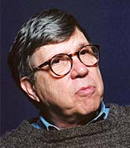
进化论者利用的解释框架：唯物论、无神论
尽管科学的某些架构明显荒谬；尽管科学未能实现其对健康和长寿的奢侈承诺；甚至，尽管科学容忍科学界一些未经证实的不靠谱的故事，但我们依然坚持站在科学的那一边，因为我们有将自然主义奉行到底的先行决定。
Lewontin, Richard. “Billions and Billions of Demons.” The New York Review January 9, 1997, 31
Notes:
We take the side of science in spite of the patent absurdity of some of its constructs, in spite of its failure to fulfill many of its extravagant promises of health and life, in spite of the tolerance of the scientific community for unsubstantiated just-so stories, because we have a prior commitment, a commitment to naturalism. It is not that the methods and institutions of science somehow compel us to accept a material explanation of the phenomenal world, but, on the contrary, that we are forced by our a priori adherence to material causes to create an apparatus of investigation and a set of concepts that produce material explanations, no matter how counter-intuitive, no matter how mystifying to the uninitiated. Moreover, that materialism is absolute, for we cannot allow a Divine Foot in the door.

Slide 28
进化论者利用的解释框架：唯物论、无神论
并非科学方法或科学制度以某种方式迫使我们接受对这现象世界的唯物解释；相反，我们是受到遵守唯物起因这一事先假定的驱使，创立一系列产生唯物论解释的实验研究方法和观点；无论这些解释多么有悖直觉和常理，或多么困扰外行人。而且，这唯物主义是绝对的，因为我们不能允许一位神的脚踏进这门槛。
Lewontin, Richard. “Billions and Billions of Demons.” The New York Review January 9, 1997, 31
Notes:
We take the side of science in spite of the patent absurdity of some of its constructs, in spite of its failure to fulfill many of its extravagant promises of health and life, in spite of the tolerance of the scientific community for unsubstantiated just-so stories, because we have a prior commitment, a commitment to naturalism. It is not that the methods and institutions of science somehow compel us to accept a material explanation of the phenomenal world, but, on the contrary, that we are forced by our a priori adherence to material causes to create an apparatus of investigation and a set of concepts that produce material explanations, no matter how counter-intuitive, no matter how mystifying to the uninitiated. Moreover, that materialism is absolute, for we cannot allow a Divine Foot in the door.

Slide 29
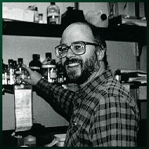
什么才算为科学？
Lewontin的定义：符合唯物论和无神论 才算为“科学”
对比生化学家Michael Behe博士的定义：
“[科学是]竭力尝试对物质世界做出真实解释的。”
Michael J. Behe 达尔文的黑匣子 Darwin‘s Black Box: The Biochemical Challenge to Evolution. Free Press, 1998. 240页；中文版225页。

Slide 30
唯物论的偏见
“即使所有数据都指向一个智慧的创造者，但这样一个假设要从科学中剔除掉，因为它不符合自然主义（唯物论）的观点”
Kansas State University immunologist Scott Todd, correspondence to Nature 410 (6752):423, 30 Sept. 1999.
Notes:
“Even if all the data point to an intelligent designer, such an hypothesis is excluded from science because it is not naturalistic.” Kansas State University immunologist Scott Todd,
correspondence to Nature 410 (6752):423, 30 Sept. 1999.

Slide 31
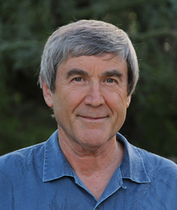
即便不合理，指定答案也只能是：唯物论、无神论
保罗 ‧ 戴维斯(Paul Davies)教授是进化论者、天体生物学家，寻找外星生命。他说：
“大部份细胞的运作，最贴切地不是用物质——硬件——来形容，而是用信息或软件来形容。”《卫报》The Guardian 2002年12月11日
他承认：
“在物理学中还没有一个已知的定律能让信息从无到有地出现……”New Scientist, 163(2204):27-30, 1999年09月18日
Notes:
贴切 tie1qie4 apt, appropriate
Even if it makes no sense,the answer must be: Naturalism, Atheism.
Prof. Paul Davies is an evolutionist and an astrobiologist seeking for life in outer space. He said:
“Most of the workings of the cell are best described not in terms of material stuff—hardware—but as information, or software.” The Guardian 2002-12-11
He admits: “There is no known law of physics able to create information from nothing …” New Scientist, 163 (2204):27–30 18 September 1999

Slide 32
即便不合理，指定答案也只能是：唯物论、无神论
他又承认：
“没有人知道一堆无生命的化学物质怎么偶然聚合形成了第一个活细胞.........那些笨拙的原子是怎么随机编写出自己的软件的？” New Scientist, 179(2403):32, 2003年07月12日
不过他只能够问“怎么”，他总不能质疑生命是否偶然进化出来！
Notes:
Even if it makes no sense,the answer must be: Naturalism, Atheism.
He also admits: “Nobody knows how a mixture of lifeless chemicals spontaneously organised themselves into the first living cell… How did stupid atoms spontaneously write their own software?” New Scientist 179(2403):32, 12 July, 2003
But he can only ask “how”—he never questions whether it actually happened!

Slide 33
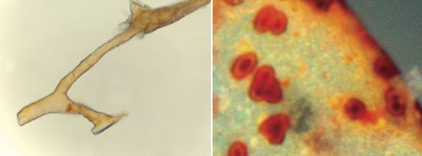
思想框架使进化论者看不到面前证据的意义
Notes:
Blindfold vb 蒙住眼睛; n: 眼罩 yan3zhao4
Mental frameworks blind evolutionists to the implications of the evidence

Slide 34
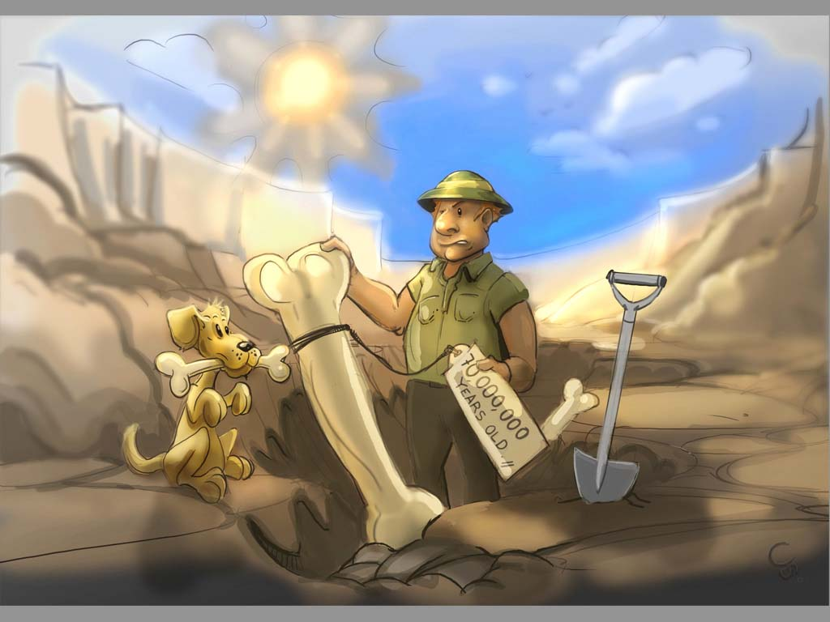
对过往历史的预设
解释
现观察到的证据
Notes:
Biao1Qian1 标签 tag, label

Slide 35
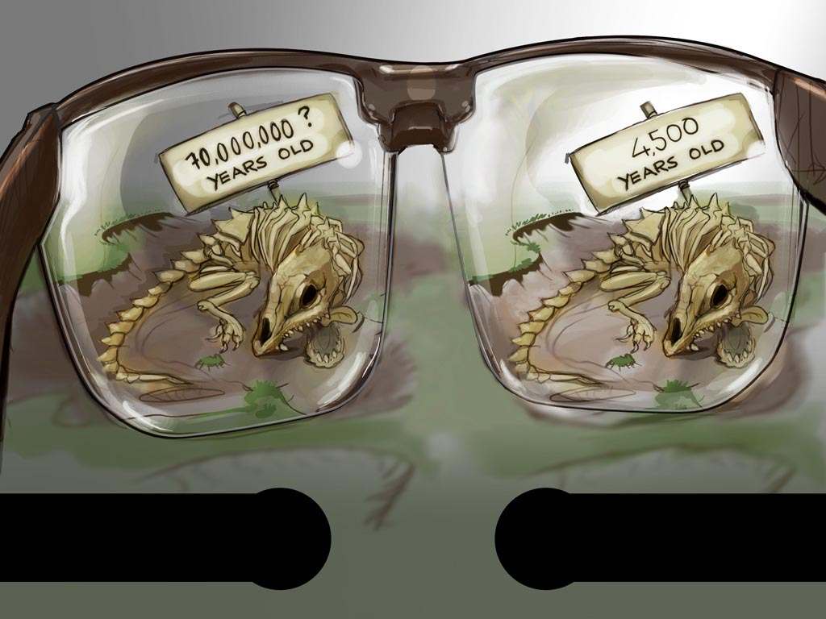
7000 0000年?
4500年?
世俗化的历史
圣经的历史
Notes:
Secular history vs biblical history
There are different ways of looking at the same facts. The facts are the rocks and fossils that exist in the present. The stories we make up to explain how they came to be there are not facts, but interpretations. The world view or philosophical outlook that we bring affects the stories that we think up to explain the facts. No one is without a world-view, so no one is unbiased or neutral, in how we deal with the facts.

Slide 36
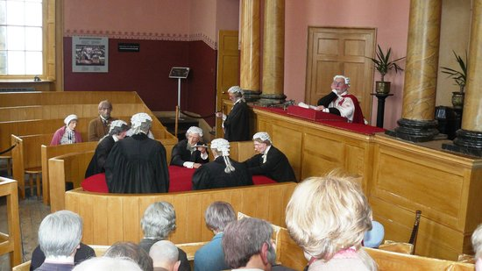
同一套数据，不同的解释
Notes:
起诉方 prosecution
辩护方defense
Same data – different interpretations
Prosecution interprets the data to show the accused is guilty
Defence interprets the same data to show the accused is innocent
起诉方将证据解释为对被告的罪证
辩护方将同样的证据解释为证明被告无罪的证据
But what if there was a reliable EYE WITNESS?

Slide 37
解释框架（世界观）
进化论
数十亿年
随机过程
从头开始一直有死亡
从分子到人类
从恐龙到鸟类
等等…
Notes:
We see the world through the ‘glasses’ of our belief system or worldview. Influenced by BELIEFS, PEER PRESSURE etc For example, if we believe in evolution, then we see the world with evolutionised glasses.

Slide 38
解释框架（世界观）
进化论
数十亿年
随机过程
从头开始一直有死亡
从分子到人类
从恐龙到鸟类
等等…
更换眼镜……
Notes:
We need to change the glasses we wear

Slide 39
解释框架（世界观）
……从新观察客观的证据
更换眼镜……

Slide 40
解释框架（世界观）
创造论、
年轻地球论
数千年
堕落之前没有死亡
物种被造各从其类
恐龙和人类共存过
挪亚洪水
等等……
Notes:
We see the same data but interpret it very differently.

Slide 41
解释框架（世界观）
更换眼镜，从新观察……
……就会发现：
客观的证据符合神在圣经中给人类的启示

Slide 42
提醒：不可走“信仰主义”的错路！
我们不是说，“随便选择你喜欢的前设或解释框架，然后就得到你喜欢的结论”
创造论和年轻地球论有足够的证据证明其真实性
进化论与公认的自然规律有明显的冲突
可是，除非人愿意承认并质疑自己的思想框架，否则就不能脱离错误的理解
大部分科学家不愿意考虑
Notes:
We’re not saying “choose whatever presuppostions or framework you like, then you can get the conclusions you want”
Creationism and YE have ample evidence
Evolution has obvious contractions with known physical laws
BUT, ppl won’t be able to escape false theories unless they admit their mental framework and are willing to question it.
Most scientists aren’t willing

Slide 43
唯物论这种“思想紧身衣”，从哪儿而来？
Notes:
紧身衣 jin3shen1 yi1
约束衣 yue1shu4 yi1 (also used)
Where did this mental “straightjacket” come from?

Slide 44
古希腊、罗马哲学家：年老地球论和进化论
约公元前610‑546安娜西曼德(Anaximander)：
人类是从鱼类演变来的，鱼类又是从海里的黏液变来的
约公元前450恩培多克勒(Empedocles)：
随机突变，自然选择，适者生存
公元前460‑361德谟克利特(Democritus)：
永恒宇宙、无限空间
Notes:
黏液 Nian2Ye4 【also：粘液】
Ancient Greek and Roman philosophers postulated long ages and evolution

Slide 45
古希腊、罗马哲学家：年老地球论和进化论
公元前341‑270伊壁鸠鲁(Epicurus)：
明确的无神论
公元23‑79老普林尼(Pliny the Elder)：
“我们如此地依赖于随机以至随机已经代替了上帝的位置”
Notes:
Ancient Greek and Roman philosophers postulated long ages and evolution

Slide 46
圣经产生新的世界观
基督教变成西方文化主导思想
圣经世界观取代了其他宗教和哲学，包括淘汰偶像崇拜、年老地球论、进化论
Notes:
Christianity came to dominate the West. It replaced various pagan religions and philosophies, including idol worship, long ages and evolution

Slide 47
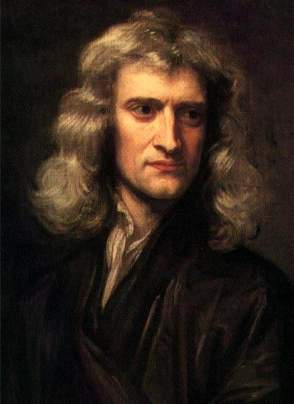
圣经世界观引导现代科学
绝大部分人，包括科学家，拥有圣经性的世界观和解释框架
在此情况下，西方发展出现代科学
牛顿
Notes:
Most ppl held a Biblical worldview. Modern science developed under this worldview (Newton pic)。

Slide 48
启蒙期哲学家拒绝基督教
18世纪，所谓“启蒙运动”哲学家拒绝圣经，想把上帝淘汰掉：
需要办法在没有创造者的情况下解释宇宙、地球、生物的来源
他们热衷于阅读古希腊和古罗马的书籍
他们开始复兴古代人年老地球论和进化论的概念
Notes:
热衷于 Re4 Zhong1 Yu2
In the 18th cen., philosophers of the so-called “Enlightenment” rejected the Bible and wanted to get rid of God. They needed a way to explain the universe, earth, living things without God. They enthusiastically read the ancient Greeks and Romans. They began to revive the ancient ideas of old earth and evolution

Slide 49
罗马书1:18原来神的愤怒，从天上显明在一切不虔、不义的人身上，就是那些行不义，阻挡真理的人。19神的事情，人所能知道的，原显明在人心里，因为神已经给他们显明；20自从造天地以来，神的永能和神性是明明可知的，虽是眼不能见，但藉著所造之物，就可以晓得，叫人无可推诿。

Slide 50
西方中最积极的推动进化论的人：
想要做任何他们想做的事……
死后不想面对他们的罪带来的审判……
因此，他们不想要有真神上帝存在……
Notes:
Strongest promoters of evol in the West:
Want to be able to do whatever they wish
Don’t want to face judgment after death
THEREFORE don’t want God to exist

Slide 51
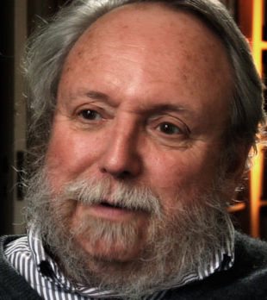
进化论是宗教
“进化论并不仅仅作为单纯的科学被其实践者推崇。进化论作为一个思想体系、一个世俗宗教 ——一个有意义和有道德观的全面的基督信仰替代品。……进化论是宗教。进化论在一开始就是这样，一直到今天也是如此。”
无神论者和进化论者Michael Ruse 博士，哲学和动物学教授，University of Guelph， Canada
National Post, May 13, 2000, pp. B1,B3,B7.
Notes:
实践者 practitioners (ck’d)
(被）推崇 tui1chong2 praise highly, value, admire (be esteemed as)
Evolution is a Religion. ‘Evolution is promoted by its practitioners as more than mere science. Evolution is promulgated as an ideology, a secular religion—a full-fledged alternative to Christianity, with meaning and morality. … Evolution is a religion. This was true of evolution in the beginning, and it is true of evolution still today.’
The issue is not SCIENCE VERSUS RELIGION as it is so often portrayed.
Rather, we are talking about the SCIENCE OF ONE RELIGION VERSUS THE SCIENCE OF ANOTHER.

Slide 52
1778 | 蒲丰 Buffon | 自然神论 | 冷却地球 | 75000 (一百万)年
1794 | 伊拉斯莫斯·达尔文 | 自然神论/无神论 | 生物近乎 | 长时论
1795 | 赫顿 Hutton | 自然神论/无神论 | 均变论 (古今一致论) | 没有起点(永恒宇宙)
1796 | 拉布拉斯 Laplace | 无神论 | 星云假说 | 长时论
1809 | 拉马克 Lamark | 自然神论/无神论 | 生物进化 | 长时论
1812 | 居维叶 Cuvier | 自然神论 | 灾变论 | 长时论
1833 | 莱尔 Lyell | 自然神论 | 均变论 (古今一致论) | 长时论
1778 蒲丰 自然神论 冷却地球 75000 (一百万)年 Buffon Deist Cooling earth 75000 (一百万)年
1795 赫顿 自然神论/无神论 均变论 没有起点(永恒宇宙) Hutton Deist / Atheist Uniformitarian Eternal universe
1796 拉布拉斯 无神论 星云假说， 长时论 Laplace Atheist Nebular hypothesis Long ages
1809 拉马克 自然神论/无神论 生物进化 长时论 Lamark Deist / Atheist Biological evolution Long ages
1812 居维叶 自然神论 灾变论 长时论 Cuvier Deist Multiple catastrophies Long ages
1833 莱尔 自然神论 均变论 长时论 Lyell Deist Uniformitarian Long ages
Notes:
USED 2019.10 BUT NOT EFFECTIVE, AS KK CONFIRMED. Buffon's private notes indicate that he thought the earth was actually about a million years old, but he never published this as the Catholic Church already felt his 75,000 year estimate to be in conflict with Scripture.

Slide 53
1、地质学：年老地球论

Slide 54
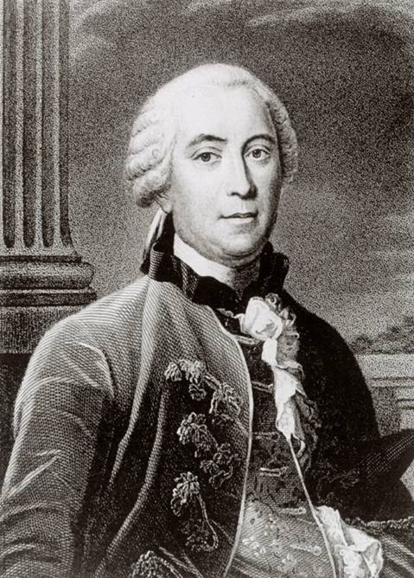
蒲丰 (Buffon) 1707-88
自然神论
在75000 到一百万年中渐渐冷却的地球
《自然的纪期》(Epochs of Nature) ,1778年
Notes:
蒲丰 Pu2 Feng1
渐渐 Jian4 Jian4
Source: Ian Taylor Wide-ranging scientist with writings in mathematics, zoology, botany, astronomy and physics Based on cooling experiments with various metal balls he estimated that the earth was about 75,000 years old. But based on his limited knowledge of sedimentary rocks he estimated as long as 3 million years for the formation of the earth (the latter figure was only in his manuscript—the published version of the book had the lower number). Though he attempted to say that his seven epochs of earth history could be seven figurative days of creation, his views were not even acceptable to the Catholic authorities in France, who forced him to recant in writing everything in his works that contradicted the Biblical account of creation.
He believed that a comet slammed into the sun breaking off material that became the planets. Part of the early earth broke off to become our moon. He believed in spontaneous generation of the first forms of life.
Comparing a metal ball to the earth to estimate age is like comparing bananas to alligators. Both are long and narrow. A banana reaches its full size in about 3**** months and since the alligator is about 25**** times longer than a banana it must take 12.5**** years for the alligator to reach full size. In fact, it takes ******

Slide 55
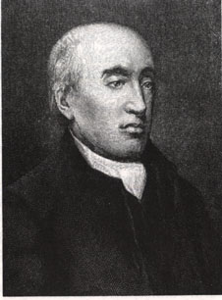
詹姆斯‧赫顿 (James Hutton) 1726-97
自然神论者，私下可能是无神论者
认为宇宙永恒，无始无终
《地质学理论》(Theory of Earth) ，1795年
Notes:
赫顿 He4Dun4

Slide 56
詹姆斯‧赫顿 (James Hutton) 1726-97
“必须通过现在能看到的事物来解释我们地球的历史......我们不能用不属于地球本来所有的力量，也不能使用除了我们知晓的规律以外的任何其它作用。”
詹姆斯 ·赫顿，引用于Aurther Holmes, Principles of Physical Geology (UK: Thomas Nelson & Sons Ltd., 1965), pp. 43–44.
“均变论”（古今一致论）：这个原则没有科学研究根据，纯粹是他的哲学和宗教观！
Notes:
“The past history of our globe must be explained by what can be seen to be happening now. ... No powers are to be employed that are not natural to the globe, no action to be admitted except those of which we know the principle.” James Hutton, quoted in Arthur Holmes, Principles of Physical Geology (UK: Thomas Nelson & Sons Ltd., 1965), pp. 43–44.

Slide 57
詹姆斯‧赫顿 (James Hutton) 1726-97
“但普遍（全球）洪水应该不能在地球的理论之内；因为地球的目的很明显是维持蔬菜和动物的生活，而不是摧毁。”
詹姆斯·赫顿，《地球的理论》 (Edinburgh: William Creech, 1795), vol. 1, p. 273.
否认全球洪水是圣经早已预言过的！
Notes:
“But, surely, general deluges form no part of the theory of the earth; for, the purpose of this earth is evidently to maintain vegetable and animal life, and not to destroy them.” Section IV, chapter 3, paragraph 6, in the on-line version of this book. Chapter 3, section 3 in the book version

Slide 58
圣经预言“均变论”以及否认诺亚洪水
彼得后书3: 3第一要紧的，该知道在末世必有好讥诮的人，随从自己的私欲，出来讥诮说：4“主要降临的应许在哪里呢？因为从列祖睡了以来，万物与起初创造的时候仍是一样。”5他们故意忘记，从太古凭神的命有了天；并从水而出，藉水而成的地，6故此当时的世界被水淹没，就消灭了。
Notes:
讥诮 Ji1Qiao4

Slide 59
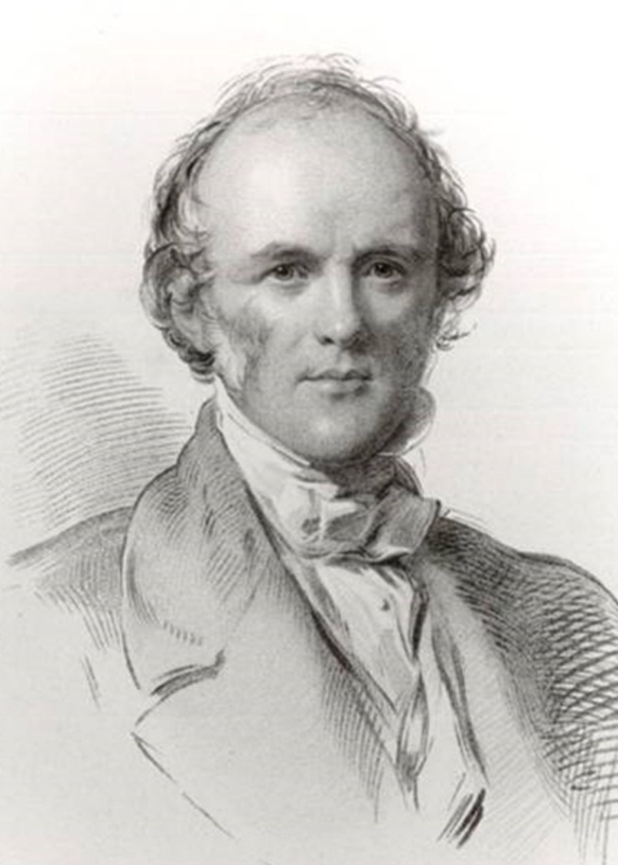
查尔斯‧莱尔 (Charles Lyell) 1797-1875
律师，自然神论者
变成地质学家：古今一致论(均变论)，长时论
《地质学原理》1830-33
“现在是认识过去的钥匙”
在一封致朋友的信中，莱尔说自己的目标是：“把科学从摩西那里解放出来。”
Notes:
In a letter to a friend, Lyell stated that his goal was “to free science from Moses”
Picture Source: Ian Taylor (via Mortenson)
From Yingguang’s PDF of his PPT:
I am sure you may get into Q.R. [Quarterly Review] what will free the science from Moses, for if treated seriously, the [church] party are quite prepared for it. --Lyell
◆ 相信您读了《每季综述》，会发现我的文章能将科学从摩西解放出来，这如果得到正视，教会也完全可以接受。——莱尔
However, the basis for Lyell's chronology was not science, but rather a long-standing animus of the Word of God in general, and the chronology of Moses in particular. Lyell in fact altered data in an attempt to make his dating scheme appear reasonable (Taylor, 1987, pp. 82-83).
Lyell was by training a lawyer, or in the terminology of the time, a barrister, a fact formally acknowledged in the title of the memorial volumes published after his death (Lyell, 1881, vol. 1, p. iii; vol. 2, p iii). Lyell's real "hidden agenda" was revealed in private correspondence with colleagues and friends. He wrote that he had "driven" the biblical Flood "out of the Mosaic record" (Lyell, 1881, vol. 1, p. 253). He also revealed his plan for undermining the Bible. He would not make a frontal attack against the Scripture, but "conceived the idea ... that if ever the Mosaic chronology could be set down [discredited] without giving offense, it would be in an historical sketch ..."(Lyell, 1881, vol. 1, p. 271). Lyell's reference to "an historical sketch" meant a work about "historical geology" written from an evolutionary viewpoint. His well known Principles of Geology was the fulfillment of this plan.
(Henry JF 2003:169-170.) Henry, Jonathan F. 2003. “An Old Age for the Earth is the Heart of Evolution” CRSQ 40(Dec 2003): 164-172.

Slide 60
莱尔稍微透露了他的动机
“一个优秀的作家和造诣深厚的地质学家说了一句话，给我留下很深的印象：‘为了（圣经的）启示以及科学的好处，甚至为了各类的真理的好处，地质学涉及实地研究的部分应该在视圣经不存在的情况下进行研究。’”
1832年，查尔斯·莱尔的报告 M.J.S. Rudwick, “Charles Lyell Speaks in the Lecture Theatre,” Brit. J. Hist. Sci., IX:2:32 (July 1976), p. 150.
Notes:
造诣 zao4yi4
“I have always been strongly impressed with the weight of an observation of an excellent writer and skillful geologist who said that ‘for the sake of revelation as well as of science—of truth in every form—the physical part of Geological inquiry ought to be conducted as if the Scriptures were not in existence’ ”
lecture at King's College London, 4 May 1832

Slide 61
莱尔有关尼亚加拉瀑布侵蚀的欺骗
当地人说：每年超过1米
莱尔断言、报告约30厘米
莱尔说需要35000年
事实：1.2到1.5米，需要少于12000年
过往水流比现在多，经过的岩层薄，实际上需要几千年而已
Notes:
瀑布 Bao4Bu4
Lyell’s Niagara Falls erosion deception. Lyell claimed 35,000 years for Niagara Falls erosion and this was instrumental in getting the church in the UK to capitulate to deep time and to abandon Ussher type chronology. But he ignored eyewitness accounts of the rate of erosion of >1 metre per year, which would have given <12,000 years (not enough for Lyell). More detailed measurements 1842–1927: 1.2–1.5 m/year. But taking into account the narrower gorge, thinner limestone layer providing less protection to the soft underlying shale, etc. then less than 4,000 years old.
Picture: CMI owns copyright (in our own library). creation.com/niagara-falls-and-the-bible
61

Slide 62
赫顿、莱尔：不可以有全球性洪水！
原来，大部分主流地质学承认洪水：
“挪亚大洪水这场大灾难，一直都被视为许多岩石现象的解释，尤其是岩石中的化石”
英国斯旺西大学(University College of Swansea) 地质学教授德里克‧阿格 Derek Ager,《地质学大全》Planet Earth, 185页, 1977年
在否认挪亚洪水时，赫顿、莱尔也否认任何“灾难性”地质过程。
Notes:
“The great catastrophe of Noah’s Flood was long seen as the explanation for most of the phenomena of the rocks, especially the fossils they contain.”
英国斯旺西大学(University College of Swansea) 地质学教授德里克‧阿格(Derek Ager) ,《地质学大全》（Planet Earth）, 185页, 1977
As part of denying global flood, Hutton & Lyell denied all catastrophic geological processes

Slide 63
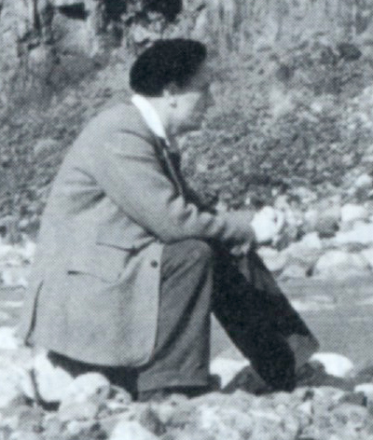
赫顿、莱尔：不可以有全球性洪水！
德里克‧阿格尔博士Derek Ager
主流地质学家，相信进化论和年老地球论，不相信全球洪水
厌恶创造论、年轻地球论
藐视创造论为假科学、反科学
同时还是承认一些“灾难性”的地质过程
承认赫顿、莱尔的纯碎“均变论”，“古今一致论”是错的
Notes:
Derek Ager (1923-1993), Professor and Head of the Geology Dept. at University College of Swansea (Wales) from 1969-1988 and president of the British Geological Association 1988-1990, continued in “retirement” as Emeritus Professor till his death in 1993. In his life he visited over 57 countries to look at rocks and wrote 200 papers and four books, as well as many short articles for New Scientist.
Warning to YEC not to use information from his book: Derek Ager, The New Catastrophism (Cambridge, UK: Cambridge Univ. Press, 1993), p. xi. Ager says (bold in the original): “On that side too were the obviously untenable views of bible-oriented fanatics, obsessed with myths such as Noah's flood, and of classicists thinking of Nemesis. That is why I think it necessary to include the following 'disclaimer': in view of the misuse that my words have been put to in the past, I wish to say that nothing in this book should be taken out of context and thought in any way to support the views of the 'creationists' (who I refuse to call 'scientific').”
In The Nature of the Stratigraphic Record, p. 20, he says:
“This is heady wine and has intoxicated palaeontologists since the days when they could blame it all on Noah's flood. In fact, books are still being published by the lunatic fringe with the same explanation. In case this book should be read by some fundamentalist searching for straws to prop up his prejudices, let me state categorically that all my experience (such as it is) has led me to an unqualified acceptance of evolution by natural selection as a sufficient explanation for what I have seen in the fossil record. I find divine creation, or several such creations, a completely unnecessary hypothesis. Nevertheless this is not to deny that there are some very curious features about the fossil record.”

Slide 64
阿格尔：地质学走偏了
“我作为历史外行发表这段关于地质学史的冗长题外话是想说明地质学怎么落到理论家的手中，这些理论家，相比与野外考察，更多是受到了当时社会和政治情况的影响。换句话说，我们已允许自
己是被洗脑，避免在任何的历史解释中涉及极端的、可能被称之为‘灾变性’的地质过程。” Derek Ager, The Nature of the Stratigraphical Record (London: Macmillan, 1981), pp. 46-47.
Notes:
冗长 lengthy, verbose
“My excuse for this lengthy and amateur digression into history is that I have been trying to show how I think geology got into the hands of the theoreticians who were conditioned by the social and political history of their day more than by observations in the field. In other words, we have allowed ourselves to be brain-washed into avoiding any interpretation of the past that involves extreme and what might be termed 'catastrophic' processes.”
Derek Ager, The Nature of the Stratigraphical Record (London: Macmillan, 1981), pp. 46-47.
Derek Ager (1923-1993), Professor and Head of the Geology Dept. at University College of Swansea (Wales) from 1969-1988 and president of the British Geological Association 1988-1990, continued in “retirement” as Emeritus Professor till his death in 1993. In his life he visited over 57 countries to look at rocks and wrote 200 papers and four books, as well as many short articles for New Scientist.
Warning to YEC not to use information from his book: Derek Ager, The New Catastrophism (Cambridge, UK: Cambridge Univ. Press, 1993), p. xi. Ager says (bold in the original): “On that side too were the obviously untenable views of bible-oriented fanatics, obsessed with myths such as Noah's flood, and of classicists thinking of Nemesis. That is why I think it necessary to include the following 'disclaimer': in view of the misuse that my words have been put to in the past, I wish to say that nothing in this book should be taken out of context and thought in any way to support the views of the 'creationists' (who I refuse to call 'scientific').”
In The Nature of the Stratigraphic Record, p. 20, he says:
“This is heady wine and has intoxicated palaeontologists since the days when they could blame it all on Noah's flood. In fact, books are still being published by the lunatic fringe with the same explanation. In case this book should be read by some fundamentalist searching for straws to prop up his prejudices, let me state categorically that all my experience (such as it is) has led me to an unqualified acceptance of evolution by natural selection as a sufficient explanation for what I have seen in the fossil record. I find divine creation, or several such creations, a completely unnecessary hypothesis. Nevertheless this is not to deny that there are some very curious features about the fossil record.”

Slide 65
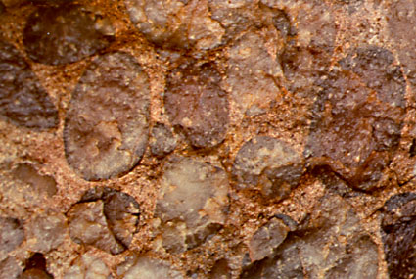
阿格尔：快形成的岩层
论到一个威尔士斯旺西镇 (Swansea, Wales)（阿格尔老家附近）的“侏罗纪早期”砾岩——“萨顿石”(Sutton Stone)：
“这通常被视为在数次海侵的过程中形成的底砾岩。在化石证据有限的情况下，有观点认为，这种砾岩覆盖了三到五个菊石带，因此形成时间可长达500万年。我认为这是在几分钟到几小时内沉积形成的。”
Derek Ager, The New Catastrophism (Cambridge: Cambridge Univ. Press, 1993), p. 120.
Notes:
Regarding “Sutton Stone,” a conglomerate labeled as “Early Jurassic” near Ager's home in Swansea, Wales:
This has usually been interpreted as the basal [bottom most] conglomerate of a diachronous [at different times] transgressive sea [ocean covering the land, in this case during several different very long periods across millions of years]. It has been suggested, with very little fossil evidence, that this conglomerate spans three to five ammonite zones and therefore up to five million years in time. I think it was deposited in a matter of hours or minutes.” Derek Ager, The New Catastrophism (Cambridge: Cambridge Univ. Press, 1993), p. 120.

Slide 66
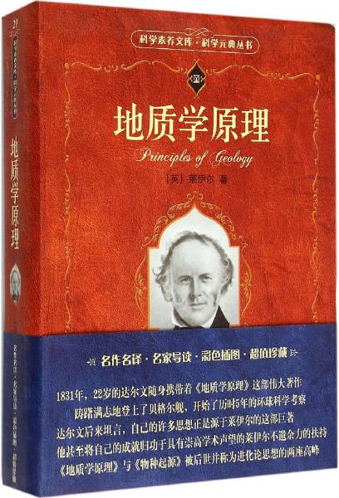
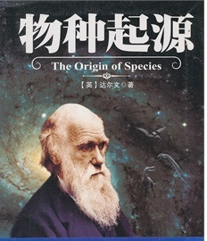
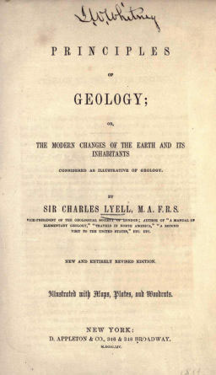
莱尔影响达尔文
“1831年，22岁的达尔文随身携带的《地质学原理》这部伟大著作，踌躇满志地登上了贝格尔舰，开始了历时5年的环球科学考察”
达尔文自己也承认，如果没有莱尔的年老地球论，他的进化论立不住脚。
Notes:
携带 Xie2Dai4
踌躇满志 Chou2Chu2 Man3Zhi4 hopefully, confidently, ambitiously
舰 Jian4

Slide 67
2、生物学：进化论

Slide 68
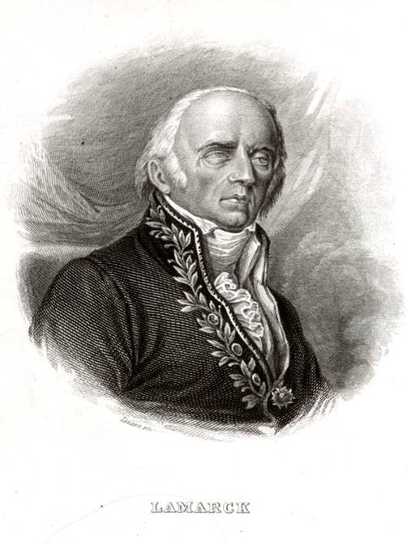
拉马克 (Lamark) 1744-1829
自然神论 / 无神论
生物进化，长时段
《动物学哲学》 (1809)
Notes:
Source: Ian Taylor

Slide 69
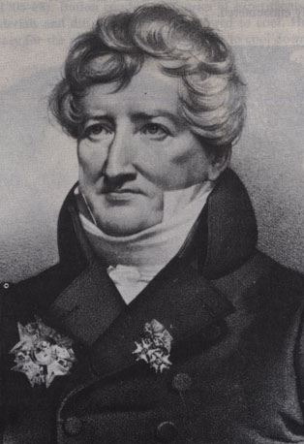
乔治‧居维叶 (Cuvier) 1769-1832
自然神论者
多次灾变，长时段
《地质理论》
(1812)
Notes:
Source: The Historical Perspective (Milton Keynes: Open University Press, 1973), p. 68.
He believed multiple local or regional catastrophes. All the animals were not killed in these events and creatures migrated in after the events to repopulate the flooded areas.

Slide 70
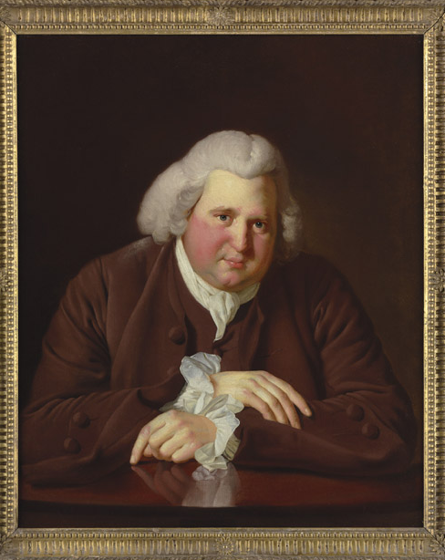
伊拉斯莫斯 ‧ 达尔文 (Erasmus Darwin) 1731-1802
医生，查尔斯·达尔文的爷爷
公开反对基督教
把“对地狱的恐惧”归为一种疾病
1794‑1796年出《生理学》(Zoonomia)一书
断言微生物是从海洋中的非生物随机产生的，经过数 百万年，逐渐进化为其他所有的生物形态，包括人类

Slide 71
进化论使达尔文离开基督教
“那么，我们能从达尔文自己的轨迹中吸取哪些关于宗教和进化论关系的教训呢？ 首先，他提出进化论的时候，他从相信一位有位格的神变成相信自然神论，又到不可知论。第二，他不能容忍在进化论中有任何神的介入，甚至神的计划。第三，他不认同宗教是道德的基础。因此，对于任何想要重新让达尔文带上宗教信仰的面具，称达尔文的进化论对宗教，尤其是基督教传统标准没有威胁，以上几点都是他的障碍。”
——历史学家 Richard Weikart
Notes:
“So, what lessons can we draw about the relationship between religion and evolutionary theory from Darwin’s own trajectory? First, as he developed his evolutionary theory, he moved from Christian belief in a personal God to a deistic position to agnosticism. … Second, he rejected any divine intervention or even divine purpose in his evolutionary scheme. Third, he rejected the religious basis for morality. None of these points is good news for those trying to refashion Darwin into a religious believer whose evolutionary theory is no threat to religion, especially to traditional forms of Christianity”
--Historian Richard Weikart

Slide 72
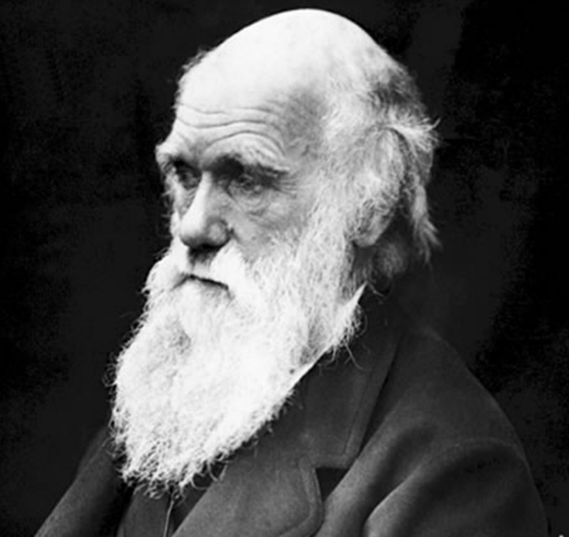
达尔文不希望圣经是真实的
“我的确难以想象为什么会有人希望基督教是真实的，如若果真如此，那圣经白纸黑字所说的非信徒，包括我的父亲、兄弟和几乎我所有的好友，他们的结局就是要受到永恒的惩罚，这是个可恶的教条。” (引自：达尔文的自传）

Slide 73
3、天文学

Slide 74
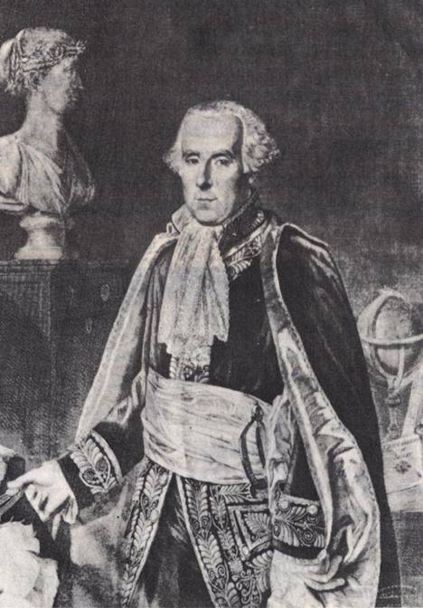
皮埃尔‧拉布拉斯 (Pierre LaPlace) 1749-1827
无神论
星云假说，长时段
《宇宙系统论》 (1796)
Notes:
Source: The Historical Perspective (Milton Keynes: Open University Press, 1973), p. 51.

Slide 75
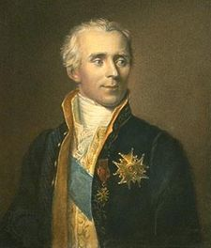
拉布拉斯见拿破仑
拿破仑：“在你的系统当中，上帝占什么位置？”
拉布拉斯：“我不需要这样的假设！”
Notes:
Quote and it’s meaning questioned, might only have meant he had solved the apparent problem of the instability of the solar system and did not need to suggest God’s occasional intervention, as Newton had. Original seemingly didn’t have LaPlace using word “God.”

Slide 76
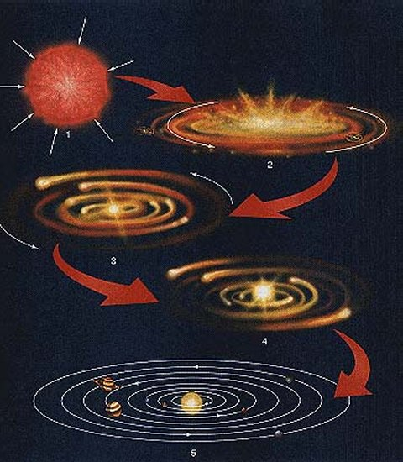
太阳系的起源：星云假说
据称：太阳和行星都是旋转的尘埃形成的。
实际上，太热、太快，磁场太强了，无法收缩
但是即便可以，所有的行星都应该按照同一个方向旋转：角动量守恒。
Notes:
行星 Xing2 Xing1 Planet
尘2 埃1
旋转 Xuan2 Zhuan3
角度量 Jiao3 Dong4 Liang4
http://www.aerospaceweb.org/question/astronomy/q0247.shtml, accessed 28 Feb 2008.

Slide 77
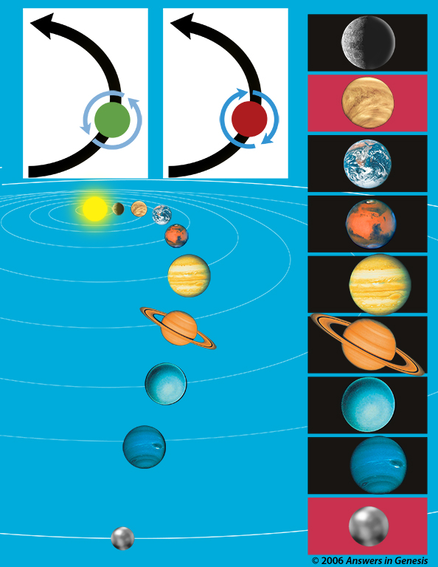
角动力
绕太阳
绕太阳
公转
公转
行星和卫星有太阳系1%的质量和98%的角动量
有些还是反着转的！
人们对此提出了很多假设，但是没有一个说得通
水星
行星的自转
行星的自转
金星
地球
火星
木星
土星
天王星
海王星
冥王星
Notes:
角动量 Jiao3 Dong4 Liang4
反3转3 Fan3 Zhuan3
Tiny planets and moons have 1% of mass and 98% of spin
Some even rotate backwards!
Some moons orbit their planets backwards
Various explanations suggested…none really work

Slide 78
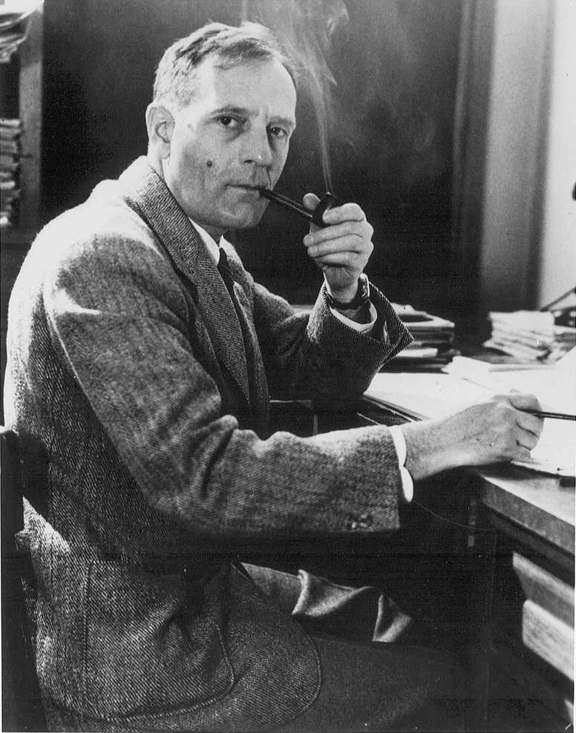
哈勃：位于宇宙的中心是不被许可的
埃德温·哈勃发现如果所有的
东西都是在飞离我们，那么我
们必须是在宇宙的中心：
“这个情况就意味着我们在宇
宙中占据了一个独特的位置……
但是我们必须不惜任何代价避
免这个不受欢迎的特殊位置假
说……这个特殊的位置，当然是不可接受的。不仅如此，它还与理论不符，因为理论要求的是均质性。”
Notes:
哈勃 Ha1 Bo2
Eric Hubble, discovered of redshifts and ‘founder’ of the Big Bang realized that an if everything is moving away from us, we must be near the center:
Hubble: We’re not allowed to be at the center
‘Such a condition would imply that we occupy a unique position in the universe … . But the unwelcome supposition of a favoured location must be avoided at all costs … . Such a favoured position, of course, is intolerable; moreover, it represents a discrepancy with the theory, because the theory postulates homogeneity.’

Slide 79
哈勃：位于宇宙的中心是不被许可的
为了解决这个问题：他发明了‘没有中心也没有边缘’的观点：
“所以，为了恢复均质性，逃避特殊位置的惊骇，也就是对均一性的偏离，这些都是由衰落因素引进的想法，必须由代表空间曲率的第二个术语所补偿。”
Hubble, E. Observational approach to cosmology, Clarendon Press, Oxford, pp. 50–59, 1937.
Notes:
惊骇 Jing1 Hai4
Eric Hubble, discovered of redshifts and ‘founder’ of the Big Bang realized that an if everything is moving away from us, we must be near the center:
Hubble: We’re not allowed to be at the center
‘Such a condition would imply that we occupy a unique position in the universe … . But the unwelcome supposition of a favoured location must be avoided at all costs … . Such a favoured position, of course, is intolerable; moreover, it represents a discrepancy with the theory, because the theory postulates homogeneity.’

Slide 80
哈勃：位于宇宙的中心是不被许可的
：
“无论哪个位置，每个观察者所看到的宇宙景象都是一样的。……这种说法纯粹是一个假设。
……然而，这种假设被采纳了。宇宙间必须不存在一个特殊的位置，没有中心，没有边界，宇宙各处看起来必须都是一模一样的。”
Notes:
“…all observers, regardless of location, will see the same general picture of the universe. …[This] principle is a sheer assumption.
…However, the assumption is adopted. There must be no favoured location in the universe, no centre, no boundary; all must see the universe alike.”

Slide 81
宇宙进化论
地质进化论
虚构！
生物进化论
都是建立在唯物论
哲学基础之上的假设
生命
地球
行星、
星系
恒星、
Notes:
虚构 Xu1 Gou4
Say that historically astronomical evolution and geological evolution laid the ground work for Darwin’s theory of biological evolution. Darwin used the same philosophical assumptions that the old-earth geologists and astronomers had used 50 years earlier to develop their theory of millions of years.

Slide 82
谢谢大家！
Notes:
大家好，欢迎来到今晚的在线课程。
今晚的内容是宇宙大爆炸与精细微调。

Slide 83
下来的大概不会用，除非是问答时间中

Slide 84
Stopped here 2019.10; c. 1½ hr

Slide 85
1800-1850年：教会中的妥协
在此之前，教会明白：
地球在几千年前新近的创造；
生命都是上帝直接创造的。
而此时，教会中的很多人，包括福音性信徒都已经开始妥协。
他们改变了他们对圣经的理解，将圣经与错误的“科学”融合。

Slide 86
为何会出现这样的转变？
福音性信徒向反对基督教的‘科学家’的错误妥协
这都始于1800之前，
达尔文之前……

Slide 87
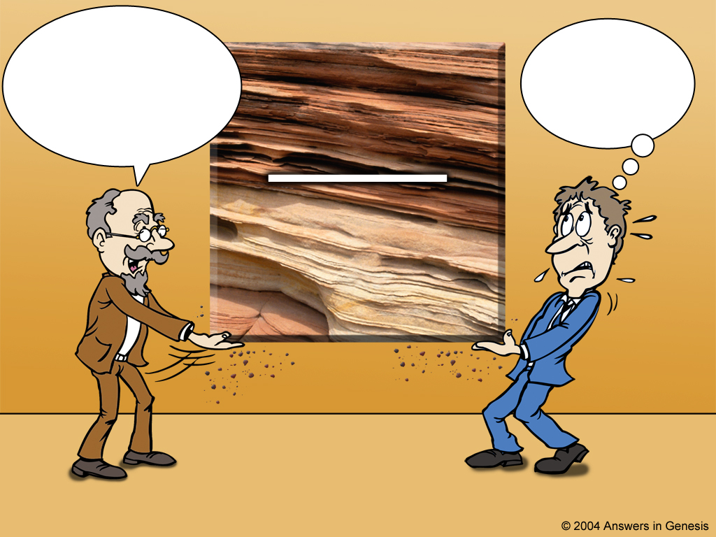
Scientist and theologian
这些岩石已
有几百万年的历史。你一定要相信我，因为我是一个
科学家。
我只能接受
这数百万年的理论，把这时间添加到圣经里!
岩石层
数百万年
科学家
神学家
Notes:
However, instead of accepting the history of God's Word, theologians have compromised with the ideas of fallible men. You say:
But, wait a minute! Hasn't science PROVED the earth is millions of years old? And what about the Gap Theory, and Theistic Evolution, and the Day Age Theory and Progressive Creation and didn't dinosaurs die out 65 million years ago? However, all of these questions start with ideas OUTSIDE the Bible

Slide 88
Genesis & Geology: 19C #1
1810年代： | 间隔论 (查莫斯) Gap Theory (Chalmers)
1810年代：间隔论 (查莫斯) Gap Theory (Chalmers)
1820年代：一日一纪论 (费伯) Day-Age Theory (Faber)
1830年代：局部洪水论 (派·斯密斯) Local Flood Theory (Pye Smith) [1830年代：创世记是神话 (自由派)] [Genesis is myth (Liberals)]
1850年代：多数学者都接受间隔或一日一纪论。 Most evangelical scholars accept Gap or Day-Age
1810年代： | 间隔论 (查莫斯) Gap Theory (Chalmers)
1820年代： | 一日一纪论 (费伯) Day-Age Theory (Faber)
1830年代： | 局部洪水论 (派·斯密斯) Local Flood Theory (Pye Smith)
1830年代： | [创世记是神话 (自由派)] [Genesis is myth (Liberals)]
1850年代： | 多数福音派学者都接受间隔或一日一纪论 Most evang. schlars: Gap or Day-Age
1820年代： | 一日一纪论 (费伯) Day-Age Theory (Faber)
1830年代： | 局部洪水论 (派‧斯密斯) Local Flood Theory (Pye Smith)
1810年代： | 间隔论 (查莫斯) Gap Theory (Chalmers)
1820年代： | 一日一纪论 (费伯) Day-Age Theory (Faber)
1830年代： | 局部洪水论 (派·斯密斯) Local Flood Theory (Pye Smith)
1830年代： | [创世记是神话 (自由派)] [Genesis is myth (Liberals)]
1850年代： | 多数福音派学者都接受间隔或一日一纪论 Most evang. schlars: Gap or Day-Age
1830年代： | [创世记是神话 (自由派)] [Genesis is myth (Liberals)]
1850年代： | 多数福音派学者都接受间隔或一日一纪论 Most evang. schlars: Gap or Day-Age

Slide 89
年老地球论必然导致接受进化论
In the early19th century, many in the church capitulated to the long-age dogma of Hutton and Lyell, ignoring the scientific problems and spiritual warnings of the Scriptural Geologists.⁴ And after they had accepted geological evolution, they were powerless to resist Darwin’s biological evolution.⁵ First, they had already jettisoned Genesis as a source of authority. Second, Darwin could link slow and gradualgeological processes with slow and gradual biological processes. Third, without the history of Creation, Fall, Flood and dispersion, they had no real history at all. Darwin could easily refute the counterfeit creation ideas of the compromised church. These included God creating disease germs and carnivores as such (ignoring the Fall and Flood),⁶ extinctions (Flood), and creatures in their present location (ignoring the Flood and dispersion).
And like Hitler, why should atheists make any concessions when the enemy is displaying such craven weakness? In reality, all the concessions are on the churchian side. The atheists concede nothing of value in return. Why shouldn’t they hold out for still more appeasement, while they use the Christians’ weapons against them?
A recent example of the continued appeasement is Howard van Till of Calvin College, who argued for decades that evolution was no threat to Christianity, and his college supported him. But after retirement, he showed his true colours (which blind Freddy’s deaf guide dog could have discerned) by abandoning any pretence of believing in any supernatural God. One report says, ‘Over the next two decades, he became the heretic his critics had suspected.’⁷ Thus Van Till is just the latest in the long line of apostates, whose slippery slide began with appeasement on Genesis, e.g. Billy Graham’s fellow evangelist Charles Templeton (1915–2001).⁸
Jonathan Sarfati, http://creation.com/chamberlain-and-the-church
长时论却为进化论做了铺垫：
“19世纪早期，很多教会都屈从于赫顿和莱尔的长时论教条，不理会忠实于圣经的地质学家对其中存在的科学问题和属灵问题的警戒。当他们接受了地质进化论以后，他们就无力否认达尔文的生物进化论了。”
约拿单·萨法提Jonathan Sarfati, creation.com/chamberlain-and-the-church
Notes:
Spurgeon spoke in 1855—four years before Origin of the Species (1859).
Spurgeon probably rejected evolution, but long ages prepares the way for evolution:
In the early19th century, many in the church capitulated to the long-age dogma of Hutton and Lyell, ignoring the scientific problems and spiritual warnings of the Scriptural Geologists.⁴ And after they had accepted geological evolution, they were powerless to resist Darwin’s biological evolution. --Jonathan Sarfati, creation.com/chamberlain-and-the-church

Slide 90
长时论必然削弱对圣经和创造者的信心
《创世记》不是关于起源问题的可靠、权威的历史记载
疾病、痛苦、死亡和肉食动物不是人类堕落的后果
化石记录被误当做漫长岁月中的沉积，因此很容易引向进化论
关键错误：接受长时论
Notes:
Genesis is not trustworthy, authoritative history of origins
Disease, suffering, death, carnivores are not the result of the Fall
Fossil record misinterpreted as deposited across long ages—easy to see as evolution
Key error: accepting long ages…

Slide 91
下滑过程
下滑过程
1.长时论 | 间隔论
2.有神进化论 | 一日一纪论，渐进创造论
3. 史上不存在 亚当夏娃 | 自由神学，以及所谓的 “福音性”文体框架论
4. 拒绝基督教 | 自然神论 / 无神论
结果…

Slide 92
进化论是纳粹思想的基石
纳粹背后也是同样道理
希特勒是狂热的达尔文主义者
大屠杀直接由纳粹进化论思想导致
Notes:
屠杀 Tu2 Sha1
Mein Kampf: 我的奋斗 Fen4Dou4
Evolution was the basis of Nazi ideology
Same logic behind Nazism
Hitler was fanatical Darwinist
Holocaust directly caused by Nazi evolutionary ideas.

Slide 93
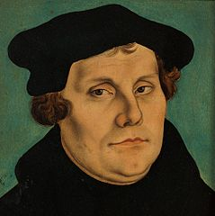
21世纪的德国
20 April 2012
16:20 CEST+02:00
The former East Germany is officially one of least religious places on the planet, with more than half of people living there saying they do not believe in God.
A study by social scientists at the University of Chicago showed that the legacy of the state atheism of the formerly Soviet-controlled East was still keenly felt, with 52 percent saying they did not believe in God.
Just eight percent of East Germans surveyed said they believed in a God “personally concerned with every human being.”
The study used data from 1991, 1998 and 2008 in 30 different countries, Die Welt newspaper said this week. In West Germany just 10 percent of those asked said they did not believe in God.
Neighbouring Poland is far more religious than either part of Germany, with almost 60 percent saying they believed in God.
Author of the study Tom Smith said, “Countries with high atheism (and low strong belief) tend to be ex-socialist states and countries in northwest Europe.”
But he said Poland was an exception due to the strong influence of the Catholic Church. He described the former East Germany as “anchoring the secular pole internationally”.
The report indicated that faith was far stronger in former West Germany, where 54 percent of people surveyed said they believed in God and always had – a much higher proportion than in other developed Western European nations like Sweden, France and Great Britain.
In former West Germany, 36 percent of over-68-year-olds said they believed in God, compared with 18 percent of people younger than 28.
In the former East, the figure was 12 percent for those over 68, while not a single under-28-year-old surveyed said they believed in God.
无宗派人士可能超过 50% 并持续上升。
参加任何形式的教会礼拜的德国人可能不到 4% 。
德国福音派信徒大约 2% ，而且多数已经超过50岁。
有统计表明：周日去教会的男性 <1% 。
pewresearch.org/fact-tank/2017/04/05/christians-remain-worlds-largest-religious-group-but-they-are-dying-out-in-europe/
Between 2010 and 2015…
But among Christians in Europe the reverse is true: Deaths outnumbered births by nearly 6 million during this brief period. In Germany alone, there were an estimated 1.4 million more Christian deaths than births from 2010 to 2015. This natural decrease in Europe’s aging Christian population was unique compared with Christians in other parts of the world and other religious groups.
在马丁‧路德的出生地，萨克森‧安哈尔特州，有80% 都是无宗派人士。
Notes:
Non-religious probably exceed 50% and increasing
Probably less than 4% of Germans attend any kind of church on Sunday
About 2% of Germans are evangelicals who go to church weeks—most are over 50y.o.
Accd. to a rpt, <1% of German males are in church on a Sunday
In Saxony-Anhalt, the state where Martin Luther was born, 80% are non-religious.
Protestant: 25M mem (30% Ger. pop.), 1M attend in 2006
According to a survey among German youths (aged between 12 and 24) in the year 2006, 30% of German youths believe in a personal god, 19% believe in some kind of supernatural power, 23% share agnostic views and 28% are atheists.^{[50]}
In the eastern state of Saxony-Anhalt only 19.7 percent belong to the two big denominations of the country.^{[49]} This is the state where Martin Luther was born.
In 2010, the majority of citizens in Saxony-Anhalt were irreligious and more were leaving the churches than entering them.^{[15]} 17.6% of Saxon-Anhaltish adhered to the major denominations of Christianity (14.1% were members of the Evangelical Church in Germany and 3.5% were Catholics),^{[16]} 2% were members of other religions^{[15]} (mostly Judaism, the New Apostolic Church, Islam and Mandeism). 80.4% of the citizens of Saxony-Anhalt were religiously unaffiliated.^{[15]}
2012? In the former East Germany, 52 percent of inhabitants said they did not believe in any God, and just 8 percent said they believed in a God “personally concerned with every human being,” according to a German newspaper report from 2012.
In Western Germany, some 54 percent of people said they believed in God, but this figure is declining rapidly, indicating that the majority of believers are elderly.
In former West Germany, 36 percent of over-68-year-olds said they believed in God, compared with 18 percent of people younger than 28.
In the former East Germany, the figure was 12 percent for those over 68, while not a single under-28-year-old surveyed said they believed in God.
Of those that identify themselves as Protestants, the number of people who go to church regularly is far smaller with 4 percent of Protestants attending church on Good Friday, the paper reported.
It is a similar picture among Catholics. Back in the 1950s one in two German Catholics regularly attended church services. The number has now fallen to just 12.3 percent, according to the German conference of bishops.
Different article: There are 23.7 million Catholics in Germany, comprising 29 per cent of the population of 80 million, making Catholicism the largest religious group. But figures released at the end of last week by the German Bishops' Conference show that in 2015, a total of 181,925 people left the Church, while 2,685 people became Catholic, and 6,474 reverted to Catholicism.
When compared to the official statistics of 20 years ago, average church attendance is down from 18.6 per cent in 1995 to 10.4 per cent in 2015, while the number of baptisms has declined by more than a third, from almost 260,000 in 1995 to just over 167,000 in 2015.

Slide 94
英国如何变成非基督教国家?
“……我相信在英国，是地质学和进化论把我们由基督教国家变成非基督教国家。”
--舍伍德‧泰勒，牛津科学历史博物馆馆长，1949年
F. Sherwood Taylor, Geology changes the outlook，Ideas and Beliefs of the Victorians, Sylvan Press Ltd出版, 伦敦, 195页 ,1949年 (英国广播公司电台专题节目系列)
Notes:
What changed England into a pagan nation?
“… I myself have little doubt that in England it was geology and the theory of evolution that changed us from a Christian to a pagan nation.”
—Taylor was Curator of the Museum of the History of Science, Oxford. Note the date: 1949! How much more so today!

Slide 95
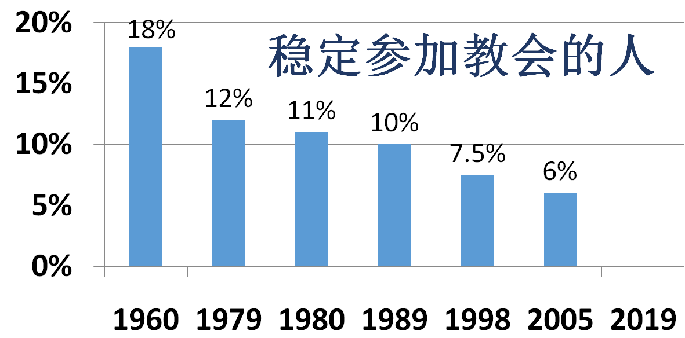
英国：基督徒显著减少
Actual editable chart
19世纪英国向全球各地，包括中国差派传教士
教会参与率在1840-60年达到巅峰, 后来开始下滑
英国的最后一次大型复兴发生于1859年——正是达尔文发表《物种起源》的同一年
教会参加人的平均年龄：
1980: 37
2005: 51
2019: ??
总人口的3%是福音性信徒而每周日做礼拜
无宗教人士达总人口的51%
??
Notes:
Dian1 Feng1 巅峰
In the 19th century, England was sending missionaries to every corner of the globe—including China. Church attendence peaked in 1840-60 then began a steady decline sometime thereafter. The last major revival in England was in 1859—the same year Darwin published Origin of the Species.
**UK: Church attendance peaks in 1840-60, then begins steady decline sometime thereafter, “due to secularization.” Reg. attendance (pres’ly at any church?) 1960-18% 1979-12% 1980-11%(avg. 37y.o.) 1989-10% 1998-7.5% 2005-6%(avg. 51y.o.). Church of Eng. avg. attendance: 1968 2.8%; 2002 1.7%; 2013 1.2%. Abysmal rel. belief stats—like Russia! Born post 1985, 55% no rel., >60% no rel. or non-Xian rel. TK has infographic in ppt.
“The proportion of people saying they have no religion peaked at 51 per cent in 2009 and has plateaued since then.
By 2020, estimates are that the number of Muslims attending prayers will reach at least 683,000, while the number of Christians attending weekly Mass will drop to 679,000.
While nearly half of British Muslims are under the age of 25, a quarter of Christians are over 65. "In another 20 years there are going to be more active Muslims than there are churchgoers," said Keith Porteous Wood, director of the National Secular Society.
Between 2012 and 2014, the proportion of Britons who identify themselves as Anglicans fell from 21% to 17%, a decrease of 1.7 million people,
By Jonathan Wynne-Jones, Religious Affairs Correspondent
9:00PM GMT 31 Jan 2009
More than half of the public believe that the theory of evolution cannot explain the full complexity of life on Earth, and a "designer" must have lent a hand, the findings suggest.
And one in three believe that God created the world within the past 10,000 years.
The survey, by respected polling firm ComRes, will fuel the debate around evolution and creationism ahead of next week's 200th anniversary of the birth of Charles Darwin.
Richard Dawkins, the evolutionary biologist and author of The God Delusion, said the findings revealed a worrying level of scientific ignorance among Britons.
In the survey, 51 per cent of those questioned agreed with the statement that "evolution alone is not enough to explain the complex structures of some living things, so the intervention of a designer is needed at key stages”
A further 40 per cent disagreed, while the rest said they did not know.
The suggestion that a designer's input is needed reflects the "intelligent design" theory, promoted by American creationists as an alternative to Darwinian evolution.
Asked whether it was true that "God created the world sometime in the last 10,000 years", 32 per cent agreed, 60 per cent disagreed and eight per cent did not know.
The findings – to be published tomorrow in a report by Theos, a theology think-tank – follow a row over the place of creationism in education.
A recent poll of science teachers found that one in three believe creationism should be taught in science classes alongside evolution and the Big Bang theory of the origin of the universe.
…
Speaking at the British Association Festival of Science at the University of Liverpool last year, Professor Reiss estimated that about one in 10 children was from a family which supported a creationist rather than evolutionary viewpoint.
http://www.telegraph.co.uk/news/religion/4410927/Poll-reveals-public-doubts-over-Charles-Darwins-theory-of-evolution.html

Slide 96
美国：自20世纪60年代以来的巨变
20世纪50年代末，美国担心会在科技方面落后于前苏联。
他们决定要加强高中的科学教育。据说进化论者顺水推舟，开始在高中生物课本中推行进化论。
自60年代开始，进化论普遍在公立学校推广。
Notes:
末 Mo4
In the late 1950s, Americans became worried about falling behind the Soviet Union in science and technology. They decided to increase emphasisis on science in high schools
It is said that evolutionists took advantage of this trend to promote evolution in high school biology textbooks. From the 1960s on, evolution was widely promoted in public schools.

Slide 97
亚当或猿猴，你的祖先是谁？
Adam vs. Ape as ancestor
Notes:
If God made us (Adam is our ancestor like the Bible says) then He rules over us. If we are just a product of cosmic evolution, then no one rules over us and we can do whatever we can get away with. And that is at the core of the breakdown in social order in countries that previously based their thinking on the Bible. And sadly, at a time when evolution should be collapsing under the weight of evidence, we have some church leaders in the West telling people that they can accept evolution and its billions of years and add it to the Bible.

Slide 98
进化论成为美国教育的主流之后：
1960s 后： | 许多教会自由主义化，向进化论妥协，成员流失……（这才是“科学”！）
上述情况都已经进入或正在逐渐进入中国
1960s 后： | 性解放……（动物要随从本能）
1972 后： | 堕胎（杀动物没所谓）
1990s (及更早)： | 同性恋（有些动物有时候也会）
2000s： | 同性婚姻 （婚姻是人类社会的产物，人类有权改变）
2010s： | 变性（我的感觉一定是真的）
Notes:
But from c.1960 on, evolution dominates U.S. education. Result:
1960s onward: Most churches liberal, compromise with long ages & evolution, lose members…
1960s onward: Sexual revolution… (animals follow instincts)
1960s--1972: abortion (animals can be killed)
1990s (& earlier): homosexuality (some animals sometimes do it)
2000s: homosexual marriage (marriage is human idea, we can change it)
2010s: ‘transgender’ (anything I feel must be right…)
ALL of these have entered or are entering China.

Slide 99
提摩太‧凯勒：“新福音派”妥协者
按照年老地球和“猿人”化石重新解读圣经。
认为亚当犯罪之前的千百万年一直存在死亡、疾病、自然灾害和肉食动物。
认为亚当很可能是一个先存于人
类的高度进化的“猿人”（原始
人类，“hominoid”)。
称创世记一章和二章之间有矛盾，
将创世记第一章算是一类“神话”。
“新福音派”= 自由神学的萌芽！
凯勒书籍中有很多很好的内容：扬长避短！
参考：Keller, Tim. “Creation, Evolution, and Christian Laypeople,” 2010
Notes:
萌芽 Meng2Ya2
扬长避短 Yang2 Chang2 Bi4 Duan3
Reinterprets the Bible in light of old earth and “ape men” fossils.
Believes there were millions of years of death, disease, natural disasters and carnivorousness before Adam’s Fall
Thinks Adam was probably a pre-existing, highly evolved “ape man” hominoid
Claims contradictions between Gen. 1 & 2, regards Gen. 1 as some kind of myth
“Neo-evangelical” = early stage Liberal
Keller’s books contain much good material: take the good and leave the bad!

Slide 100
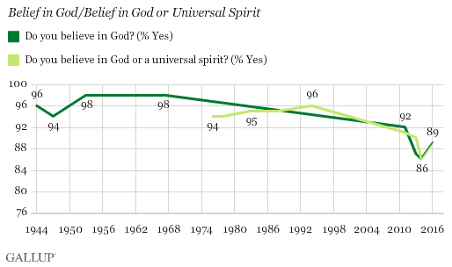
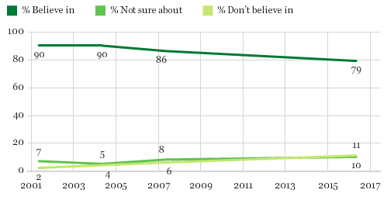
现代美国
60%的福音性教会的下一代离开教会
1950-1999至少94%美国人相信有神。现在基督教人数和影响力都在下滑；无宗教人持续上升。
相信有神？2001--2016年的转变
信 90%
信 79%
不清7%
不 清10%
不信2%
不 信11%
Notes:
Key Points: Belief in God down, belief in evolution up. Tracks generationally: younger less belief in God (17% diff), more belief in Darwin (4%) [BUT see 2013 Pew above—prob’ly more reliable]. Belief in God lost 11% 2003—2013.
New York, N.Y. - December 16, 2013 - A new Harris Poll finds that while a strong majority (74%) of U.S. adults do believe in God, this belief is in decline when compared to previous years as just over four in five (82%) expressed a belief in God in 2005, 2007 and 2009. Also, while majorities also believe in miracles (72%, down from 79% in 2005), heaven (68%, down from 75%), that Jesus is God or the Son of God (68%, down from 72%), the resurrection of Jesus Christ (65%, down from 70%), the survival of the soul after death (64%, down from 69%), the devil, hell (both at 58%, down from 62%) and the Virgin birth (57%, down from 60%), these are all down from previous Harris Polls.
Belief in Darwin's theory of evolution, however, while well below levels recorded for belief in God, miracles and heaven, is up in comparison to 2005 findings (47%, up from 42%).
Dec. 2013: Echo Boomers are less likely than their counterparts in all older generations to express belief in God (64% Echo Boomers, 75% Gen Xers, 81% Baby Boomers, 83% Matures), miracles (65%, 74%, 76% and 78%, respectively), that Jesus is God or the Son of God (58%, 67%, 74% and 75%, respectively) and angels (59%, 71%, 73% and 68%, respectively.
On the other end of the generational spectrum, Matures are far less likely than any other generation to express belief in ghosts (44% Echo Boomers, 46% Gen Xers, 46% Baby Boomers, 24% Matures), witches (27%, 29%, 28% and 18%, respectively) and reincarnation (27%, 25%, 23% and 13%, respectively).
2013
Thirty-seven percent say they believe God created human beings in their present form within the last 10,000 years, while 25 percent say that God guided the process of evolution through which humans developed. Twenty-one percent say that God did not guide the process of human evolution, CBS News reports. According to YouGov, the general belief in evolution as the process through which human life developed without God's help has increased by eight percentage points since the same question was asked in a CBS poll in 2004, when 13 percent said that they believe humans developed through evolution without God's guidance. Those who believe that God guided the evolution process through which humans were created is down by two percentage points since 2004 when 27 percent of those polled said that God was involved in evolution. The general belief in human evolution is up six percent.

Slide 101
美国不同年代宗教信仰（2014年调查）
福音派
无宗教
1928-1945年出生
30%
11%
1946-1964年出生
28%
17%
But perhaps the most striking divide – and the driving force behind the overall drop in belief – is generational. As younger Americans enter adulthood, they are far less likely to be sure about God’s existence than are their elders. While 70% of those ages 65 and older express an absolutely certain belief in God or a universal spirit, only about half of adults under 30 feel the same way (51%).
1965-1980年出生
25%
23%
1981-1989年出生
22%
34%
1990-1996年出生
19%
36%
Notes:
Both charts from: Pew, done June 4-Sept 30, 2014.
May 12, 2015 Millennials increasingly are driving growth of ‘nones’ BY MICHAEL LIPKA
pewresearch.org/fact-tank/2015/05/12/millennials-increasingly-are-driving-growth-of-nones/
Key Points: Belief in God down, belief in evolution up. Tracks generationally: younger less belief in God (17% diff), more belief in Darwin (4%) [BUT see 2013 Pew above—prob’ly more reliable]. Belief in God lost 11% 2003—2013.
New York, N.Y. - December 16, 2013 - A new Harris Poll finds that while a strong majority (74%) of U.S. adults do believe in God, this belief is in decline when compared to previous years as just over four in five (82%) expressed a belief in God in 2005, 2007 and 2009. Also, while majorities also believe in miracles (72%, down from 79% in 2005), heaven (68%, down from 75%), that Jesus is God or the Son of God (68%, down from 72%), the resurrection of Jesus Christ (65%, down from 70%), the survival of the soul after death (64%, down from 69%), the devil, hell (both at 58%, down from 62%) and the Virgin birth (57%, down from 60%), these are all down from previous Harris Polls.
Belief in Darwin's theory of evolution, however, while well below levels recorded for belief in God, miracles and heaven, is up in comparison to 2005 findings (47%, up from 42%).
Dec. 2013: Echo Boomers are less likely than their counterparts in all older generations to express belief in God (64% Echo Boomers, 75% Gen Xers, 81% Baby Boomers, 83% Matures), miracles (65%, 74%, 76% and 78%, respectively), that Jesus is God or the Son of God (58%, 67%, 74% and 75%, respectively) and angels (59%, 71%, 73% and 68%, respectively.
On the other end of the generational spectrum, Matures are far less likely than any other generation to express belief in ghosts (44% Echo Boomers, 46% Gen Xers, 46% Baby Boomers, 24% Matures), witches (27%, 29%, 28% and 18%, respectively) and reincarnation (27%, 25%, 23% and 13%, respectively).
2013
Thirty-seven percent say they believe God created human beings in their present form within the last 10,000 years, while 25 percent say that God guided the process of evolution through which humans developed. Twenty-one percent say that God did not guide the process of human evolution, CBS News reports. According to YouGov, the general belief in evolution as the process through which human life developed without God's help has increased by eight percentage points since the same question was asked in a CBS poll in 2004, when 13 percent said that they believe humans developed through evolution without God's guidance. Those who believe that God guided the evolution process through which humans were created is down by two percentage points since 2004 when 27 percent of those polled said that God was involved in evolution. The general belief in human evolution is up six percent.

Slide 102
人类的来源，2013年美国调查 (Pew Center)
经过进化发展出来的
从开始有现今的样子
不清楚
***宝清，请增加两幅小小的图：1、的类人猿队列；2、亚当和夏娃
所有成年人
男
女
以上
Notes:
Key Points: Belief in God down, belief in evolution up. Tracks generationally: younger less belief in God (17% diff), more belief in Darwin (4%) [BUT see 2013 Pew above—prob’ly more reliable]. Belief in God lost 11% 2003—2013.
New York, N.Y. - December 16, 2013 - A new Harris Poll finds that while a strong majority (74%) of U.S. adults do believe in God, this belief is in decline when compared to previous years as just over four in five (82%) expressed a belief in God in 2005, 2007 and 2009. Also, while majorities also believe in miracles (72%, down from 79% in 2005), heaven (68%, down from 75%), that Jesus is God or the Son of God (68%, down from 72%), the resurrection of Jesus Christ (65%, down from 70%), the survival of the soul after death (64%, down from 69%), the devil, hell (both at 58%, down from 62%) and the Virgin birth (57%, down from 60%), these are all down from previous Harris Polls.
Belief in Darwin's theory of evolution, however, while well below levels recorded for belief in God, miracles and heaven, is up in comparison to 2005 findings (47%, up from 42%).
Dec. 2013: Echo Boomers are less likely than their counterparts in all older generations to express belief in God (64% Echo Boomers, 75% Gen Xers, 81% Baby Boomers, 83% Matures), miracles (65%, 74%, 76% and 78%, respectively), that Jesus is God or the Son of God (58%, 67%, 74% and 75%, respectively) and angels (59%, 71%, 73% and 68%, respectively.
On the other end of the generational spectrum, Matures are far less likely than any other generation to express belief in ghosts (44% Echo Boomers, 46% Gen Xers, 46% Baby Boomers, 24% Matures), witches (27%, 29%, 28% and 18%, respectively) and reincarnation (27%, 25%, 23% and 13%, respectively).
2013
Thirty-seven percent say they believe God created human beings in their present form within the last 10,000 years, while 25 percent say that God guided the process of evolution through which humans developed. Twenty-one percent say that God did not guide the process of human evolution, CBS News reports. According to YouGov, the general belief in evolution as the process through which human life developed without God's help has increased by eight percentage points since the same question was asked in a CBS poll in 2004, when 13 percent said that they believe humans developed through evolution without God's guidance. Those who believe that God guided the evolution process through which humans were created is down by two percentage points since 2004 when 27 percent of those polled said that God was involved in evolution. The general belief in human evolution is up six percent.

Slide 103
必然的结果！
年老地球 罪前已有死亡
千百万年的死亡 相信进化论
相信进化论 人是猴子演变来的
相信进化论、猿人 拒绝圣经、上帝
140亿年

Slide 104
如何重建根基？
诗篇11:3根基若毁坏，义人还能作什么呢？
重建根基!
我们如何重建根基？或者说，在中国，我们如何建立根基？
年老地球论行不通！

